Slide 1
Technology in Action
Alan Evans • Kendall Martin
Mary Anne Poatsy
Twelfth Edition
Notes:
Welcome to Technology in Focus: Information Technology Ethics.

Slide 2
Technology in Action
Technology in Focus:
Information Technology Ethics
Notes:
In this Technology in Focus feature, we explore what ethics is, how your personal ethics develop, and how your personal ethics fit into the world around you.

Slide 3
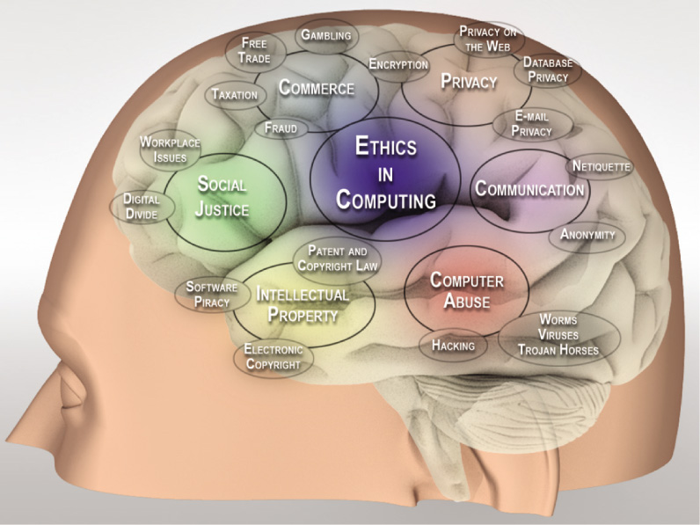
Key Issues Related to Technology and Ethics
Intellectual property rights
Privacy
E-commerce
Free speech
Computer abuse
Notes:
Key issues related to technology and ethics are:
Intellectual property rights
Privacy
E-commerce
Free speech
Computer abuse

Slide 4
What Is Ethics?
Study of general nature of morals and moral choices
Morals: conforming to established ideas of right and wrong
Difference between fairness and equity
Principles are guidelines used to make decisions
Notes:
Ethics is the study of the general nature of morals and of the specific moral choices made by individuals.
Morals involve conforming to established or accepted ideas of right and wrong (as generally dictated by society), and are usually viewed as black and white.
Ethical issues often involve subtle distinctions, such as the difference between fairness and equity.
Ethical principles are the guidelines you use to make decisions each day.

Slide 5
What is Ethics? Doesn't Everyone Have the Same Ethical Values?
Relativism
Divine Command
Theory
Utilitarianism
Virtue Ethics
Deontology (Duty-Based)
Notes:
There are many systems of ethical conduct. Figure 1 lists the five major ethical systems.

Slide 6
What is Ethics? Aren’t laws meant to guide people’s ethical actions?
Laws are formal, written standards
Designed to apply to everyone
Enforced by government agencies
Interpreted by the courts
Impossible to pass laws to cover every possibility
Ethics provides a general set of unwritten guidelines
Notes:
Laws are formal, written standards designed to apply to everyone.
Laws are enforced by government agencies and interpreted by the courts.
However, it’s impossible to pass laws that cover every possible behavior in which humans can engage.
Therefore, ethics provide a general set of unwritten guidelines for people to follow.

Slide 7
What is Ethics? Is Unethical Behavior the Same as Illegal Behavior?
Unethical Behavior
Isn’t necessarily illegal
Not all illegal behavior is unethical
Not conforming to approved standards
Amoral Behavior
No sense of right or wrong
No interest in moral consequences
Notes:
Unethical behavior can be defined as not conforming to a set of approved standards of behavior. For instance, using your phone to text-message a test answer to your friend during an exam is unethical.
Amoral behavior occurs when one has no sense of right and wrong and no interest in the moral consequences of one’s actions, such as when a murderer shows no remorse.

Slide 8
What is Ethics? Which System of Ethics Works Best?
No universal agreement
Most societies use a blend
Ethical decision are greatly influenced by personal ethics
Notes:
There is no universal agreement on which is the best system of ethics.
Most societies use a blend of different systems.
Regardless of the ethical system of the society in which you live, all ethical decisions are greatly influenced by personal ethics.

Slide 9
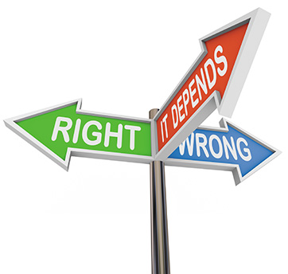
Personal Ethics What are Personal Ethics?
Set of formal or informal principles
Some people have clear, well-defined
Others’ are inconsistent in applying a set
Can be challenging to adhere to consistently
Notes:
As you choose your words and actions, you are following a set of personal ethics—a set of formal or informal ethical principles you use to make decisions in your life.
Some people have a clear, well-defined set of principles they follow.
Others’ ethics are inconsistent or are applied differently in different situations.
It can be challenging to adhere to ethical principles if the consequences lead to an unhappy result.

Slide 10
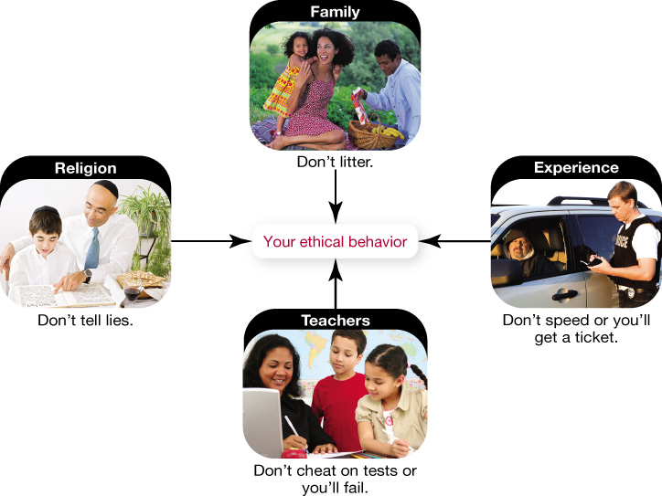
Personal Ethics How do a Person's Ethics Develop?
Family
Cultural bias
Religious affiliation
Life experiences
Notes:
Your family has a major role in establishing the values you cherish in your own life, and these might include a cultural bias toward certain moral positions.
Your religious affiliation is another major influence in your ethical life, because most religions have established specific codes of ethical conduct.
As you mature, your life experiences also affect your personal ethics.

Slide 11
Personal Ethics What are the Benefits to Ethical Living?
Society has established rules of conduct
Ignoring or being inconsistent can have immediate impact
Consistent ethical living provides health benefits
Inconsistent ethical decisions produce stress and anger
Notes:
Society has established its own set of rules of conduct in the form of laws.
Ignoring or being inconsistent in following these rules can have an immediate impact. And more and more research is showing the health benefits of ethical living.
When your day-to-day decisions are in conflict with your ethical principles, you often develop stress and anger.

Slide 12
Personal Ethics What are the Benefits to Ethical Living?
Positive psychology
Dr. Martin Seligman
Discover causes of happiness instead of treating dysfunctions
Identify personal strengths and values
Align your life
Can impact your health and happiness
Notes:
Positive psychology is a new focus in the field of psychology.
Pioneered by Dr. Martin Seligman, this field works to discover the causes of happiness instead of addressing the treatment of dysfunctions.
Identifying your personal strengths and values, and then aligning your life and applying them every day, you can experience an increase in happiness.
Finding a way to identify and apply your ethics and values can have an impact on your health and happiness.

Slide 13
Personal Ethics and Your Work Life How do Employers Affect Personal Ethics?
Do your ethics change when you go to work?
Employers expect you to follow ethics and rules of conduct
Do not blindly follow unethical practices
Notes:
You may have a set of personal ethics that guide your behavior, but do your ethics change when you go to work?
Of course, your employer expects you to follow the rules of conduct established for the business.
However, this doesn’t mean you need to blindly follow corporate practices that you feel are unethical or detrimental to society.

Slide 14
Technology and Ethics: How One Affects the Other
Technology moves faster than rules can be formulated
Use of technology is often left up to the individual
Ethical considerations are never clear-cut
Reasonable people can have different views
Notes:
Because technology moves faster than rules can be formulated to govern it, how technology is used is often left up to the individual and the guidance of one’s personal ethics.
They’re complex, and reasonable people can have different, yet equally valid, views. We present alternative viewpoints in each setting for you to consider and discuss. Figure 6 summarizes the issues we’ll be discussing.

Slide 15
Ethics and Technology Issues
Social justice
Intellectual property
Privacy
E-commerce
Electronic communication
Computer abuse
Notes:
This figure shows a summary of the ethical issues that will be discussed in this chapter.

Slide 16
Intellectual Property International Pirates
Vigorous enforcement allows developers to make a fair profit
Otherwise a disadvantage in marketplace
Every country needs common understanding
U.S. can’t tell other countries how to conduct internal affairs
Notes:
Point
International copyright protections need to be vigorously enforced.
People depend on the protection of intellectual property to make a fair profit.
Otherwise, developers have a disadvantage in the marketplace.
Every country needs to have a common understanding and enforcement of intellectual property laws.
Counterpoint
Most countries have laws on their books regarding intellectual property. It is not the job of the United States to tell a foreign government how to conduct internal affairs.

Slide 17
Privacy Should Employers Peer Into Your Personal Life?
Privacy is a basic human right
Employers might misuse data or violate law
Privacy settings on social media sites should allow user the ultimate control of data
Business concerns outweigh privacy concerns
In digital age, loss of privacy is inevitable
Notes:
Point
The right to privacy is a basic human right.
Employers might misuse or lose control of the data or violate current employment law.
Privacy settings on social media sites should allow users control over who views their data.
Counterpoint
Business concerns outweigh privacy concerns. Businesses should screen data in social media sites to determine the character and fitness of employment candidates.
In the digital age, loss of a certain amount of privacy is inevitable.

Slide 18
E-Commerce Geolocation: Who Knows Where You Are?
People comfortable sharing personal information
Without sharing, businesses lose revenue
Useful for public safety
Society too complacent with privacy issues
Consumers to be educated and make informed choices
Notes:
Point
People have become comfortable with sharing information.
Businesses would lose revenue if geolocation ceased.
Devices and apps might become useful as public safety and news-gathering devices.
Counterpoint
Society has become too complacent with privacy issues.
Consumers need to be educated about geolocation and the ways it can impact them so that they are able to make informed choices.

Slide 19
Electronic Communication Does Free Speech Have a Price?
U.S. companies should comply with local laws
U.S. company can have no impact on reform
Corporations should consider country’s stand on human rights
Financial and political incentives put pressure on other countries
Notes:
Point
U.S. companies should comply with local laws.
It is not the place of a company to try to change laws of foreign countries.
Counterpoint
U.S. companies should put what is right ahead of what is financially expedient.
Those who are in favor of Google’s actions are believers that international corporations should begin to take a firm stance against governments that do not promote basic human rights.

Slide 20
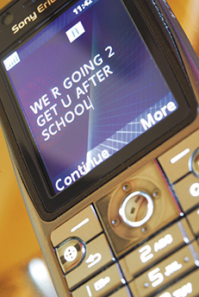
Computer Abuse Cyberbullying: Who Should Protect Children From Each Other?
Individuals responsible for own behavior
Parents are responsible to protect children
Education is key and needs to be controlled by parents
Society is affected
Educators have more resources than parents
Notes:
Point
Bullying is a personal behavior issue, and those decisions should be made by parents.
Because educating children about bullying is key to preventing it, decisions about the content of such training needs to be controlled by parents.
Counterpoint
Parents need to be assured that publicly funded institutions are “safe havens” where their children will not be exposed to malicious activities.
Educators have better resources for teaching children about the serious effects of cyberbullying.

Slide 21
Using Computers to Support Ethical Conduct
Can use technology to support ethical conduct
Charitable organizations use Internet for fundraising
Web is a tool for organizing aid to areas in crisis
Websites and Facebook can locate friends and family members after disaster
Notes:
Although there are many opportunities to use computers and the Internet unethically, we can also use technology to support ethical conduct. For example, many charitable organizations use the Internet and other technology tools for fundraising.
Google Person Finder, part of Google Crisis Response, helps individuals and organizations to provide information and updates on persons missing after a disaster.

Slide 22
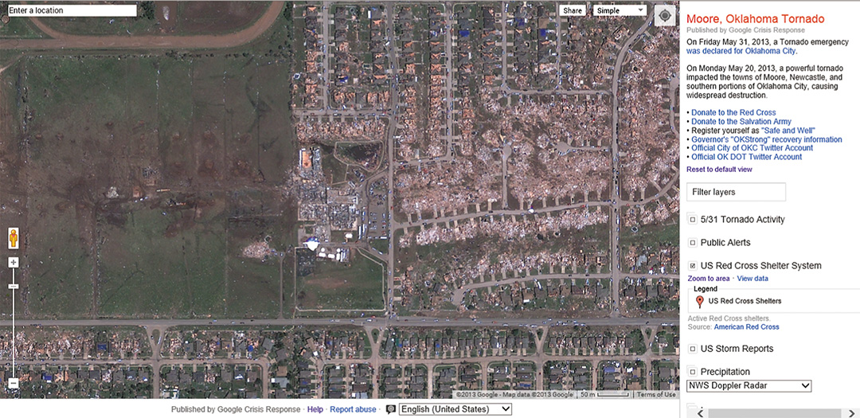
Using Computers to Support Ethical Conduct
Google Crisis Response
Notes:
Google Crisis Response is a project sponsored by Google that helps disseminate information before and after a crisis to coordinate relief efforts and provide updates to the public.

Slide 23
All rights reserved. No part of this publication may be reproduced, stored in a retrieval system, or transmitted, in any form or by any means, electronic, mechanical, photocopying, recording, or otherwise, without the prior written permission of the publisher. Printed in the United States of America.
Copyright © 2016 Pearson Education, Inc.

