Slide 1
Technology in Action
Alan Evans • Kendall Martin
Mary Anne Poatsy
Twelfth Edition
Notes:
Welcome to Chapter 5: Digital Devices and Media: Managing a Digital Lifestyle.

Slide 2
Technology in Action
Chapter 5
Digital Devices and Media: Managing a Digital Lifestyle
Notes:
In this chapter, we’ll check out a number of mobile devices and their features.

Slide 3
Mobile Devices
Digital Convergence
Telephony: Smartphones and Beyond
Tablets, Netbooks, and Ultrabooks

Slide 4
Digital Convergence
Objective
How is the trend of digital convergence seen in the market?
Notes:
How is the trend of digital convergence seen in the market?

Slide 5
Telephony: Smartphones and Beyond
Objectives
What hardware and software comprise a typical smartphone?
How do I synchronize information between my phone and my computer, and how do mobile Internet data plans work?
What do I need to keep my smartphone secure?
How does digital telephony support VoIP services?
Notes:
What hardware and software comprise a typical smartphone?
How do I synchronize information between my phone and my computer, and how do mobile Internet data plans work?
What do I need to keep my smartphone secure?
How does digital telephony support VoIP services?

Slide 6
Tablets, Netbooks, and Ultrabooks
Objective
What distinguishes the performance of tablets, netbooks, and ultrabooks?
Notes:
What distinguishes the performance of tablets, netbooks, and ultrabooks?

Slide 7
Digital Convergence
Single unifying device
Media, Internet, entertainment, and telephony needs
Smartphones
Electronics systems in cars
Digital Living Network Alliance (DLNA)
Notes:
Digital convergence, the use of a single unifying device to handle media, Internet, entertainment, and telephony needs, is exemplified in the range of devices now on the market. You see digital convergence in the evolution of smartphones, which now let you do just about anything a computer can do.
The Digital Living Network Alliance is an organization working to standardize different kinds of appliances and network devices used in our homes.

Slide 8
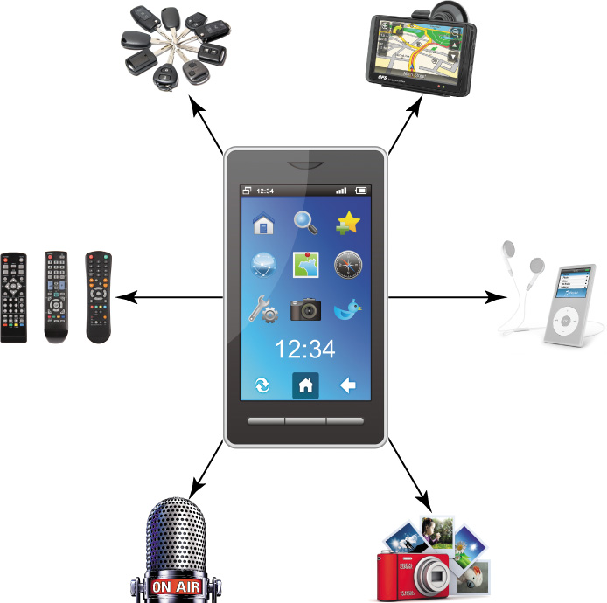
Telephony: Smartphones and Beyond
Telephony—use of equipment to provide voice communications over a distance
Notes:
Communication has changed radically in the digital age. Hardware devices that support communication also have evolved because of digital technologies. Telephony, the use of equipment to provide voice communications over a distance, has shifted from an analog science to a digital one.

Slide 9
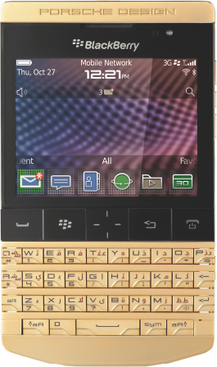
Telephony: Smartphones and Beyond Smartphone Basics
Smartphone functions and features
Cellular (cell) phones
Mobile, cellular technology
Feature phones
Notes:
Smartphones illustrate the power of digital convergence. They incorporate functions and features that used to be available only in separate dedicated devices.
All phones that use mobile, cellular technology can be called cellular (cell) phones. Less powerful cell phones are available. Feature phones have modest processors, simpler interfaces, and often no touch screen. As more features are integrated into every cell phone product, it becomes difficult to distinguish a smartphone from a feature phone.

Slide 10
Telephony: Smartphones and Beyond Smartphone Components
Additional memory
Smartphone operating systems
Memory stores information and programs
OS—read-only memory (ROM)
Data is stored in separate internal memory chips
Notes:
There are a number of operating systems on the smartphone market now.
Operating systems are required to translate the user’s commands into instructions for the processor.
Your phone’s memory stores all of the phone’s information and programs. The OS is stored in read-only memory (ROM), the phone’s permanent memory.
Other phone data is stored in separate internal memory chips.
Many smartphones let you add memory through micro SD flash cards.

Slide 11
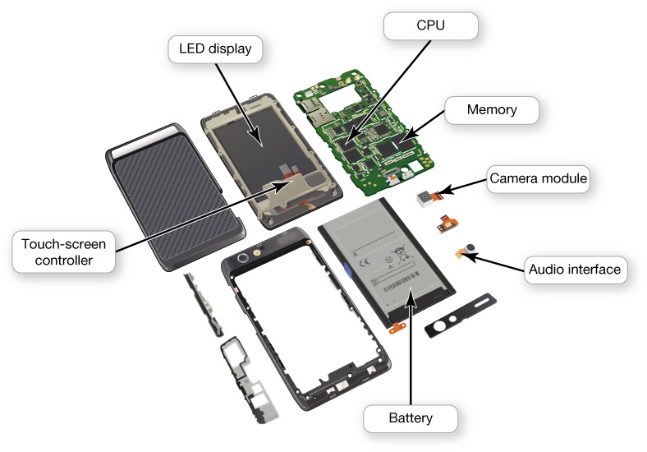
Telephony: Smartphones and Beyond Smartphone Components
Primary input devices
Microphone
Touch pad
Output devices
Speaker
Liquid crystal display (LCD)
OLED: newer display screen
Notes:
The primary input devices for a smartphone are its microphone and touch pad. The smartphone’s digital camera is also an input device.
Cell phone output devices include a speaker and a liquid crystal display (LCD). Higher-end models include full-color, high-resolution LCD screens.
Newer on the market are organic light-emitting diode (OLED) displays, which allow very bright, sharp imaging and draw less power than LCD screens.

Slide 12
Telephony: Smartphones and Beyond How Cell Phone Technology Works
Cellular network
Base transceiver station
Mobile switching center
Digital processing
Notes:
A set of connected “cells” makes up a cellular network. Each cell is a geographic area centered on a base transceiver station, which is a large communications tower.
When you place a call on a cell phone, a base station picks up the request for service. The station then passes the request to a central location called a mobile switching center.
When you speak into a cell phone, a series of digital processing steps occur.

Slide 13
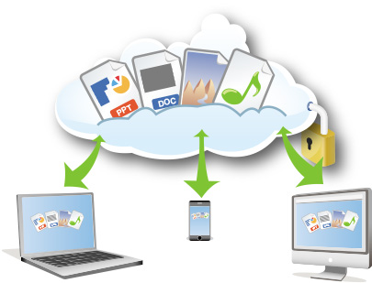
Telephony: Smartphones and Beyond Synchronizing
Synchronizing (syncing)
Two main ways to transfer information
Wired
Wireless
Wired solutions
USB port
Flash card
Wireless synchronization
Notes:
The process of updating your data is called synchronizing, or syncing.
Two main ways to transfer information:
Wired
Wireless
Almost all phones are designed with a USB port. Once connected, your phone will appear on your computer like an additional flash drive.
If your phone supports a high-density micro SD card, you can slip it directly into a flash card reader in your computer.
Bluetooth technology uses radio waves to transmit data signals.

Slide 14
Telephony: Smartphones and Beyond Text Messaging
Short message service (SMS)
Short text messages
Up to 160 characters
Convenient and quick
Uses cell phone network
Multimedia message service (MMS)
Notes:
Short message service (SMS) is a technology that lets you send short text messages (up to 160 characters).
SMS uses the cell phone network. When you send an SMS message, an SMS calling center receives the message and delivers it to the appropriate mobile device.
An extension of SMS called multimedia message service (MMS) lets you send messages that include text, sound, images, and video clips to other phones or e-mail addresses.

Slide 15
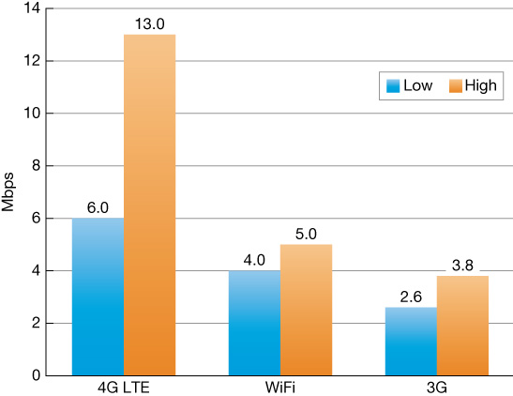
Telephony: Smartphones and Beyond Mobile Internet
Connection speed will depend on which technology you are using (3G, 4G LTE)
Notes:
The range of speeds you achieve when connecting to the Internet with your smartphone or mobile device depends on the type of connection.

Slide 16
Telephony: Smartphones and Beyond VoIP
Digital phone service
Technology similar to e-mail
Skype
Notes:
Voice over Internet Protocol (VoIP) is a form of voice-based Internet communication that turns a standard Internet connection into a means to place phone calls. VoIP uses technology similar to that used in e-mail to send your voice data digitally over the Internet.
Skype is one very well-known provider.

Slide 17
Telephony: Smartphones and Beyond VoIP
Calls can be placed anywhere you have Internet access
Free or low-cost long-distance calling
Portability
Drawbacks
Sound quality and reliability
Loss of service at home if power is out
Security risks
Notes:
VoIP calls can be placed from anywhere you have Internet access.
There are also standalone VoIP phones sold, sometimes called IP phones.
The advantage of VoIP is that it’s free or low-cost. Portability is another advantage.
Although VoIP is affordable and convenient, it does have drawbacks:
Sound quality and reliability issues
Loss of service if the power is interrupted
Security risks

Slide 18
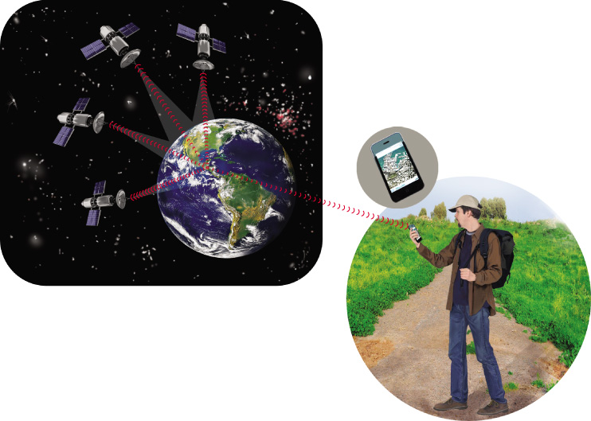
Telephony: Smartphones and Beyond Smartphone GPS
Enhanced 911 program
Automatically gives precise location
Built and operated by the U.S. Department of Defense
Notes:
Today every cell/smartphone has to include a GPS chip. The Federal Communications Commission mandated this to enable the complete rollout of the Enhanced 911 program. E911 automatically gives dispatchers precise location information for any 911 call.
Built and operated by the U.S. Department of Defense, the global positioning system is a network of 21 satellites that constantly orbits the Earth.

Slide 19
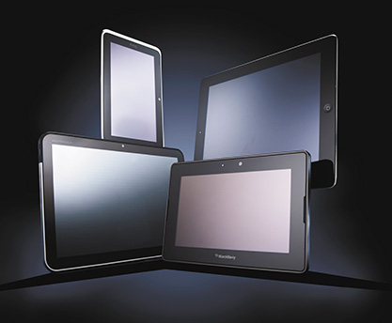
Tablets, Netbooks, Ultrabooks Tablets
Smartphone and tablet similarities
Operating systems
Processors
Touch-screen interfaces
Long battery life
Similar software applications
Similar Internet connectivity
Bluetooth
Notes:
In many regards, smartphones and tablets are similar. They have the following features:
Similar operating systems
Similar processors
Touch-screen interfaces
Long battery life
Similar software applications
Similar Internet connectivity
Bluetooth

Slide 20
Tablets, Netbooks, Ultrabooks Netbooks
Netbooks
Traditional OS
Keyboard
Weigh 2 pounds or less
Inexpensive compared with tablets and ultrabooks
Notes:
A netbook uses a full traditional OS, like Windows 8.
A netbook has a physical keyboard. Netbooks weigh 2 pounds or less and are inexpensive compared with both tablets and ultrabooks, so they are a good option if you’re looking for value.

Slide 21
Tablets, Netbooks, Ultrabooks Ultrabooks
Ultrabooks
Full-featured computers
Very thin, lightweight computing solution
Don’t have optical drives
Offer SSD drives
Weigh under 3 pounds
Full-size keyboards
13- to 15-inch screens
Notes:
Ultrabooks are a newer category of full-featured computers that focus on offering a very thin, lightweight computing solution. Ultrabooks don’t offer optical drives, for example, allowing a very thin profile.
Most ultrabooks offer SSD drives.
They weigh in at under 3 pounds. They also include full-size keyboards and 13- to 15-inch screens, and are good choices when you want to run traditional OS and have a lot of computing power.

Slide 22
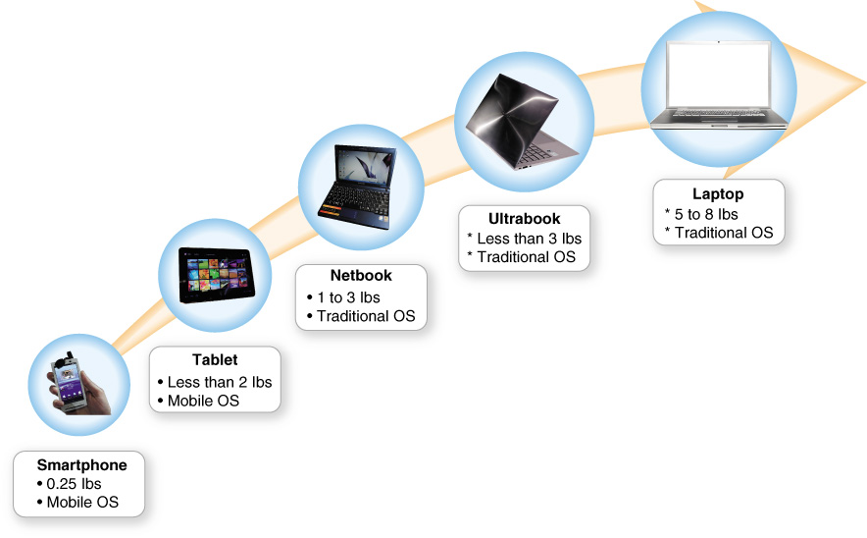
Tablets, Netbooks, Ultrabooks Making a Choice
Guidelines to determine what fits your personal needs
Screen size and style of keyboard
Weight
Number of devices
Notes:
Use these guidelines to determine what best fits your personal needs when choosing which device to buy.
Screen size and style of keyboard: You can adapt these with accessories, but most of the time these will determine how you interact with your device.
Weight: Does an additional 2 pounds matter?
Number of devices: As technology prices fall, you might be able to have more than one device.

Slide 23
The Digital Information Age
Digital Defined
Digital Media
Notes:
In this section, we’ll examine the digital information age.

Slide 24
Digital Defined
Objective
What advantage do digital formats have over analog signals?
Notes:
What advantage do digital formats have over analog signals?

Slide 25
Digital Media
Objectives
How is the digital format changing the way media is created and distributed?
How do I work with digital images and videos?
Notes:
How is the digital format changing the way media is created and distributed?
How do I work with digital images and videos?

Slide 26
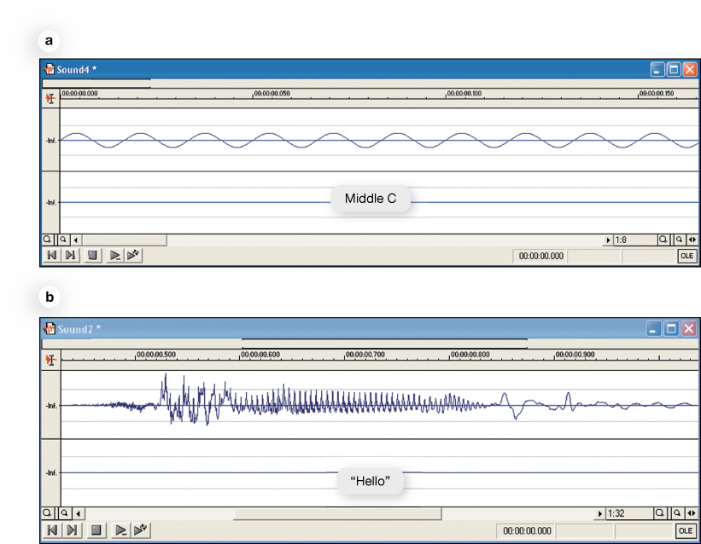
Digital Defined
Any kind of information can be digitized
Digital formats
Long strings of numbers
Analog-to-digital conversion
Notes:
Any kind of information can be digitized.
Digital formats describe signals as long strings of numbers. This gives us a way to describe sound and light waves so that sounds and images can be reproduced perfectly.
A sequence of numbers can express complicated analog shapes with analog-to-digital conversion. The incoming analog signal is measured many times each second. The series of numbers produced by the analog-to-digital conversion process gives the digital form of the wave.

Slide 27
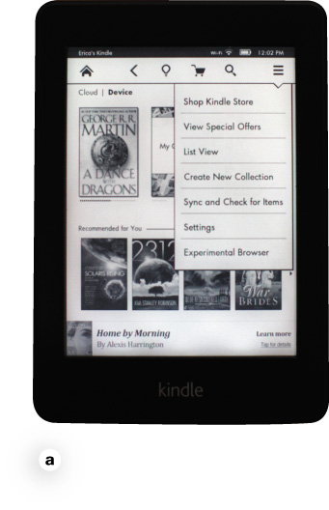
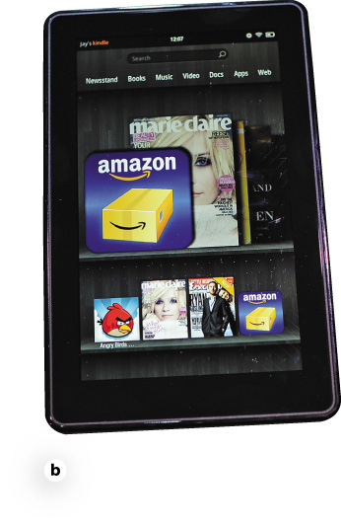
Digital Media Digital Publishing
Software for PC or Apple computers
Kindle and the NOOK
Download texts as PDF
Browser add-ons
Digital formats
Vendors associated with e-reader devices
Project Gutenberg
Self-publishing
Notes:
There are free software versions of the Kindle and the NOOK that run on either PC or Apple computers. You can download texts and read them as a PDF file or by using browser add-ons.
Digital formats for publishing vary.
Amazon sells the Kindle.
Barnes and Noble sells the NOOK.
Project Gutenberg is a repository site with a collection of 42,000 free books.
Self-publishing is much easier in the age of digital texts.

Slide 28
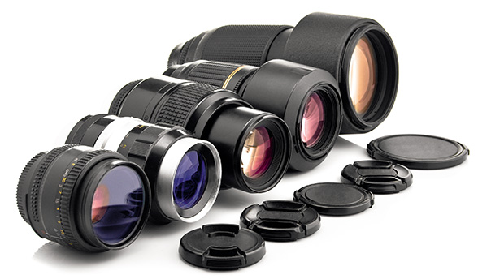
Digital Media Digital Photography
Digital cameras
Capture images and video
Convert to digital data
Factors that determine image quality
Quality of lenses
Image sensor size
File format and compression applied
Color management software
Camera's resolution
Notes:
Digital cameras do not use film. Instead, they capture images on electronic sensors and then convert those images to digital data.
When choosing a camera, the first question to answer is whether you want a compact “point-and-shoot” model camera or a more serious digital SLR.
The overall image quality is determined by many factors:
Quality of lenses
Image sensor size
File format and compression applied
Color management software
Camera's resolution

Slide 29
Check Your Understanding
How is the trend of digital convergence seen in the market?
What hardware and software comprise a typical smartphone?
How do I synchronize information between my phone and my computer, and how do mobile Internet data plans work?
What do I need to keep my smartphone secure?
How does digital telephony support VoIP services?
Notes:
How is the trend of digital convergence seen in the market?
What hardware and software comprise a typical smartphone?
How do I synchronize information between my phone and my computer, and how do mobile Internet data plans work?
What do I need to keep my smartphone secure?
How does digital telephony support VoIP services?

Slide 30
Check Your Understanding
What distinguishes the performance of tablets, netbooks, and ultrabooks?
What advantage do digital formats have over analog signals?
How is the digital format changing the way media is created and distributed?
How do I work with digital images and video?
Notes:
What distinguishes the performance of tablets, netbooks, and ultrabooks?
What advantage do digital formats have over analog signals?
How is the digital format changing the way media is created and distributed?
How do I work with digital images and video?

Slide 31
All rights reserved. No part of this publication may be reproduced, stored in a retrieval system, or transmitted, in any form or by any means, electronic, mechanical, photocopying, recording, or otherwise, without the prior written permission of the publisher. Printed in the United States of America.
Copyright © 2016 Pearson Education, Inc.

