Slide 1
Technology in Action
Alan Evans • Kendall Martin
Mary Anne Poatsy
Twelfth Edition
Notes:
Welcome to Chapter 7: Networking: Connecting Computing Devices.

Slide 2
Technology in Action
Chapter 4
Networking:
Connecting Computing Devices
Notes:
This chapter discusses connecting computing devices via a computer network.

Slide 3
How Networks Function
Networking Fundamentals
Network Architectures and Components
Connecting to the Internet

Slide 4
Networking Fundamentals
Objective
What is a network, and what are a network’s advantages and disadvantages?
Notes:
What is a network, and what are a network’s advantages and disadvantages?

Slide 5
Network Architectures and Components
Objectives
What are the different ways to classify networks?
Which type of network is most commonly found in the home?
What are the main components of every network?
Notes:
What are the different ways to classify networks?
Which type of network is most commonly found in the home?
What are the main components of every network?

Slide 6
Connecting to the Internet
Objective
What are my options for connecting to the Internet?
Notes:
What are my options for connecting to the Internet?

Slide 7
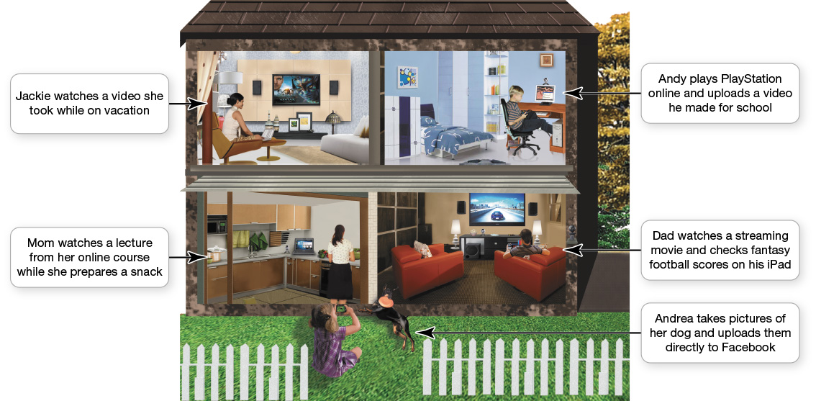
Networking Fundamentals
Computer network
Node
Computer
Peripheral
Network device
Notes:
A computer network is simply two or more computers that are connected via software and hardware so that they can communicate with each other.
Each device connected to a network is referred to as a node.
A node can be a computer, a peripheral such as a printer or game console, or a network device such as a router.

Slide 8
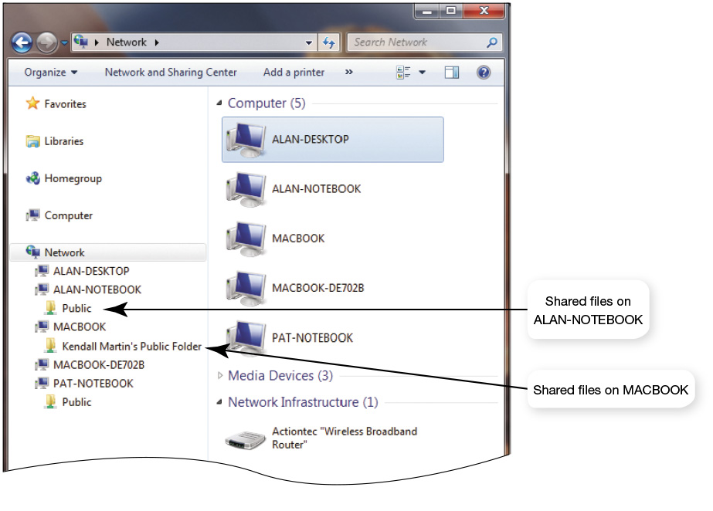
Networking Fundamentals
Computer network resource sharing benefits:
High-speed Internet connection
Peripheral devices
Files
Common communications
Notes:
There are several benefits to having computers networked:
Sharing an Internet connection: A network lets you share the high-speed Internet connection coming into your home.
Sharing printers and other peripherals: Networks let you share printers and other peripheral devices.
Sharing files: You can share files between networked computers without having to use portable storage devices to transfer the files.
Common communications: Computers running different operating systems can communicate on the same network.

Slide 9
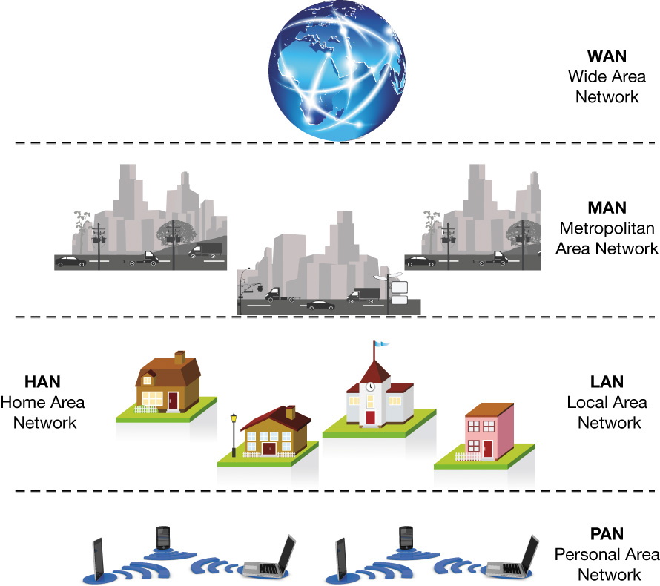
Network Architectures
Classified by:
Distance
How managed
Rules to exchange data
Communications medium used
Notes:
The network you have in your home differs greatly in terms of its size, structure, and cost from that found across your college campus. This difference is based in part on their network architectures.
Network architectures are classified according to the following characteristics:
The distance between nodes
The way in which they are managed
The set of rules used to exchange data between network nodes
The communications medium used to transport the data

Slide 10
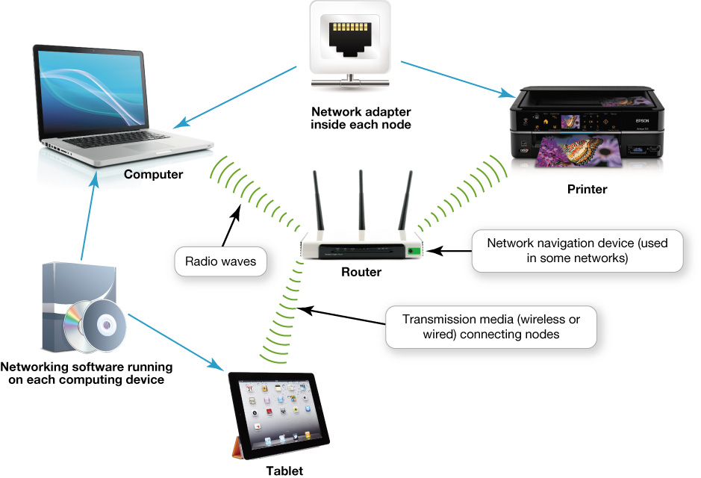
Network Components
Notes:
To function, all networks must include:
A means of connecting the nodes on the network (cables or wireless technology)
Special hardware devices that allow the nodes to communicate with each other and to send data
Software that allows the network to run

Slide 11
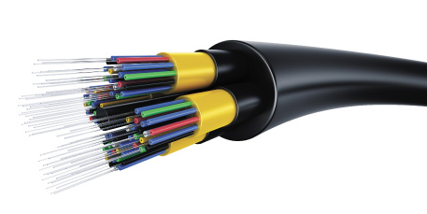
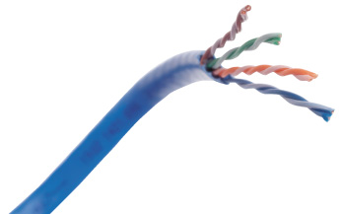
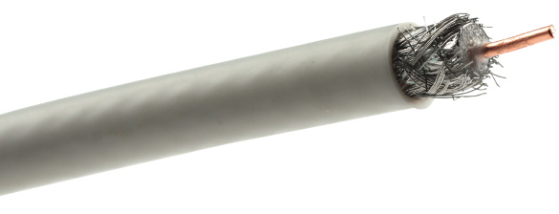
Network Components Transmission Media
Communications channel between nodes
Wireless networks
Wired networks
Notes:
Network nodes are connected by transmission media, which can be either wired or wireless.
The type of network and the distance between nodes determine the cable used:
Twisted-pair cable has copper wires that are twisted around each other and surrounded by a plastic jacket.
Coaxial cable consists of a single copper wire surrounded by layers of plastic.
Fiber-optic cable is made up of plastic or glass fibers that transmit data at extremely fast speeds.

Slide 12
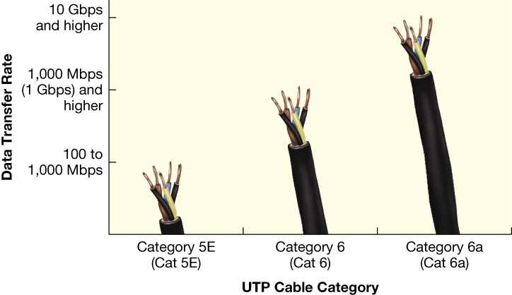
Network Components Transmission Media
UTP cable
Types of UTP cable
Cat 5E
Cat 6
Cat 6a
Decreased throughput in wireless networks
Notes:
The most popular transmission media option for wired Ethernet networks is UTP cable.
The three main types of UTP cable are:
Cat 5E is the cheapest and is sufficient for many home networking tasks.
Cat 6 is designed to achieve data transfer rates that support gigabit Ethernet networks.
Cat 6a is designed for ultra-fast Ethernet networks that run at speeds as fast as 10 Gbps.
Wireless networks have decreased throughput compared with wired networks.

Slide 13
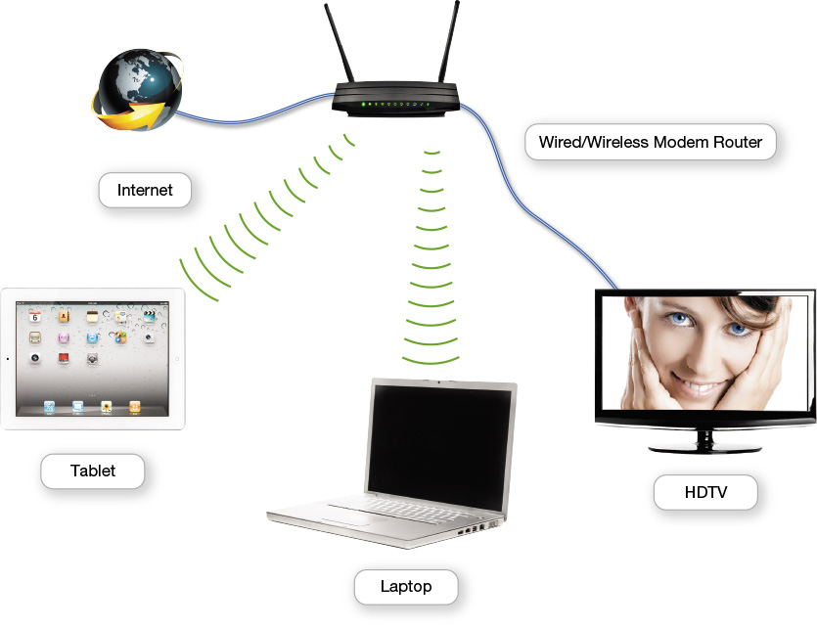
Network Components Basic Network Hardware
Network adapter
Network interface card (NIC)
Broadband modem
Packets
Router
Switch
Notes:
Each node needs a network adapter. An integrated network adapter is referred to as a network interface card.
A broadband connection requires a modem, which translates the signal into digital and back again.
Data is sent in bundles called packets.
Network navigation devices facilitate and control the flow of data.
A router transfers packets of data between two or more networks.
A switch acts like a traffic signal on a network.

Slide 14
Network Components Network Software
Operating software for P2P networking
Client/server network
Communicate through centralized server
Specialized network operating system (NOS) software
Notes:
Because home networks are P2P networks, they need operating system software that supports P2P networking.
As opposed to P2P networks, the nodes on a client/sever network don’t communicate directly with each other; rather, they communicate through a centralized server. Communicating through a server is more efficient in a network with a large number of nodes, but it requires more complex software. Therefore, servers on client/server networks have specialized network operating system (NOS) software installed.

Slide 15
Connecting to the Internet
Home network
Share an Internet connection
Must purchase Internet access from ISP
Specialized providers
Companies that provide other services
Broadband
Dial-up
Notes:
One of the main reasons for setting up a network is to share an Internet connection. Some businesses and large organizations have a dedicated connection to the Internet, but other businesses and homeowners purchase Internet access from Internet service providers (ISPs). ISPs might be specialized providers.
Broadband is the preferred way to access the Internet, but in some situations cellular or dial-up access might be necessary.

Slide 16
Connecting to the Internet Broadband Internet Connections
Broadband
Standard broadband technologies
Satellite broadband
Mobile broadband
Notes:
Broadband is often referred to as high-speed Internet. This high rate of access is in contrast to dial-up Internet access.
The standard wired broadband technologies in most areas are cable, DSL, and fiber optic service.
Satellite broadband is used mostly in rural or mountain areas.
There are also wireless broadband options. Mobile broadband connects you to the Internet through the same cellular network that cell phones use.

Slide 17
Connecting to the Internet Wired Broadband Internet Connections
Cable Internet
DSL (digital subscriber line)
Fiber optic service
Notes:
Cable Internet is a broadband service that transmits data over the coaxial cables.
DSL uses twisted-pair cable, the same as that used for regular telephones, to connect your computer to the Internet.
Fiber optic service uses fiber optic lines, which are strands of optically pure glass or plastic that are as thin as a human hair. Because light travels so quickly, this technology can transmit an enormous amount of data at superfast speeds.

Slide 18
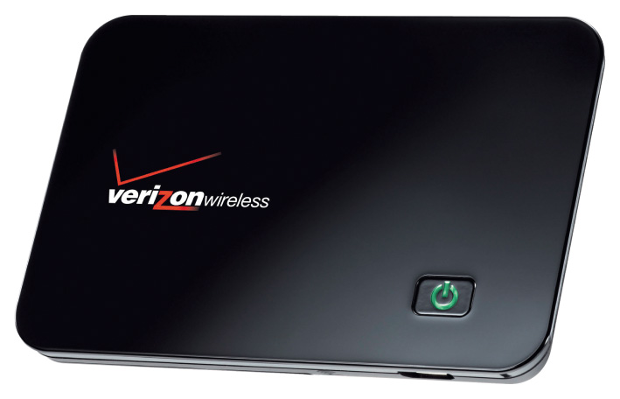
Connecting to the Internet Wireless Internet Access
Wireless Internet at home
WiFi hotspot
Wireless in-flight Internet
Mobile Broadband 3G
4G LTE
Notes:
To access the Internet wirelessly at home, you need to establish WiFi on your home network by using a router.
When away from home, you can find a WiFi hotspot.
Even wireless in-flight Internet service is available.
Mobile broadband connects you to the Internet through 3G or 4G access.
Some of the early 4G systems support less than the required rate and are not fully compliant with 4G standards, and so are called 4G LTE.

Slide 19
Your Home Network
Installing and Configuring Home Networks
Securing Wireless Networks
Notes:
This section addresses issues connected with setting up your home network.

Slide 20
Installing and Configuring Home Networks
Objectives
How do I tell if my home network is up to date, and how do I identify the devices on the network?
Besides computers, what other devices can I connect to a home network?
How do I configure the software on my computer and set up other devices to get my network up and running?
What problems might I encounter when setting up a wireless network?
Notes:
How do I tell if my home network is up to date, and how do I identify the devices on the network?
Besides computers, what other devices can I connect to a home network?
How do I configure the software on my computer and set up other devices to get my network up and running?
What problems might I encounter when setting up a wireless network?

Slide 21
Securing Wireless Networks
Objective
Why are wireless networks more vulnerable to security risks than wired networks, and what special precautions are required to ensure my wireless network is secure?
Notes:
Why are wireless networks more vulnerable to security risks than wired networks, and what special precautions are required to ensure my wireless network is secure?

Slide 22
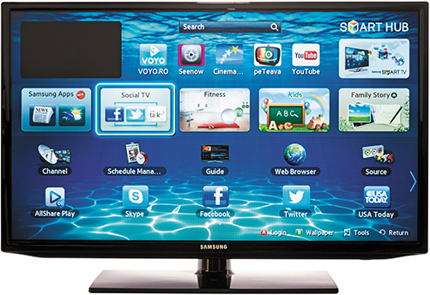
Installing and Configuring Home Networks
Devices connecting to home networks
Smartphones
Gaming consoles
Tablets
Smart TVs
Computers
Printers
Notes:
Now that you understand the basic components of a home network and your Internet connection options, you’re ready to install a network in your home.
Only a few years ago, most home networks included just a few computers and a printer. However, a network that can manage those devices is often very different from one that can support the smartphones, gaming consoles, tablets, and smart TVs many homes have added to their networks since.

Slide 23
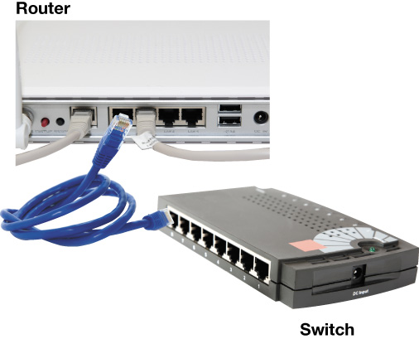
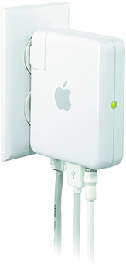
Installing and Configuring Home Networks Connecting Devices to a Router
Routers for Windows computers
802.11n
802.11ac
Routers for Apple computers
AirPort Extreme router
AirPort Express
Notes:
All routers that support the 802.11n standard (and newer 802.11ac) should work with computers running Windows or OS X. However, Apple has designed routers that are optimized for working with Apple computers.
Windows machines can also connect to an AirPort router, so it’s a great choice for households with both Apples and PCs.
The AirPort Express router can be used for home networks to support devices running iOs, OS X, and Windows.

Slide 24
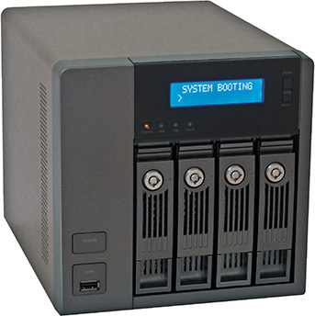
Installing and Configuring Home Networks Network-Attached Storage Devices
NAS devices
AirPort Time Capsule
Notes:
Network-attached storage (NAS) devices are specialized devices designed to store and manage network data. NAS devices provide for centralized data storage and access.
For Apple computers, the AirPort Time Capsule is a wireless router combined with a hard drive that facilitates the backup of all computers connected to the network. The AirPort Time Capsule looks very similar to the AirPort router, and it works in conjunction with the Time Machine backup feature of OS X.

Slide 25
Installing and Configuring Home Networks Specialized Home-Networking Devices
New digital picture frames
Built-in wireless
Access network and online photos
Receive pictures via e-mail
Security
Wireless monitoring cameras
Notes:
You can use your home network to share photos with a digital picture frame (some come with built-in wireless adapters). You can set up an e-mail address for the picture frame so that friends and family can e-mail pictures directly to the frame.
You can use your home network to enhance your home security with monitoring cameras that feature wireless connectivity. You can connect these cameras to your network and monitor them in real time.

Slide 26
Installing and Configuring Home Networks Troubleshooting Wireless Network Problems
802.11n or 801.11ac added performance options:
Dual-band N router
Wireless range extender
Notes:
The maximum range of 802.11n or 802.11ac wireless devices is about 350 feet. As you go farther away from your router, the throughput you achieve decreases.
A dual-band N router allows for simultaneous support for both 2.4-GHz and 5-GHz frequency bands for 802.11n and all prior 802.11 standards.
A wireless range extender is a device that amplifies your wireless signal to extend to parts of your home that are experiencing poor connectivity.

Slide 27
Securing Wireless Networks
Use a firewall to secure Internet connections
Wired networks more secure than wireless
Added vulnerabilities for wireless:
Signal range can extend to neighbors
Extra precautions required to secure wireless
Notes:
Computers that connect to the Internet need to be secured. A firewall is a hardware or software solution that shields your network.
Wireless networks present special vulnerabilities. You should take additional steps and precautions to keep your wireless network safe and secure.
With a wired network, it’s fairly easy to tell if a hacker is using your network.
When residences are close together, wireless signals can reach a neighbor’s residence.

Slide 28
Check Your Understanding
What is a network, and what are a network’s advantages and disadvantages?
What are the different ways to classify networks?
Which type of network is most commonly found in the home?
What are the main components of every network?
What are my options for connecting to the Internet?
Notes:
What is a network, and what are a network’s advantages and disadvantages?
What are the different ways to classify networks?
Which type of network is most commonly found in the home?
What are the main components of every network?
What are my options for connecting to the Internet?

Slide 29
Check Your Understanding
How do I tell if my home network is up to date, and how do I identify the devices on the network?
Besides computers, what other devices can I connect to a home network?
How do I configure the software on my computer and set up the devices required to get my network up and running?
Notes:
How do I tell if my home network is up to date, and how do I identify the devices on the network?
Besides computers, what other devices can I connect to a home network?
How do I configure the software on my computer and set up the devices required to get my network up and running?

Slide 30
Check Your Understanding
What problems might I encounter when setting up a wireless network?
Why are wireless networks more vulnerable to security risks than wired networks, and what special precautions are required to ensure my wireless network is secure?
Notes:
What problems might I encounter when setting up a wireless network?
Why are wireless networks more vulnerable to security risks than wired networks, and what special precautions are required to ensure my wireless network is secure?

Slide 31
All rights reserved. No part of this publication may be reproduced, stored in a retrieval system, or transmitted, in any form or by any means, electronic, mechanical, photocopying, recording, or otherwise, without the prior written permission of the publisher. Printed in the United States of America.
Copyright © 2016 Pearson Education, Inc.

