Slide 1
Technology
in Action
Alan Evans • Kendall Martin
Mary Anne Poatsy
Twelfth Edition
Notes:
Welcome to Chapter 4: Application Software: Programs That Let You Work and Play.

Slide 2
Technology in Action
Chapter 3
Application Software:
Programs That Let You Work and Play
Notes:
This chapter discusses the kinds of software you can use to perform a variety of tasks, from simple word processing to digital image editing. We’ll also discuss how you can buy software, what the different versions of software mean, how you can legally get free software from the web, and how you install and uninstall software safely on your system.

Slide 3
Programs that Let You Work
The Nuts and Bolts of Software
Productivity and Business Software

Slide 4
The Nuts and Bolts of Software
Objectives
What’s the difference between application software and system software?
What are the different ways I can access and use software?
Notes:
What’s the difference between application software and system software?
What are the different ways I can access and use software?

Slide 5
Productivity and Business Software
Objectives
What kinds of applications are included in productivity software?
What kinds of software do small and large businesses use?
Notes:
What kinds of applications are included in productivity software?
What kinds of software do small and large businesses use?

Slide 6
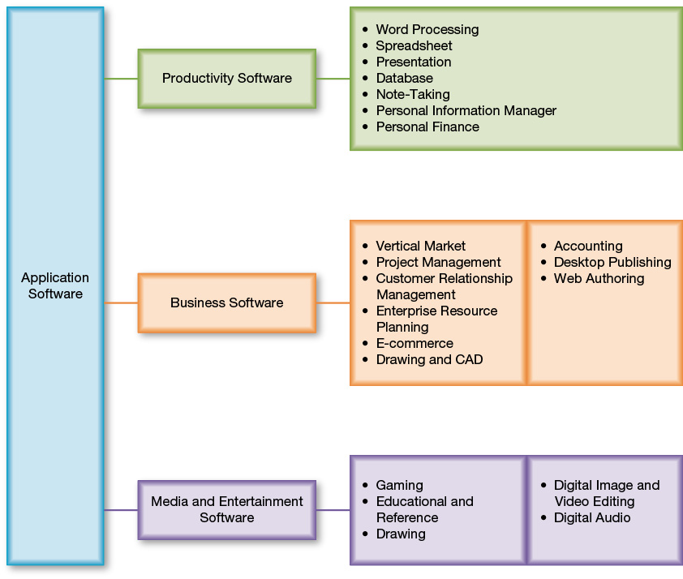
The Nuts and Bolts of Software
Software: A set of instructions that tell the computer what to do
Two basic types of software
  Application software
  System software
Notes:
Software refers to instructions that tell the computer what to do. An instruction set, also called a program, provides a means to interact with and use the computer.
Your computer has two basic types of software.
Application software is used to do tasks at home, school, and work.
System software helps run the computer and coordinate instructions between application software and the computer’s hardware devices. System software includes the operating system and utility programs.

Slide 7
The Nuts and Bolts of Software
Preinstalled software
Installed software
  Proprietary (or commercial) software
  Open source software
Software as a Service (SaaS)
  Web-based applications
  Collaborate online
Notes:
New computers come with software preinstalled, including an operating system and application software.
Types of installed software include:
You buy proprietary software by downloading it from the Internet or buying it on DVD.
Open source software is free software that is available with few licensing and copyright restrictions.
In Software as a Service, the vendor hosts the software online and you access it over the Internet without installing it. You can collaborate online with others.

Slide 8
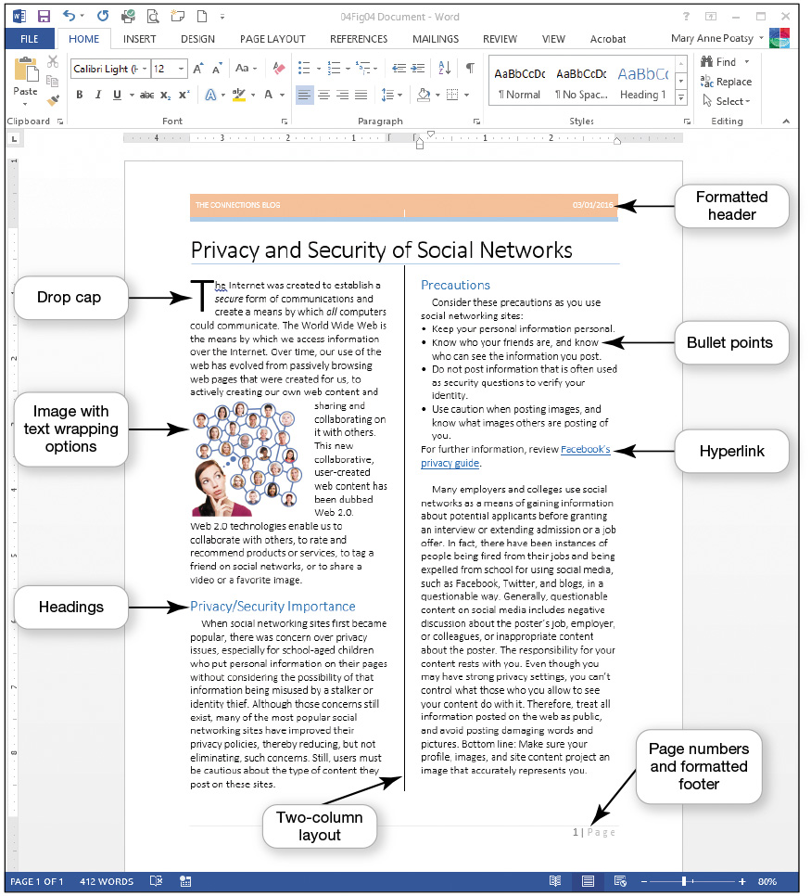
Productivity and Business Software
Word Processing Software
Create and edit documents for:
  Research papers
  Class notes
  Résumés
Program Examples
  Microsoft Word
  Writer
Notes:
You’ve probably used word processing software to create and edit documents such as research papers, class notes, and resumes. Microsoft Word is the most popular word processing program that you can buy and install on your computer.
If you are looking for a more affordable alternative, you might want to try an open source alternative such as Writer, a word processing program from the Apache OpenOffice suite.

Slide 9
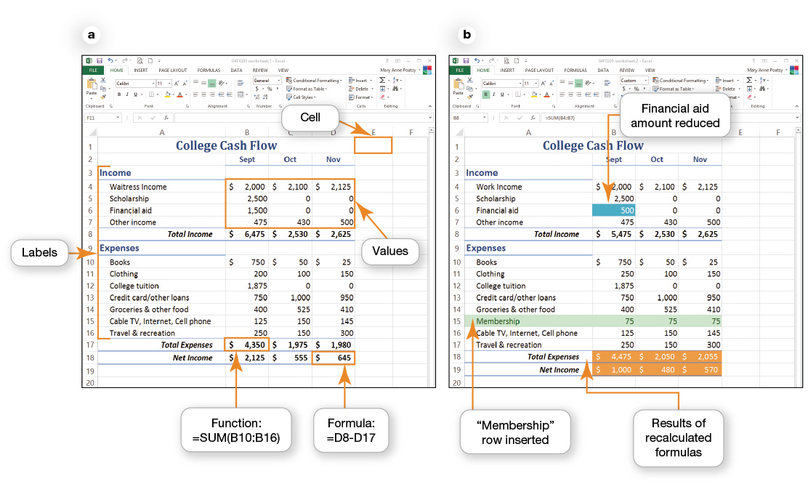
Productivity and Business Software
Spreadsheet Software
Performs calculations and numerical analyses
Examples
  Microsoft Excel
  OpenOffice Calc
Notes:
Spreadsheet software lets you make calculations and perform numerical analyses.
Microsoft Excel and Apache OpenOffice Calc are two examples of spreadsheet software. One benefit of spreadsheet software is that it can automatically recalculate all formulas and functions in a spreadsheet when values for some of the inputs change.

Slide 10
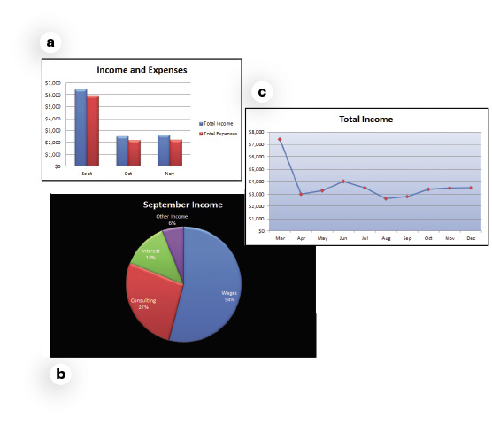
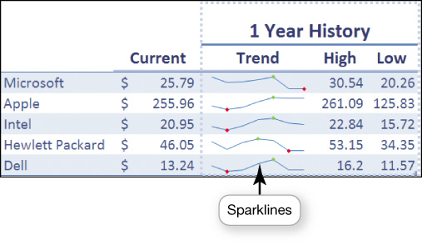
Productivity and Business Software
Spreadsheet Software
Create charts
Sparklines
Notes:
Most spreadsheet applications let you create a variety of charts, including basic column charts, pie charts, and line charts, with or without 3-D effects. In addition to these basic charts, you can make stock charts (for investment analysis) and scatter charts (for statistical analysis), or create custom charts.
A newer feature in Excel is sparklines—small charts that fit into a single cell and make it easy to show data trends.

Slide 11
Productivity and Business Software
Presentation Software
Tips for designing good presentations
  Be careful with color
  Use bullets for key points
  Use images
  Consider font size and style
  Keep animation and background audio to a minimum
Notes:
Here are tips for designing good presentations:
Be careful with color: Choose dark text on a light background or light text on a dark background.
Use bullets for key points: Limit is four to six bulleted points per slide.
Use images: Images can convey thoughts or illustrate points.
Consider font size and style: Keep the font size large enough to read from the back of the room.
Keep animation and background audio to a minimum.

Slide 12
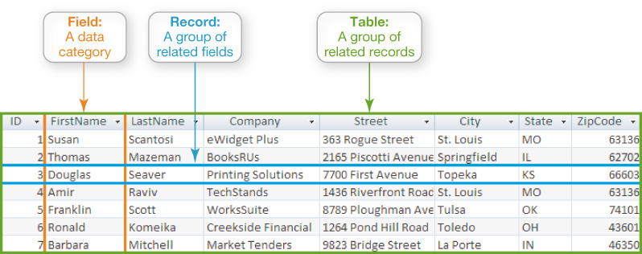
Productivity and Business Software
Database Software
Store and organize data
Fields > Records>Tables
Notes:
Database software such as Oracle, MySQL, and Microsoft Access are powerful applications that let you store and organize data.
As mentioned earlier, spreadsheet applications are easy to use for simple tasks such as sorting, filtering, and organizing data.
Traditional databases are organized into fields, records, and tables.

Slide 13
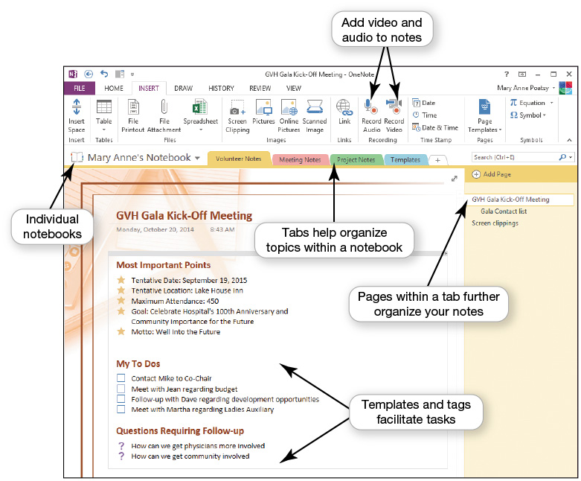
Productivity and Business Software
Note-taking Software
Notes:
Microsoft OneNote is a popular note-taking and organizational tool you can use for research, brainstorming, and collaboration.
You can organize notes into tabbed sections. You can access notes from other Microsoft Office applications.
A free online option, Evernote, lets you take notes via the web, your phone, or your computer and then sync your notes between your devices. You can share your notes with other Evernote users for easy collaboration.

Slide 14
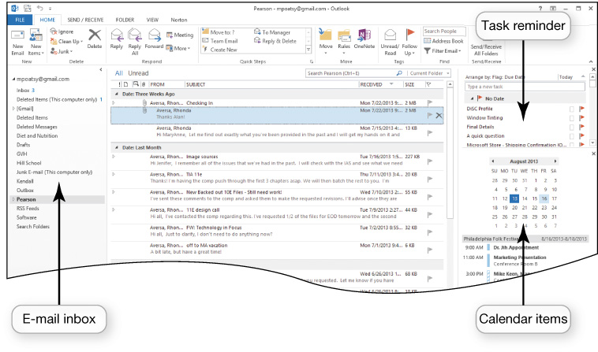
Productivity and Business Software
Personal Information Manager Software
Manage e-mail, contacts, calendars, and tasks
Web-based PIMs
  Yahoo!
  Google
Other options
  Toodledo
  OmniFocus
Notes:
Most productivity suites contain some form of personal information manager (PIM) software to help you manage e-mail, contacts, calendars, and tasks. Microsoft Outlook is the most widely used PIM program.
Yahoo! and Google also include coordinating calendars and contacts similar to Microsoft Outlook.
Toodledo is a free program that coordinates well with Microsoft Outlook, and OmniFocus is a more full-featured option for Mac devices.

Slide 15
Productivity and Business Software
Personal Financial Software
Financial planning software
  Manage daily finances
  Electronic checkbook registers
  Automatic bill payment tools
Tax preparation software
  Intuit TurboTax
  H&R Block At Home
Notes:
Financial planning software helps you manage your daily finances.
Financial planning programs include electronic checkbook registers and automatic bill payment tools. With these features, you can make recurring monthly payments, such as rent or student loans, with automatically scheduled online payments.
Tax preparation software such as Intuit Turbo Tax and H&R Block At Home let you prepare your state and federal taxes on your own.
Both Quicken and Mint integrate seamlessly with TurboTax.

Slide 16
Productivity and Business Software
Small Business Software
Accounting software
  Track accounts receivable and payable
  Inventory management, payroll, and billing
Desktop publishing (DTP) software
  Design books and publications
Web Authoring software
  Design web pages
Notes:
Accounting software helps small business owners manage their finances more efficiently by providing tools for tracking accounts receivable and accounts payable. In addition, these applications offer inventory management, payroll, and billing tools.
If your business requires newsletters, catalogs, annual reports, or other large, complicated publications, consider using desktop publishing (DTP) software.
Web authoring software allows even the novice to design interesting and interactive web pages without knowing any HTML code.

Slide 17
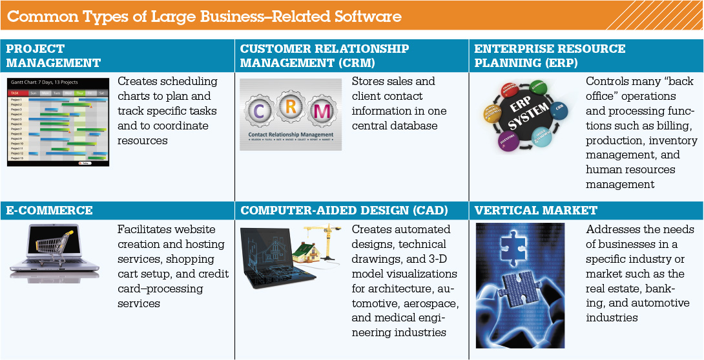
Productivity and Business Software
Software for Large and Specialized Businesses
Notes:
There are specialized programs for project management software, customer relationship management (CRM), enterprise resource planning (ERP), e-commerce, marketing and sales, finance, point of sale, security, networking, data management, and human resources.
Some applications are tailored to the specific needs of a company or industry.
Software designed for a specific industry is called vertical market software.
Engineers use computer-aided design (CAD) programs such as Autodesk’s AutoCAD to create automated designs, technical drawings, and 3-D model visualizations.

Slide 18
Programs that Let You Play
Multimedia and Entertainment Software
Managing Your Software

Slide 19
Multimedia and
Entertainment Software
Objective
What different types of multimedia and entertainment software are available?
Notes:
What different types of multimedia and entertainment software are available?

Slide 20
Managing Your Software
Objectives
What’s important to know when buying software?
How do I install and uninstall software?
Notes:
What’s important to know when buying software?
How do I install and uninstall software?

Slide 21
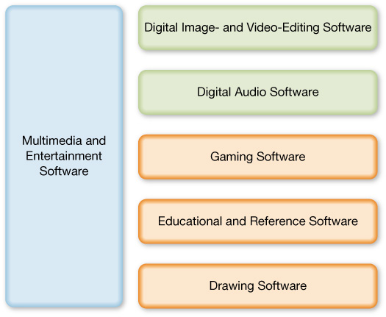
Multimedia and Entertainment Software
Notes:
Multimedia software includes digital image- and video-editing software, digital audio software, and other specialty software required to produce computer games, animations, and movies.

Slide 22
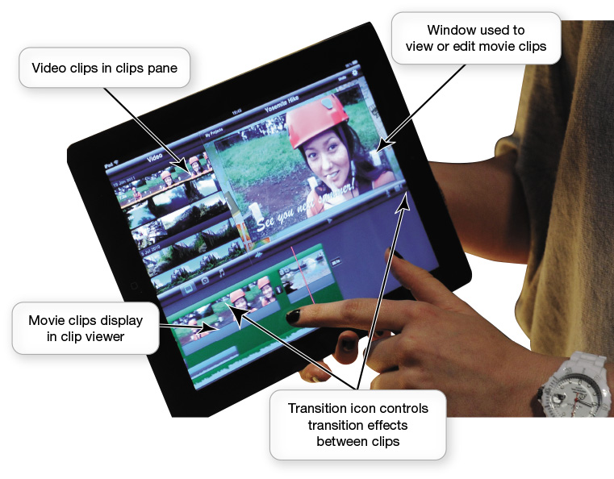
Multimedia and Entertainment Software
Digital Image and Video Editing Software
Video-editing software
Examples
  Adobe Premiere Pro and Apple’s Final Cut Pro
  Windows Movie Maker and iMovie
Notes:
It’s easy to upload videos directly to YouTube or Facebook unedited, but you can use digital video-editing software to help refine your videos.
The most expensive products (such as Adobe Premiere Pro and Apple's Final Cut Pro) offer the widest range of special effects and tools. Some moderately priced programs have enough features to keep the casual user happy. Windows Movie Maker and iMovie have intuitive features that make it simple to create professional-quality movies.

Slide 23
Multimedia and Entertainment Software
Digital Audio Software
Digital audio files
Downloaded music files, audiobooks, or podcasts
  Compressed: MP3, ACC, WMA
  Uncompressed: WAV, AIFF
Create and record audio files
Audio editing software
Notes:
Digital audio files, such as downloaded music files, audiobooks, or podcasts, may be stored on your computer.
MP3 is the most common audio compression format, but there are other compressed formats, such as AAC and WMA.
You might also see uncompressed audio files on your computer, such as WAV and AIFF files.
Digital audio applications let you create and record your own audio files.
Audio-editing software includes tools that make editing audio files easy.

Slide 24
Multimedia and Entertainment Software
Gaming Software
Create characters to extend a game
  EverQuest, Oblivion, Unreal Tournament
Create your own games
  Unity, Adobe Flash, RPG Maker VX, GameMaker
Notes:
You can use the editors and game engines available for games such as EverQuest, Oblivion, and Unreal Tournament to create custom levels and characters to extend the game.
Multimedia applications such as Unity, Adobe Flash, and RPG Maker VX provide the tools you need to explore game design and creation. The program GameMaker is a free product that lets you build a game without any programming.

Slide 25
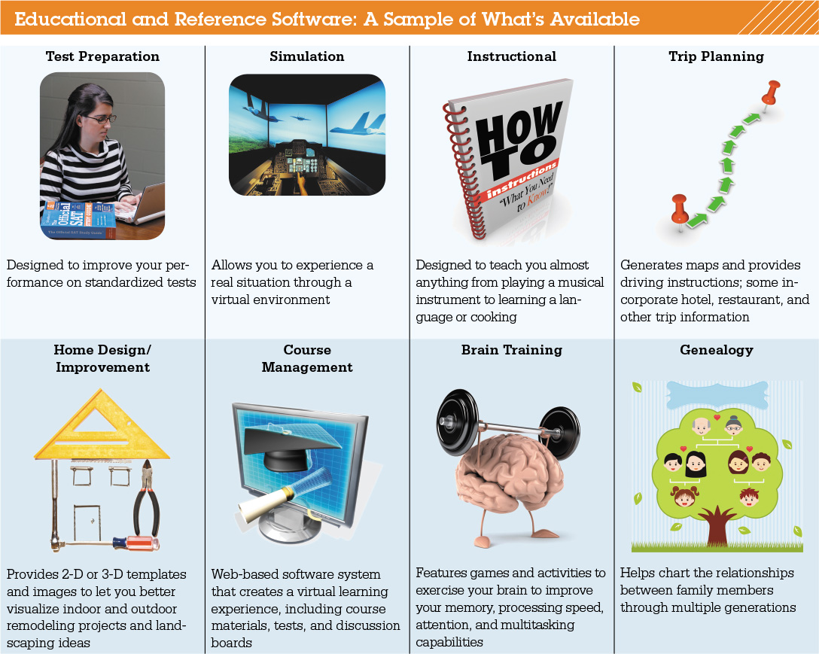
Multimedia and Entertainment Software
Educational and Reference Software
Notes:
Many programs provide tutorials for popular computer applications.
Some training programs, known as simulation programs, allow you to experience or control the software as if it were an actual event.
Although some courses are run from an individually developed website, many online courses are run using course management software such as Blackboard, Moodle, and Canvas.
Collaboration tools facilitate virtual office hour sessions.

Slide 26

Multimedia and Entertainment Software
Drawing Software
Create:
  Two-dimensional, line-based drawings
  Technical diagrams
  Animations
Professional-level
  Adobe Illustrator
Home and landscape planning
Notes:
Drawing software lets you create or edit 2-D, line-based drawings. You can use it to create technical diagrams or original nonphotographic drawings, animations, and illustrations using standard tools.
Adobe Illustrator includes tools that let you create professional-quality creative and technical illustrations.
There are many software packages to help plan the layout of homes and landscapes, such as those offered by Broderbund.

Slide 27
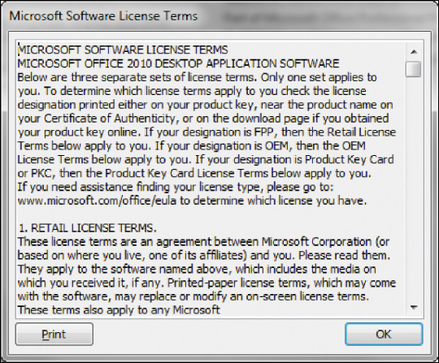
Managing Your Software
Software Licenses
End User License Agreement (EULA)
States the following:
  Ultimate owner of
  software
  Whether copies can
  be made
  Number of installations allowed
  Warranties
Notes:
A software license, also known as an End User License Agreement, is an agreement between you, the user, and the software company.
Generally, the agreement states who the ultimate owner of the software is, under what circumstances copies of the software can be made, and whether the software can be installed on any other machine. Finally, the license agreement will state what, if any, warranty comes with the software.

Slide 28
Managing Your Software
Installing and Uninstalling Software
DVD or downloading from the Internet
Full installation
Custom installation
Recovering from a computer crash
Uninstalling Software
Notes:
Before you use most software, you must install it. Installations differ depending whether you're installing from a DVD or downloading from the Web.
A full installation copies all the most commonly used files to your hard drive.
In custom installation, you decide which features you want installed.
You should create a system repair disc.
The Recovery utility included in Windows helps to recover from a computer crash
Uninstalling software removes it from your hard drive.

Slide 29
Check Your Understanding
What’s the difference between application software and system software?
What are the different ways I can access and use software?
What kinds of applications are included in productivity software?
What kinds of software do small and large businesses use?
Notes:
What’s the difference between application software and system software?
What are the different ways I can access and use software?
What kinds of applications are included in productivity software?
What kinds of software do small and large businesses use?

Slide 30
Check Your Understanding
What types of multimedia and entertainment software are available?
What’s important to know when buying software?
How do I install and uninstall software?
Notes:
5. What types of multimedia and entertainment software are available?
6. What’s important to know when buying software?
7. How do I install and uninstall software?

Slide 31

All rights reserved. No part of this publication may be reproduced, stored in a retrieval system, or transmitted, in any form or by any means, electronic, mechanical, photocopying, recording, or otherwise, without the prior written permission of the publisher. Printed in the United States of America.
Copyright © 2016 Pearson Education, Inc.

