Slide 1
Technology in Action
Alan Evans • Kendall Martin
Mary Anne Poatsy
Twelfth Edition
Notes:
Welcome to Chapter 5: System Software: The Operating System, Utility Programs, and File Management.

Slide 2
Technology in Action
Chapter 2
System Software: The Operating System, Utility Programs, and File Management
Notes:
This chapter discusses system software and how vital it is to your computer. We will examine the operating system (OS) by looking at the different operating systems on the market as well as the tasks the OS manages. We’ll also discuss how you can use the OS to keep your files and folders organized so that you can use your computer more efficiently. Finally, we’ll look at the many utility programs included as system software on your computer.

Slide 3
Understanding System Software
Operating System Fundamentals
What the Operating System Does
The Boot Process: Starting Your Computer

Slide 4
Operating System Fundamentals
Objectives
What software is included in system software?
What are the different kinds of operating systems?
What are the most common operating systems?
Notes:
What software is included in system software?
What are the different kinds of operating systems?
What are the most common operating systems?

Slide 5
What the Operating System Does
Objectives
How does the operating system provide a means for users to interact with the computer?
How does the operating system help manage resources such as the processor, memory, storage, hardware, and peripheral devices?
How does the operating system interact with application software?
Notes:
How does the operating system provide a means for users to interact with the computer?
How does the operating system help manage resources such as the processor, memory, storage, hardware, and peripheral devices?
How does the operating system interact with application software?

Slide 6
The Boot Process: Starting Your Computer
Objective
How does the operating system help the computer start up?
Notes:
How does the operating system help the computer start up?

Slide 7
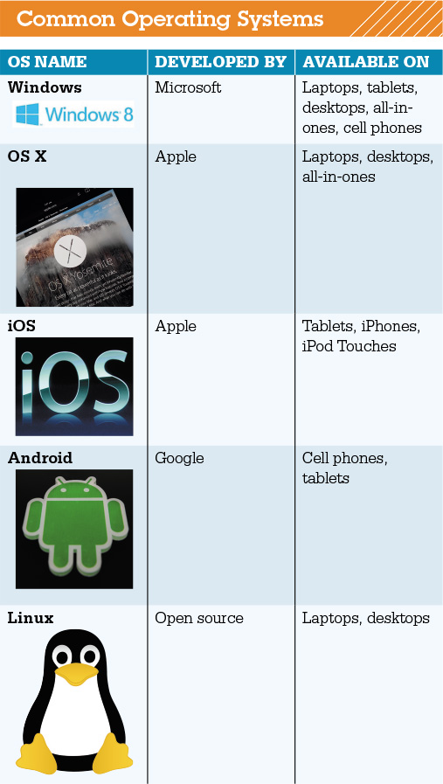
Understanding System Software Operating System Fundamentals
Two basic types of software
Application software
System software
Operating system fundamentals
Multitasking
Networking capabilities
Categorized by type
Notes:
You use application software to do everyday tasks at home and at work.
System software helps run the computer and coordinates instructions between application software and the computer’s hardware devices.
Modern operating systems allow a single user to multitask—to perform more than one process at a time. Operating systems such as Windows and OS X provide networking capabilities as well.
Operating systems can be categorized by the type of device on which they’re installed.

Slide 8
Understanding System Software Operating System Fundamentals
Categorized by device
Mainframes
Network computers
Personal computers
Mobile devices
Robots
Notes:
Laptops, tablet computers, and smartphones all need specific operating systems designed to take advantage of their unique characteristics. However, as devices begin to converge in terms of functionality, and operating systems continue to become more powerful, developers such as Microsoft and Apple are making operating systems that have similar functionality or are making single operating systems that can run on multiple devices.

Slide 9
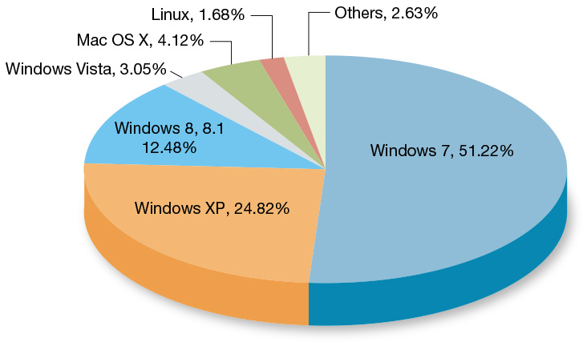
Understanding System Software Operating Systems for Personal Computers
Top three operating systems
Windows
Max OS X
Linux
Windows 8 optimized for touch screen
Cloud-based OS
Notes:
Microsoft Windows, Mac OS X, and Linux are the top three operating systems for personal computers.
The newest release of Microsoft’s OS, Windows 8, provides a new interface optimized for touch-screen devices.
Now that broadband Internet access and providing computer resources via the Internet are becoming more commonplace, operating systems have features that are tied to cloud computing.

Slide 10
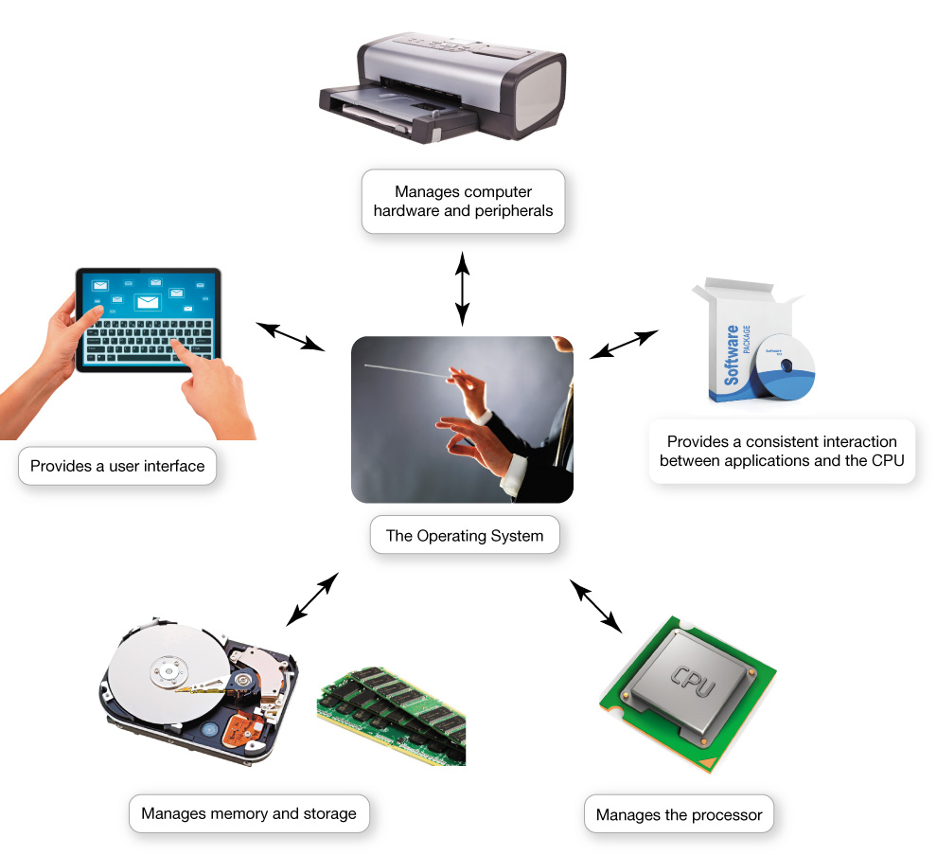
What the Operating System Does
OS—Coordinates and directs the flow of data and information
Notes:
The operating system is like an orchestra's conductor. It coordinates and directs the flow of data and information through the computer system.

Slide 11
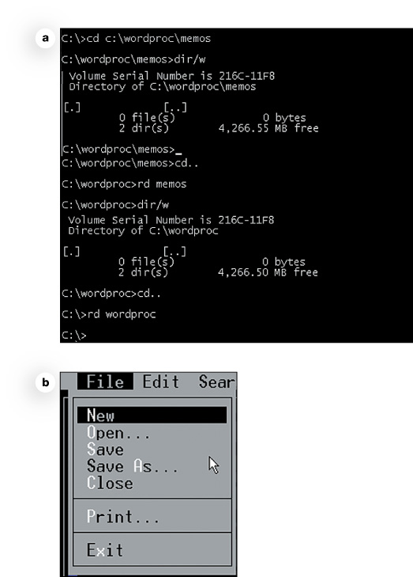
What the Operating System Does The User Interface
Enables user to interact with the computer
Types of interfaces
Command-driven interface
Menu-driven interface
Graphical user interface (GUI)
Notes:
The OS provides a user interface that lets you interact with the computer.
In a command-driven interface you enter commands to communicate with the computer system.
A menu-driven interface is one in which you choose commands from menus displayed on the screen. This eliminated the need for users to know every command.
Current operating systems use a graphical user interface (GUI). GUIs display graphics and use the point-and-click technology of the mouse and cursor.

Slide 12
What the Operating System Does Processor Management
Performs tasks at once
Arranges execution of activities
Assigns time to activity
Switches among processes
Handles events
Notes:
When computing, you ask the processor to perform several tasks at once.
The CPU still needs the OS to arrange for the execution of all these activities.
The OS assigns a slice of its time to each activity. It must switch among different processes millions of times a second.
Every keystroke, mouse click, and signal to the printer creates an action, or event, in the respective devices to which the OS responds.

Slide 13
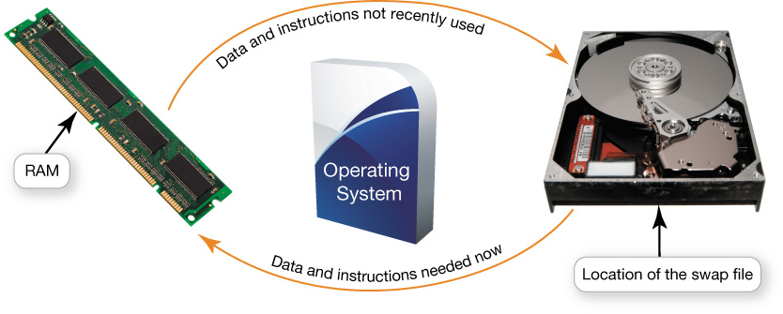
What the Operating System Does Virtual Memory
RAM—limited capacity
Full RAM—Instructions are stored on hard drive
Borrowing drive space is called virtual memory
Increase RAM to avoid using virtual memory
Notes:
RAM has limited capacity.
When there isn’t enough room in RAM, it borrows room from the hard drive.
Borrowing hard drive space is called virtual memory.
When more RAM is needed, the OS swaps out from RAM data or instructions that haven't been used recently and moves them to a temporary storage area on the hard drive.
Increasing the amount of RAM helps to avoid having to send data and instructions to virtual memory.

Slide 14
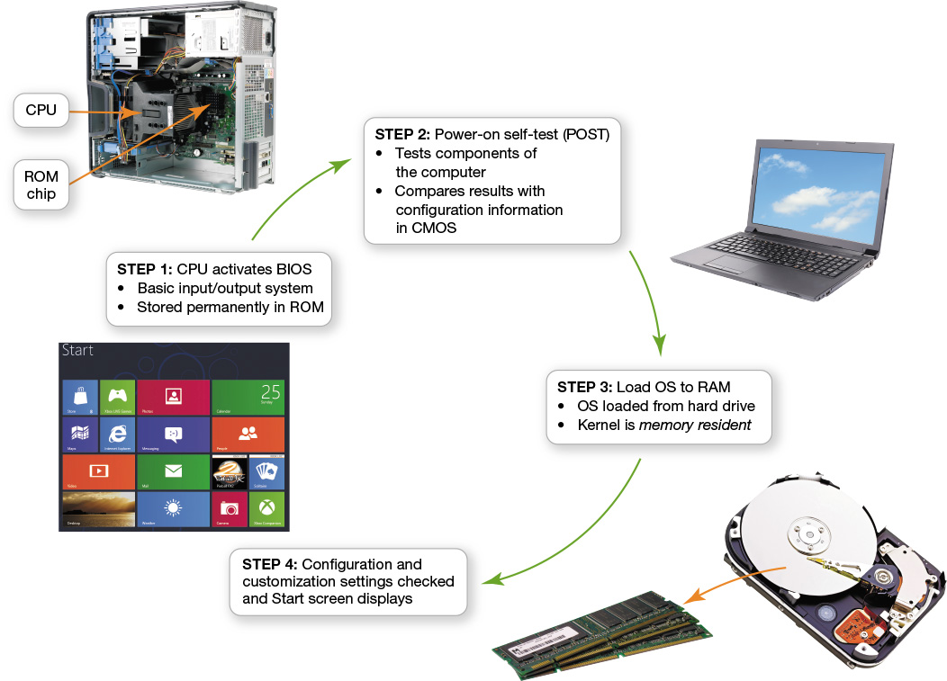
The Boot Process: Starting the Computer
The boot process loads the operating system into RAM
Notes:
The boot process loads the OS into RAM. The term boot, from bootstrap loader, alludes to the straps of leather, called bootstraps, that people used to use to help them pull on their boots.

Slide 15
Using System Software
The Windows Interface
Organizing Your Computer: File Management
Utility Programs

Slide 16
The Windows Interface
Objective
What are the main features of the Windows interface?
Notes:
What are the main features of the Windows interface?

Slide 17
Organizing Your Computer: File Management
Objective
How does the operating system help me keep my computer organized?
Notes:
How does the operating system help me keep my computer organized?

Slide 18
Utility Programs
Objective
What utility programs are included in system software and what do they do?
Notes:
What utility programs are included in system software and what do they do?

Slide 19
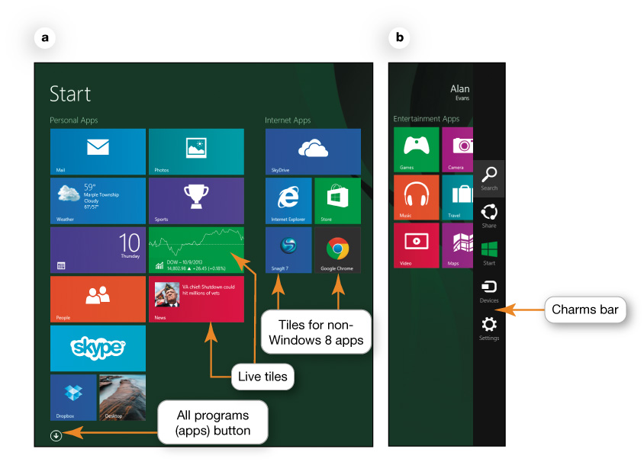
The Windows Interface
Windows 8
Laptops, phones, and tablets
Three ways to accomplish tasks
Using a mouse
Touching the screen
Using keystrokes
Start screen
Notes:
Windows 8 is designed for a variety of devices, including laptops, phones, and tablets. There are often three different ways to accomplish tasks in Windows 8:
Using a mouse
Touching the screen
Using keystrokes
The Start screen is the first interaction you have with the OS and the first image you see on your display. As its name implies, the Start screen is the place where you begin all of your computing activities.

Slide 20
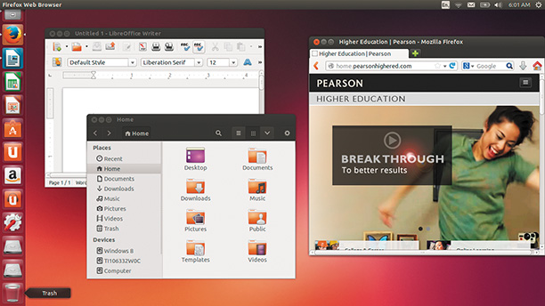
The Windows Interface
Mac OS X and Windows
Not compatible
Similar in functionality
Linux
Most interfaces are based on familiar Windows and OS X paradigms
Notes:
Although the Mac OS X and the Windows operating systems aren’t compatible, they’re extremely similar in terms of functionality.
Different versions of Linux feature different user interfaces, but most of them, like Ubuntu, are based on familiar Windows and OS X paradigms such as using icons to launch programs and having apps run in a window environment.

Slide 21
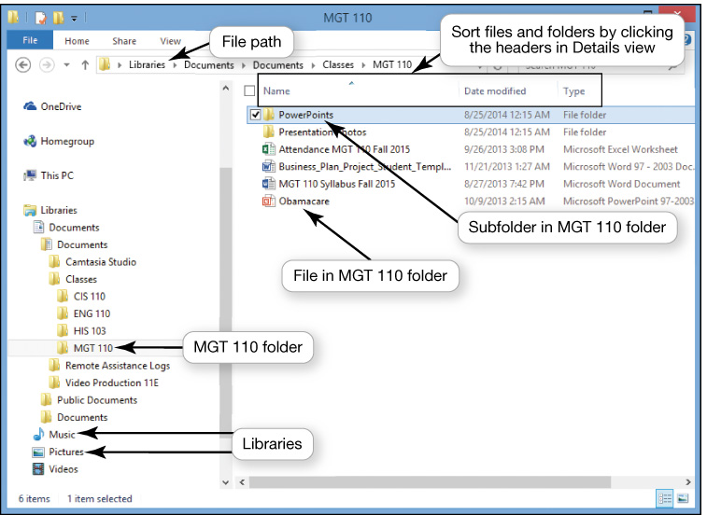
Organizing Your Computer: File Management
Additional function of the operating system
Organizational structure
Hierarchical directory structure
Folders
Libraries
Drives
Root directory
Notes:
An additional function of the OS is to enable file management, which provides an organizational structure to the computer’s contents.
Windows organizes your computer in a hierarchical directory structure composed of drives, libraries, folders, subfolders, and files.
The C: drive is like a large filing cabinet in which all files are stored. The C: drive is the top of the filing structure of your computer, referred to as the root directory.

Slide 22
Organizing Your Computer: File Management Naming Files
File name—uniquely identified
Extension, or file type
Naming conventions
Up to 255 characters
Notes:
The first part of a file, or the file name, is generally the name you assign to the file when you save it. In a Windows application, an extension, or file type, follows the file name and a period or dot (.).
Each OS has its own naming conventions. File names can have as many as 255 characters.
All files must be uniquely identified, unless you save them in different folders or in different locations.

Slide 23
Organizing Your Computer: File Management Working with Files
File management actions
Open
Copy
Move
Rename
Delete
Notes:
You can perform many file-management actions.
You open a file by double-clicking the file from its storage location.
You can copy a file to another location using the Copy command.
To move a file from one location to another, use the Cut command.
The Recycle Bin is represented by an icon that looks like a recycling bin, where files deleted from the hard drive reside until you permanently purge them from your system.

Slide 24
Utility Programs
Incorporated into operating system
Firewall and file-compression utilities
Standalone utility programs
Antivirus and security programs
Freeware
Notes:
Utility programs are small applications that perform special functions and come in three flavors:
Those that are included with the OS
Those sold as standalone programs
Those offered as freeware (anti-malware software like Ad-Aware from Lavasoft)
In general, the basic utilities designed to manage and tune the computer hardware are incorporated into the operating system.
The standalone utility programs typically offer more features or an easier user interface for backup, security, diagnostic, or recovery functions.

Slide 25
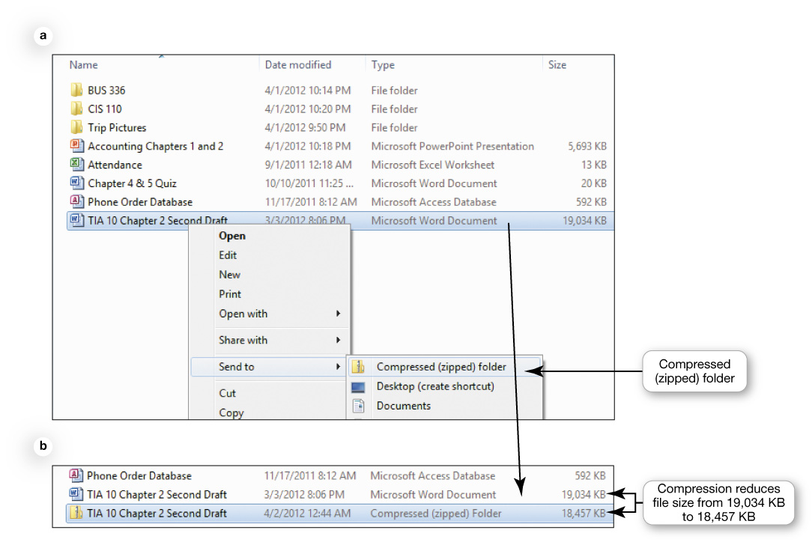
Utility Programs File Compression Utilities
Make a large file more compact
Easier and faster to send files
Built-in file compression
Notes:
File compression makes a large file more compact, making it easier and faster to send large attachments by e-mail, upload them to the web, or save them to a disc.
Windows has a built-in file compression utility that takes out redundancies in a file to reduce the file size. You can also obtain several standalone freeware and shareware programs, such as WinZip and StuffIt, to compress your files.

Slide 26
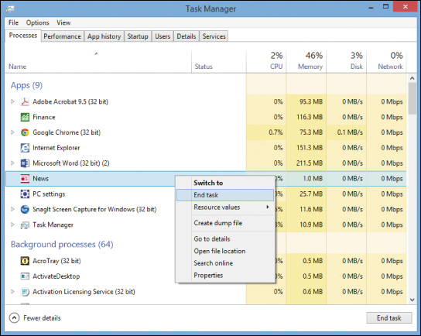
Utility Programs System Maintenance Utilities
Disk Cleanup
Error-checking
File allocation table (FAT)
Task Manager
Notes:
Disk cleanup removes unnecessary files from your hard drive
Sometimes the system becomes confused, leaving references on the file allocation table or FAT to files that no longer exist or have been moved.
Error-checking is a Windows utility that checks for lost files and fragments as well as physical errors on your hard drive.
If a program has stopped working, you can use the Windows Task Manager utility to check on the program or to exit the nonresponsive program.

Slide 27
Utility Programs Accessibility Utilities
Ease of Access Center
Notes:
Microsoft Windows includes an Ease of Access Center, which is a centralized location for assistive technology and tools to adjust accessibility settings.
In the Ease of Access Center, you can find tools to help users with disabilities. If you’re not sure where to start or what settings might help, a questionnaire asks you about routine tasks and provides a personalized recommendation for settings that will allow you to better use your computer.

Slide 28
Check Your Understanding
What software is included in system software?
What are the different kinds of operating systems?
What are the most common operating systems?
How does the operating system provide a means for users to interact with the computer?
Notes:
What software is included in system software?
What are the different kinds of operating systems?
What are the most common operating systems?
How does the operating system provide a means for users to interact with the computer?

Slide 29
Check Your Understanding
How does the operating system help manage resources such as the processor, memory, storage, hardware, and peripheral devices?
How does the operating system interact with application software?
How does the operating system help the computer start up?
Notes:
How does the operating system help manage resources such as the processor, memory, storage, hardware, and peripheral devices?
How does the operating system interact with application software?
How does the operating system help the computer start up?

Slide 30
Check Your Understanding
What are the main features of the Windows interface?
How does the operating system help me keep my computer organized?
What utility programs are included in system software and what do they do?
Notes:
8. What are the main features of the Windows interface?
9. How does the operating system help me keep my computer organized?
10. What utility programs are included in system software and what do they do?

Slide 31
All rights reserved. No part of this publication may be reproduced, stored in a retrieval system, or transmitted, in any form or by any means, electronic, mechanical, photocopying, recording, or otherwise, without the prior written permission of the publisher. Printed in the United States of America.
Copyright © 2016 Pearson Education, Inc.

