Slide 1
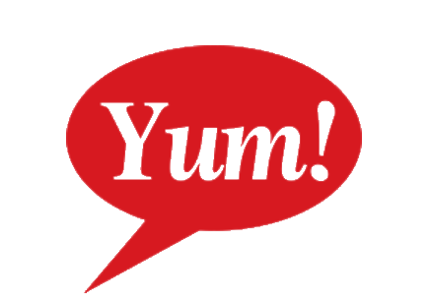

Total Number of Yum! Restaurants and Total Yum! Company Revenue
2003-2011
Amy Mueller

Slide 2
Project Data and Questions
2003 2004 2005 2006 2007 2008 2009 2010 2011
Does the number of restaurants effect the company revenue?
How many restaurants is too many?
Does each added restaurant add a guaranteed amount of revenue?
Can this model of growth continue?
Amy Mueller

Slide 3
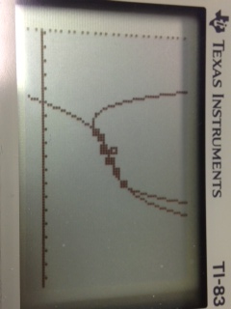
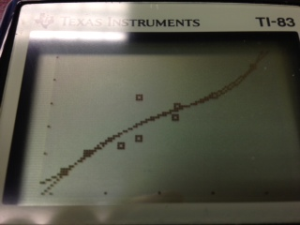
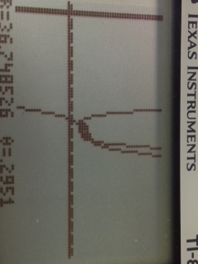
Regressions
Quartic and Cubic Regressions
R2 for Quartic =.8680
R2 for Cubic = .8657
Zoomed Middle
Zoomed In
Zoomed Out

Slide 4
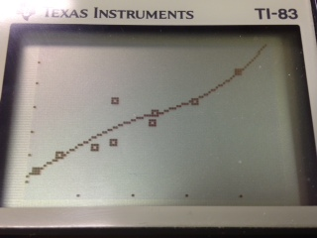
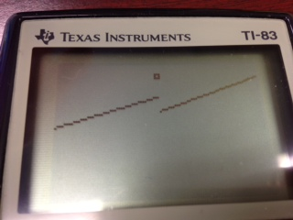
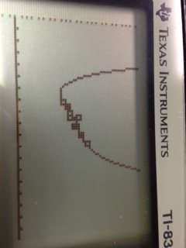
Limit
Split limit at 35.42
Quartic on the left
Cubic on the right
Zoomed Middle
Zoomed In
Zoomed Out

Slide 5
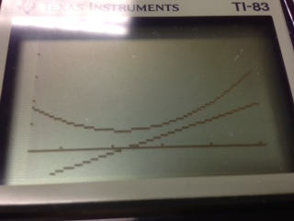
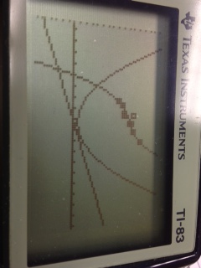
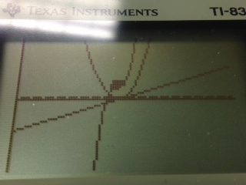
Derivative
Cubic regression
Relative Max/Min none. At no point is the 1st derivative 0
Absolute Max/Min is the ends of the regression
There is an inflection point at 35.22
No Max/Min Zoomed In
No Max/Min Zoomed Medium
No Max/Min Zoomed Out

Slide 6
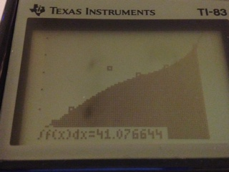
Integral
Total Value: Both number of restaurants and revenue can be added separately each year
Definite Integral
Quartic regression, integral (2nd calc 7)
37.12
f(x) dx
33.2

Slide 7
Error in Prediction
Using the Quartic Regression
Guess of 45 thousand restaurants
X=45, Y1=557.66 Y2=214.61
(214.61)(.005 billion) = 1.0735 billion/ 557.66 =
.19% error

Slide 8
Conclusions
Seems the more restaurants the more revenue
But other factors are in play
  Perhaps a popular ad campaign or food item could increase revenue without a need for increase of stores
  Pricing of items could increase or decrease revenues –changing customer patterns
  Avg. sales per restaurant decreasing, so at some point in the future potentially decrease in revenues even if increase in restaurants, contrary to the data-- same store sales important
3.9619 | 3.7302 | 3.6663 | 3.6192 | 3.3925 | 3.0682 | 3.2675 | 3.1922 | 2.9939
  Restaurant margin as a percentage of sales decreasing due to
    Supply chain issues (food issues such as the beef and higher food prices in general)
    Higher labor costs
  Cannibalization of population if too many of the same restaurant in the same area/ costs of maintaining these restaurants
    Ex. Starbucks closing of 600 stores in 2008

Slide 9
Questions?
Retro Taco Bell Ad
New Taco Bell Ad
Amy Mueller

