Slide 1


Slide 2
Technology in Action
Chapter 13
Behind the Scenes:
The Internet: How It Works
Notes:
This chapter takes you behind the scenes of the Internet. We look at how the Internet works and the various standards it follows. Along the way, we also go behind the scenes of some Internet communication features, such as e-mail and instant messaging services. We discuss just how safe these features are and what you can do to make your communications even more secure.

Slide 3
Chapter Topics
Managing the Internet
Interaction between Internet components
Internet data transmission and protocols
IP addresses and domain names
FTP and Telnet
HTML and XML
How e-mail and instant messaging work, and how to keep them secure
Notes:
Chapter topics include:
Managing the Internet
Interaction between Internet components
Internet data transmission and protocols
IP addresses and domain names
FTP and Telnet
HTML and XML
How e-mail and instant messaging work, and how to keep them secure

Slide 4
Management of the Internet
Who owns the Internet?
  Individuals
  Universities
  Government agencies
  Private companies
Who manages the Internet?
  Nonprofit organizations
  User groups
Who pays for the Internet?
  U.S. taxpayers
  Businesses
  Universities
  Other countries
Notes:
Although the U.S. government funded the development of the technologies that spawned the Internet, no one really owns it. The particular local networks that constitute the Internet are all owned by different individuals, universities, government agencies, and private companies. Many government entities and privately held companies own pieces of the communications infrastructure that makes the Internet work.
A number of nonprofit organizations and user groups, each with a specialized purpose, are responsible for managing the Internet.
The U.S. government pays for a large portion of the Internet infrastructure; it also funds research and development for new technologies. The primary source of these funds is your tax dollars. Originally, U.S. taxpayers footed the entire bill for the Internet, but as the Internet grew and organizations were formed to manage it, businesses, universities, and other countries began paying for Internet infrastructure and development.

Slide 5
Connecting to the Internet
Internet backbone
  Collection of large national and international networks
  Verizon, AT&T, Sprint Nextel, Qwest
T lines—initially used for backbone ISP connection
  Carried digital data over twisted pair wires
Optical carrier line (OC)—today’s most common backbone ISP connection
  High-speed, fiber-optic communications lines designed to provide high throughput
Notes:
The main paths of the Internet along which data travels the fastest are known collectively as the Internet backbone.
The backbone is a collection of large national and international networks, which are usually owned by commercial, educational, or government (such as NASA) organizations.
These backbone providers are required to be connected with other backbone providers and have the fastest high-speed connections. Some large companies that provide backbone connectivity are UUnet (now a division of Verizon), AT&T, Sprint Nextel, and Qwest.
Initially backbone ISPs connected through T lines. T lines carried digital data over twisted pair wires. T-1 lines were the first to be used and transmitted data at a throughput rate of 1.544 Mbps. One year later, T-3 lines were developed to transmit data at 45 Mbps. Today, backbones are typically high-speed, fiber-optic lines, designated as OC (optical carrier) lines. OC lines come in a variety of speeds.
Whereas most large ISPs connect to the Internet with OC-192 lines, AT&T has begun to use OC-768 connections in its Internet backbone network.

Slide 6
Connecting to the Internet
In the past
  Points of connection between ISPs
      Once known as network access points (NAPs)
      Designed to move large amount of data among networks
Now
  Private sector companies make up the Internet system
      Exchange data via Internet exchange points (IXPs)
      Typical IXP is made up of one or more network switches
Notes:
The points of connection between ISPs were once known as network access points (NAPs).
Network access points were designed to move large amounts of data quickly among networks.
Now, private sector companies that make up the Internet system exchange data via Internet exchange points (IXPs).
A typical IXP is made up of one or more network switches to which ISPs connect.
Switches are devices that send data on a specific route through the network.
By interconnecting directly to each other through IXPs, networks can reduce their costs and improve the speed and efficiency with which data is exchanged.

Slide 7
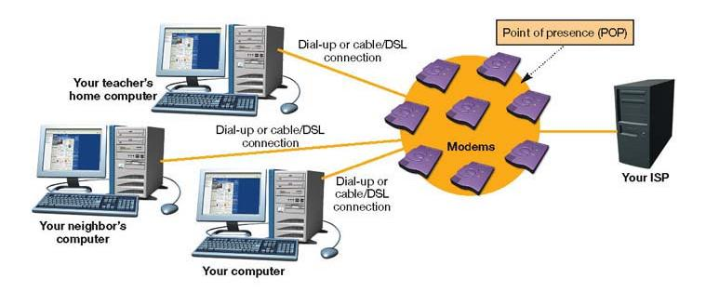
Points of Presence (POP)
Bank of modems where individual users connect to an ISP
Notes:
Whether dialing up through a conventional modem or connecting through high-speed access, individual Internet users enter an ISP through a point of presence (POP), which is basically a bank of modems through which many users can connect to an ISP simultaneously.
ISPs maintain multiple POPs throughout the geographic area they serve.

Slide 8
The Network Model of the Internet
Internet communications follow the client/server network model
Clients request services
Servers respond to requests
Notes:
The majority of Internet communications follow the client/server model of network communication.
Client computers request services, and servers provide those services to the clients.

Slide 9
The Network Model of the Internet
Types of servers
  Web servers
    Host Web pages
  Commerce servers
    Enable the purchase of goods and services over the Internet
  File servers
    Provide remote storage space for files that users
    can download
Notes:
There are various types of servers deployed on the networks that make up the Internet and from which clients can request services.
Web servers run specialized operating systems that enable them to host Web pages and provide requested Web pages to clients.
Commerce servers host software that enables users to purchase goods and services over the Web. These servers generally use special security protocols to protect sensitive information (such as credit card numbers) from being intercepted.
File servers are deployed to provide remote storage space or to act as a repository for files that users can download.

Slide 10
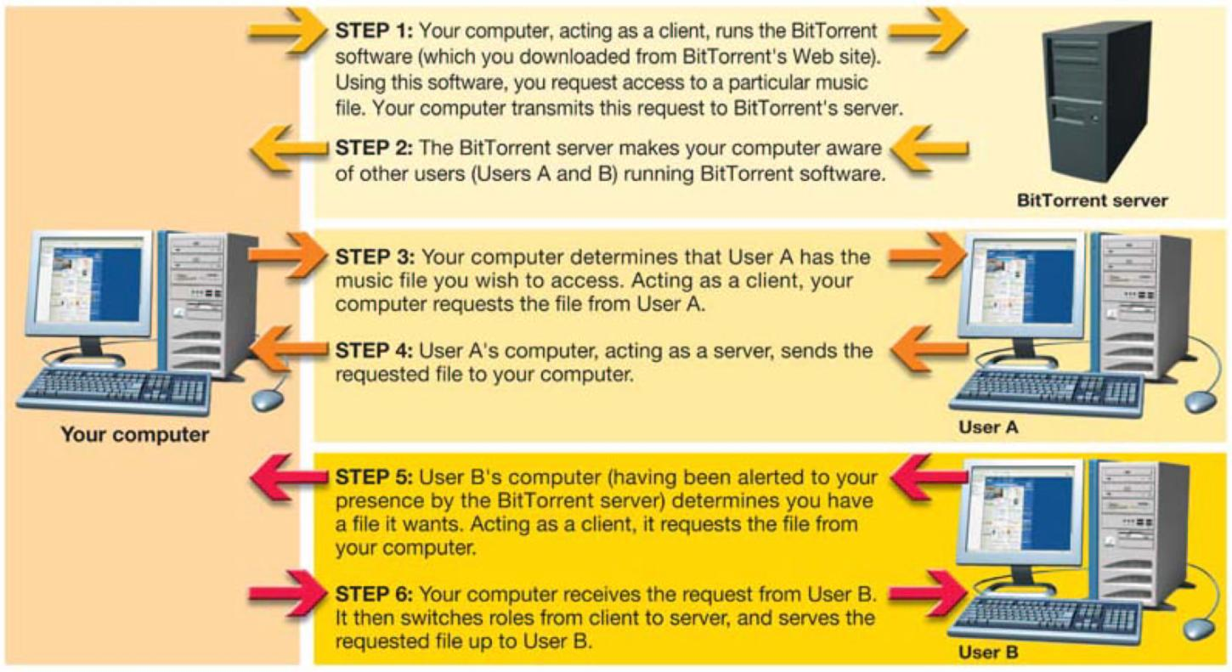
P2P File Sharing
Notes:
Certain services on the Internet operate in a peer-to-peer (P2P) mode.
For example, BitTorrent is a popular file-sharing service through which Internet users can exchange files. BitTorrent and other file-sharing services require the user’s computer to act as both a client and a server. When requesting files from another user, the computer behaves like a client. It switches to server mode when it provides a file stored on its hard drive to another computer.

Slide 11
Data Transmission and Protocols
Computer protocols are rules for electronic information exchange
Open system protocols
  Any computer can communicate with other computers using the same protocols
Notes:
The Internet follows standard protocols in sending information between computers.
To accomplish the early goals of the Internet, protocols needed to be written and agreed on by users. The protocols needed to be open systems, meaning that their designs would be made public for access by any interested party.

Slide 12
Circuit Switching
Dedicated connection between two points
Remains active until the transmission is terminated
Used in telephone communications
Inefficient for computers
Notes:
Agreeing on common standards was relatively easy. However, the tough part was developing a new method of communication because the current technology, circuit switching, was not efficient for computer communication.
In circuit switching, a dedicated connection is formed between two points, and the connection remains active for the duration of the transmission. This method of communication is extremely important when communications must be received in the order in which they are sent (such as in telephone conversations).
When applied to computers, however, circuit switching is inefficient. Computer processing and communication take place in bursts. As a computer processor performs the operations necessary to complete a task, it transmits data in a group (or burst). The processor then begins working on its next task and ceases to communicate with output devices or other networks until it is ready to transmit data in the next burst.
Circuit switching is inefficient for computers because the circuit either would have to remain open (and therefore be unavailable to any other system) with long periods of inactivity or would have to be reestablished for each burst.

Slide 13
Packet Switching
Data is broken into small units called packets.
Packets are sent over various routes to their destination.
Packets are reassembled by the receiving computer.
Packets contain
  Destination/source addresses
  Reassembling instructions
  Data
Notes:
Packet switching is the communications methodology that makes computer communication efficient.
Packet switching doesn’t require that a dedicated communications circuit be maintained. With packet switching, data is broken into smaller chunks (called packets) that are sent over various routes at the same time.
When the packets reach their destination, they are reassembled by the receiving computer.
Packet contents vary depending on the protocol being followed. At a minimum, all packets must contain (1) the address to which the packet is being sent, (2) reassembling instructions if the original data was split between packets, and (3) the data that is being transmitted.

Slide 14
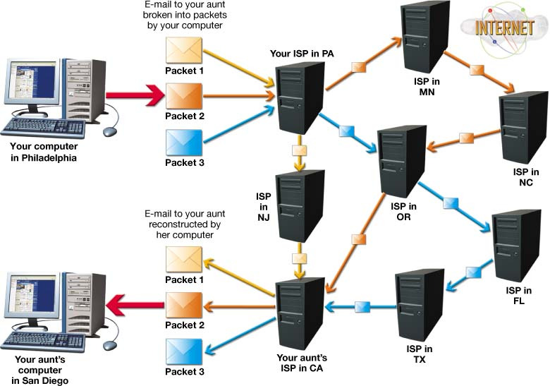
Packet Switching
Notes:
Packets can each follow their own route to their final destination. Sequential numbering of packets ensures that they are reassembled in the correct order at their destination.

Slide 15
TCP/IP
Transmission Control Protocol (TCP)
  Prepares data for transmission
  Provides error checking
  Enables resending lost data
Internet Protocol (IP)
  Responsible for sending data from one computer to another
Notes:
Although many protocols are available on the Internet, the main suite of protocols used is TCP/IP.
The suite is named after the original two protocols that were developed for the Internet: the Transmission Control Protocol (TCP) and the Internet Protocol (IP).
TCP prepares data for transmission and provides for error checking and resending lost data.
IP is responsible for sending the information from one computer to another.

Slide 16
IP Addresses
Unique number that identifies devices connected to the Internet
Typical IP address
  197.24.72.157
Static address
  Address never changes
Dynamic address
  Temporary address
Notes:
Each computer, server, or device connected to the Internet is required to have a unique identification number that defines it.
A typical IP address is expressed as a dotted decimal number or a dotted quad.
IP addresses are assigned either statically or dynamically.
Static addressing means that the IP address for a computer never changes and is most likely assigned manually by a network administrator.
In dynamic addressing, your computer is assigned a temporary address from an available pool of IP addresses.

Slide 17
Having Enough IP Addresses
IPv4 addressing scheme didn’t foresee explosive growth
CIDR (Classless Inter-Domain Routing)
  Allows a single IP address to represent several unique addresses
  Uses a network prefix (slash and number)
  Identifies how many bits in the IP address are unique identifiers
Notes:
When the original IP addressing scheme, Internet Protocol version 4 (IPv4), was created in the early 1980s, no one foresaw the explosive growth of the Internet that occurred in the 1990s.
Four billion values seemed like enough. As the Internet grew, it became apparent that we were going to run out of IP addresses.
Classless Inter-Domain Routing (CIDR, pronounced “cider”), or supernetting, was developed.
CIDR allows a single IP address to represent several unique IP addresses by adding a network prefix (a slash and a number).
The network prefix identifies how many of the possible 32 bits in a traditional IP address are to be used as the unique identifier, leaving the remaining bits to identify the specific host.

Slide 18
Having Enough IP Addresses
Internet Protocol version 6 (IPv6)
  Longer IP addresses
  Easier for non-PC devices to connect to the Internet
Notes:
Internet Protocol version 6 (IPv6) is a proposed IP addressing scheme (developed by the Internet Engineering Task Force, or IETF) that makes IP addresses longer, thereby providing more available IP addresses. IPv6 uses eight groups of 16-bit numbers, referred to as hexadecimal notation (or hex for short).

Slide 19
Domain Names
Names that take the place of an IP address
Sample domain name:
  www.mywebsite.com
Top-level domains (TLD)
  Portion of the domain name that follows the dot
  Sample top-level domain names
    .com, .org, .edu, and .net
Second-level domains
  Unique name within a top-level domain
  Sample second-level domain names
    Yahoo.com, Google.com, and Unesco.org
Notes:
A domain name is simply a name that takes the place of an IP address, making it easier for people to remember. For example, mywebsite.com is a domain name.
Domains are organized by level. The portion of the domain name farthest to the right (after the dot) is the top-level domain (TLD). TLDs (such as .com and .org) are standardized pools established by ICANN.
Within the top-level domains are many second-level domains. In the .com domain, there are popular sites such as Amazon.com, Google.com, and Microsoft.com. Each of the second-level domains needs to be unique within that particular domain, but not necessarily unique to all top-level domains. For example, Mycoolsite.com and Mycoolsite.org could be registered as separate domain names.

Slide 20
Domain Name Servers
Internet servers that translate domain names into IP addresses
ISPs go first to a default DNS to resolve a name
Name queries work up the hierarchy to the root DNS servers if required
Notes:
Say you want to get to Yahoo.com. To do so, you type the URL www.yahoo.com into your browser. When you enter the URL, your computer must convert it to an IP address. To do this, your computer consults a database maintained on a DNS server, which functions like a phone book for the Internet.
Your ISP’s Web server has a default DNS server that it goes to when it needs to translate a URL to an IP address.
If it can’t find it, it contacts one of the many root DNS servers maintained throughout the Internet. The root DNS servers know the location of all the DNS servers that contain the master listings for an entire TLD. Your default DNS receives the information from the master DNS (say, for the .com domain), stores that information in its cache for future use, and communicates the appropriate IP address to your computer.

Slide 21
Other Protocols
File Transfer Protocol (FTP)
  File-sharing protocol
  Files are downloaded and uploaded using
  the Internet
Telnet
  Protocol for connecting to a remote computer and a TCP/IP service
  Enables a client computer to control a server computer
Notes:
Other commonly used protocols on the Internet are the File Transfer Protocol and Telnet.
File Transfer Protocol (FTP) enables users to share files that reside on local computers with remote computers. If you’re attempting to download files using FTP to your local computer, the FTP client program first establishes a TCP session with the remote computer.
Telnet is both a protocol for connecting to a remote computer and a TCP/IP service that runs on a remote computer to make it accessible to other computers. Telnet enables you to take control of a remote computer (the server) with your computer (the client) and manipulate files and data on the server as if you were sitting in front of that server.

Slide 22
HTTP and SSL
Hypertext Transfer Protocol (HTTP)
  Protocol for transferring hypertext documents
  Hypertext documents are linked to other documents (through hyperlinks)
Secure Hypertext Transfer Protocol
(S-HTTP)
Secure Socket Layer (SSL)
  Security protocols that protect sensitive information
  Encrypts data
Notes:
Hypertext Transfer Protocol (HTTP) was created especially for the transfer of hypertext documents across the Internet.
Secure Hypertext Transfer Protocol (S-HTTP) is an extension to the HTTP protocol that supports sending data securely over the Web.
Secure Sockets Layer (SSL) provides for the encryption of data transmitted using TCP/IP protocols such as HTTP. All major Web browsers support SSL.

Slide 23
HTML/XHTML
Hypertext Markup Language (HTML)
  Tags that describe the formatting and layout of a Web page
Extensible Hypertext Markup Language (XHTML)
  Successor to HTML
  Has much more stringent rules regarding tagging
HTML/XHTML
  Not programming languages but sets of rules for marking up blocks of text so that a browser knows how to display them
Notes:
A Web page is merely a text document that is formatted using the Hypertext Markup Language (HTML).
The current version of HTML is called the Extensible Hypertext Markup Language (XHTML). XHTML has much more stringent rules than HTML regarding tagging (for instance, all elements require an end tag).
XHTML is the development environment of choice for Web developers today, although many people still refer to Web site formatting as HTML tagging.
HTML/XHTML are not programming languages; rather, they are sets of rules for marking up blocks of text so that a browser knows how to display them.

Slide 24

HTML/XHTML Example
HTML/XHTML
Web Page Display
<h1>This is the Heading</h1>
<p><font face="Arial">This is text using Arial font.</font></p>
<p><font face="Arial"><i>This text is italicized</i>.</font></p>
<p><font face="Arial"><b>This text is bold</b>.</font></p>
<p><font face="Arial"><font color="#FF0000">This text color is red</font>.</font></p>
<p><font face="Arial">This is a hyperlink <a href="http://vig.prenhall.com/">
www.prenhall.com</a></font></p>
Notes:
Here you see an example of HTML/XHTML tags and what they produce.

Slide 25
Extensible Markup
Language (XML)
Designed for information exchange
Tools used to create your own markup language
Used in e-commerce transactions
Notes:
Because HTML/XHTML is not designed for exchanging information, XML is used.
Extensible Markup Language (XML) is a set of tools you can use to create your own markup language. Instead of being locked into standard tags and formats for data, users can build their own markup languages to accommodate particular data formats and needs.
XML has spawned quite a few custom packages for specific communities. For example, Mathematical Markup Language (MathML) is an XML-based markup language used to describe mathematical symbols and formulas so that they can be presented in a familiar way in Web documents. Wireless Markup Language (WML) uses XML to output Web resources on mobile devices.

Slide 26
Common Gateway
Interface (CGI)
Browsers request that a program file executes (runs)
CGI files are often called CGI scripts
Adds Web page interaction
  Adding names to guest books/mailing lists
  Completing forms
Notes:
The Common Gateway Interface (CGI) provides a methodology by which your browser can request that a program file be executed (or run) instead of just being delivered to the browser. This enables functionality beyond the simple displaying of information.
CGI files can be created in almost any programming language. The programs created are often referred to as CGI scripts.
Almost any task can be accomplished by writing a CGI script, such as creating a guest book or other form on a Web page.

Slide 27
Dynamic HTML
A combination of technologies
  HTML/XHTML
  Cascading style sheets
  JavaScript
Allows a Web page to change in response to user action
Brings special effects to otherwise static Web pages
Notes:
Dynamic HTML (DHTML) is a combination of technologies—HTML/XHTML, cascading style sheets, and JavaScript—used to create lively and interactive Web sites.
The Web is based on a client/server network. Once a Web server processes a Web page and sends the page to the computer requesting it (the client), the receiving computer cannot get any new data from the server unless a new request is made. When interactivity is required on a Web page, this exchange of data between the client and server can make the interactivity inefficient and slow. DHTML technologies allow the Web page to change after it’s been loaded, generally in response to user actions such as clicking a mouse or mousing over objects on a page.
DHTML brings special effects to otherwise static Web pages without the need to download and install plug-ins or other special software.

Slide 28
Cascading Style Sheets
Statements that define in one single location how to display HTML/XHTML elements
Enable a Web developer to define a style for each HTML/XHTML element
  The rule may be applied to as many elements on as many Web pages as needed
  Speeds up global changes
Notes:
Cascading style sheets (CSS) are lists of statements (also known as “rules”) that define in one single location how to display HTML/XHTML elements. Style rules enable a Web developer to define a style for each HTML/XHTML element and apply it to as many elements on as many Web pages as needed. Then, when a global change is necessary, only the style on the style sheet needs to be changed, and all the elements in the Web document are updated automatically.
There are different layers of styles (external, embedded, and inline), so it’s possible that different rules can be created for the same type of element. In other words, in an external style sheet, there might be a rule that defines the background color for all paragraphs as blue. But somewhere else, in an embedded style sheet, the rule for background color for paragraphs might be defined as white, and in an inline style sheet, the background color might be light pink. Eventually, all these style sheets must be merged to form one style sheet for the document, creating conflicts between rules.

Slide 29
Document Object Model
Organizes the objects and elements of a Web page
Defines every item on a Web page as an object
Developers can easily change the properties of these objects
Notes:
Just as cascading style sheets organize and combine the attributes of the objects in a Web page, DHTML uses the Document Object Model (DOM) to organize the objects and page elements. The document object model defines every item on a Web page—such as graphics, tables, and headers—as an object. Then with DOM, similar to with CSS, Web developers can easily change the properties of these objects.

Slide 30
Client-Side Applications
Programs that run on a client computer with no interaction with the server
Types of client-side applications include
  HTML/XHTML document embedded with JavaScript code
  Applet: Small program that resides on the server
Notes:
A client-side application is a computer program that runs on the client and requires no interaction with a Web server. Client-side applications are fast and efficient because they run at your desktop and don’t depend on sending signals back and forth to the Web server.
Two main types of client-side methods exist.
The first involves embedding programming language code directly within the HTML/XHTML code of a Web page using an HTML/XHTML embedded scripting language.
The second type of client-side application is an applet, a small program that resides on a server. When requested, a compiled version of the program is downloaded to the client computer and run there.

Slide 31
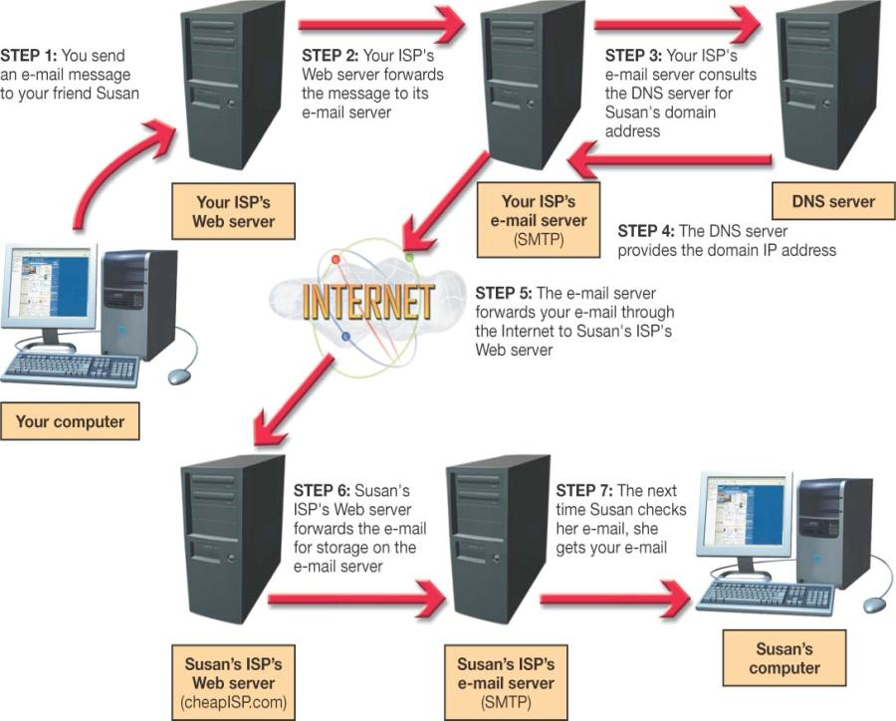
Communications Over the Internet
E-mail
  Simple Mail Transfer Protocol (SMTP)
  Multipurpose Internet Mail Extensions (MIME)
Notes:
Just like other kinds of data that flow along the Internet, e-mail has its own protocol. The Simple Mail Transfer Protocol (SMTP) is responsible for sending e-mail along the Internet to its destination.
The Multipurpose Internet Mail Extensions (MIME) specification was introduced in 1991 to simplify adding attachments to e-mail messages. All e-mail client software now uses this protocol for attaching files.

Slide 32
Communications Over the Internet
E-mail security
  Encryption
    Private-key encryption
    Public-key encryption
  Secure data transmission software
    SafeMessage
Notes:
E-mail is susceptible to being read by unintended parties, and copies of your e-mail message may exist (temporarily or permanently) on numerous servers as it makes its way through the Internet. Two options exist for protecting your sensitive e-mail messages: encryption and secure data transmission software.
Encryption refers to the process of coding your e-mail so that only the person with the key to the code (the intended recipient) can decode (or decipher) and read the message. There are two basic types of encryption: private-key and public-key.
In private-key encryption, only the two parties involved in sending the message have the code. The main problem with private-key encryption is key security. If someone steals a copy of the code, the code is broken.
In public-key encryption, two keys, known as a key pair, are created. You use one key for coding and the other for decoding. The key for coding is generally distributed as a public key. You can place this key on your Web site, for instance. Anyone wishing to send you a message codes it using your public key. When you receive the message, you use your private key to decode it. You are the only one who ever possesses the private key, and therefore it is very secure.
Using encryption doesn’t always solve the other problems associated with e-mail. Companies have developed secure data transmission software (called SafeMessage), which works outside SMTP mail servers.

Slide 33
Instant Messaging (IM)
Client/server program for real-time, text-based conversations
Popular IM programs
  AOL Instant Messenger
  ICQ
  Yahoo! Messenger
  Windows Live
Increasing security threats
  Should not be used for sensitive data
Notes:
Instant messaging (IM) is another client/server application. AOL Instant Messenger, ICQ, Yahoo! Messenger, and Windows Live are the top four instant messaging applications in use today.
The client software running on your computer makes a connection with the chat server, using your Internet connection. Once contact is established, you can log in to the server with your name and password. The client software provides the server with connection information for your computer. The server then consults the list of contacts that you have previously established in your account and checks to see if any of your contacts are online. If any are, the server sends a message back to your client providing the necessary connection information (the IP addresses) for your friends. You can now click your friends’ names to establish a chat session with them.
Instant messaging security threats have increased recently. Sensitive information should not be sent using IM.

Slide 34
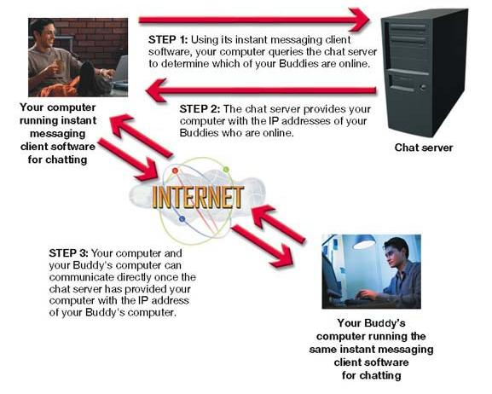
Instant Messaging (IM)
Notes:
Instant messaging (IM) is another client/server application. AOL Instant Messenger, ICQ, Yahoo! Messenger, and Windows Live are the top four instant messaging applications in use today.
The client software running on your computer makes a connection with the chat server, using your Internet connection. Once contact is established, you can log in to the server with your name and password. The client software provides the server with connection information for your computer. The server then consults the list of contacts that you have previously established in your account and checks to see if any of your contacts are online. If any are, the server sends a message back to your client providing the necessary connection information (the IP addresses) for your friends. You can now click your friends’ names to establish a chat session with them.
Instant messaging security threats have increased recently. Sensitive information should not be sent using IM.

Slide 35
Voice Over Internet (VoIP)
Allows free long-distance phone calls over the Internet
Some cell phones are VoIP enabled
  Customers must be able to connect to a WiFi signal
Notes:
Voice over Internet Protocol (VoIP) turns a standard Internet connection into a way to make free long-distance phone calls. If you have friends or relatives that live a long-distance phone call away from you, then you need to know more about VoIP. From a user’s perspective, the true advantage (at least right now) is that the service is free. Even some cell phones are VoIP-enabled. T-Mobile’s HotSpot@Home service allows customers to make cell phone calls over a VoIP network as long as the device can connect to a WiFi signal. When a WiFi signal is not detected, the cell phone makes the call through your usual cellular network.
Like e-mail, VoIP uses packet switching as the method of transferring data. Unlike circuit switching (the method used with traditional phone calls), when a VoIP call is made, the transmission lines are used only when the two computers are communicating, thus allowing the computers to accept and process other information.

Slide 36
Chapter 13 Summary Questions
Who manages and pays for the Internet?
Notes:
Who manages and pays for the Internet?

Slide 37
Chapter 13 Summary Questions
How do the Internet’s networking components interact?
Notes:
How do the Internet’s networking components interact?

Slide 38
Chapter 13 Summary Questions
What data transmissions and protocols does the Internet use?
Notes:
What data transmissions and protocols does the Internet use?

Slide 39
Chapter 13 Summary Questions
Why are IP addresses and domain names important for Internet communications?
Notes:
Why are IP addresses and domain names important for Internet communications?

Slide 40
Chapter 13 Summary Questions
What are FTP and Telnet, and how do I use them?
Notes:
What are FTP and Telnet, and how do I use them?

Slide 41
Chapter 13 Summary Questions
What are HTML and XML used for?
Notes:
What are HTML and XML used for?

Slide 42
Chapter 13 Summary Questions
How do e-mail, instant messaging, and Voice over Internet Protocol work, and how is information using these technologies kept secure?
Notes:
How do e-mail, instant messaging, and Voice over Internet Protocol work, and how is information using these technologies kept secure?

Slide 43
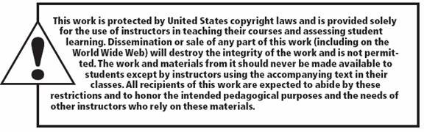
All rights reserved. No part of this publication may be reproduced, stored in a retrieval system, or transmitted, in any form or by any means, electronic, mechanical, photocopying, recording, or otherwise, without the prior written permission of the publisher. Printed in the United States of America.
Copyright © 2010 Pearson Education, Inc.
Publishing as Prentice Hall
43

