Slide 2
Preparing for the Marathon Study Strategies - NCLEX Prep
Review, Practice, Review
Right Now - Focus on:
Hesi Remediation
Hesi Case Studies
In school: 50-100 Practice Questions/week
Upon Graduation: 100 questions/day

Slide 3
NCLEX Prep – the Exam
NCLEX Test
Number of questions
75 questions at a minimum to 265 at a maximum
Includes 15 pilot questions
Time of test
6 hours given to test
Applicants are given a break after 2 hrs, after 3.5 hrs
Cost of the Test
$200 / $60 / $200 / + the review course

Slide 4
NCLEX Prep – Exam Composition April 2013
Needs Percentage of Questions
Safe and Effective Care Environment
Management of Care 17-23%
Safety and Infection Control 9-15%
Heath Promotion and Maintenance 6-12%
Psychosocial Integrity 6-12%
Physiological Integrity
Basic Care and Comfort 6-12%
Pharmacological and Parenteral Therapies 12-18%
Reduction of Risk Potential 9-15%
Physiological Adaptation 11-17%

Slide 5
Safety and Infection Control
Defn: protecting clients and health care personnel from health and environmental hazards.
Related content includes but is not limited to:
Accident/Error/Injury Prevention
Emergency Response Plan
Safe Use of Equipment
Security Plan
Ergonomic Principles
Standard Precautions/Transmission- Based Precautions/Surgical Asepsis
Handling Hazardous and Infectious Materials
Home Safety
Reporting of Incident/Event/Irregular Occurrence/Variance
Use of Restraints/Safety Devices

Slide 6
Reduction of Risk Potential -
Defn: reducing the likelihood that clients will develop complications or health problems related to existing conditions, treatments or procedures.
Related content includes but is not limited to:
Changes/Abnormalities in Vital Signs
Diagnostic Tests
Laboratory Values
Potential for Complications from Surgical Procedures and Health Alterations
System Specific Assessments
Potential for Alterations in Body Systems
Therapeutic Procedures
Potential for Complications of Diagnostic Tests/Treatments/Procedures

Slide 7
Integrated Processes
The following processes integrated throughout the Client Needs categories:
 Nursing Process – a scientific, clinical reasoning approach to client care that includes assessment, analysis, planning, implementation and evaluation.
 Caring – interaction of the nurse and client in an atmosphere of mutual respect and trust. In this collaborative environment, the nurse provides encouragement, hope, support and compassion to help achieve desired outcomes.
 Communication and Documentation – verbal and nonverbal interactions between the nurse and the client, the client’s significant others and the other members of the health care team. Events and activities associated with client care are recorded in written and/or electronic records that demonstrate adherence to the standards of practice and accountability in the provision of care.
 Teaching/Learning – facilitation of the acquisition of knowledge, skills and attitudes promoting a change in behavior.

Slide 9
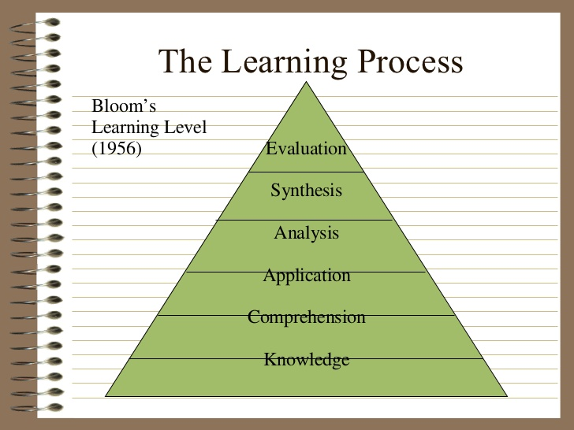

Slide 16
NCLEX Prep – Practice Questions
Test-taking Strategies:
Key Words –
Absolute - Never/Always
Priority – do first, assess first, see first
Identify the type of stem:
True Response stem – positive key words
False Response stem – negative key words
Similar Distractors:
When two options essentially say the same thing – neither can be correct – eliminate both options
Global Distractor: General statement that includes the ideas of the other options.

Slide 17
Testing –Taking Recommendations
Watch out for the words: except, always, never
Answer each question.
Get a good night's sleep before any test!
Practice with a watch and bring a watch to the test.
Study for each material section of the content –focus on the objectives of the course.
Focus on areas in which you are weak!
Don't cram! Train every day!
Work through many practice tests along the way.
Lots more – see Hand Out!!

Slide 18
Test-Taking Strategies
Composition of a question:
Case Scenario: describes a clinical situation.
Stem – asks you to select the best answer.
Options:
3 distractors THEY ARE ALL GOOD ONES!!
1 correct or best answer

Slide 19
Test-Taking Strategies
Looks for key words in each question
All distractors may be correct – select the Best Response!
Most likely (avoid responses with never, always)
Assessment always comes first
Priority Action

Slide 20
Types of Questions on NCLEX Multiple Choice
Decide the type of question:
Triage, Complication, Priority
-Try to answer without looking at the options.
Eliminate wrong options, then look for clues among the remaining options.
Focus on the client.
Select Nursing actions, Not Physician actions

Slide 21
NCLEX Prep – Fill in the Blank
Problem/situation is stated
Student must type in the correct answer
Math
Calculating intake and output
There is a calculator on the computer

Slide 22
NCLEX Prep – Picture or Graph
Hot Spot
Identify correct area on picture
Locate Point of Maximal Impulse
Locate correct site for Intramuscular injection on a 6-month old
Locate carotid pulse

Slide 23
NCLEX Prep Drag and Drop
Requires the candidate to rank order or move options to provide the correct answer
Ex: Place steps of procedure in order or Place clients in priority

Slide 24
NCLEX Prep – Audio Clips
Using Head Phones you will be asked to identify “sounds”
EX: Breath sounds:
Crackles / rales
Wheezes
rhonchi

Slide 25
Knowledge-based Question
When do coronary arteries primarily receive blood flow?
a. During inspiration
b. During diastole
c. During expiration
d. During systole

Slide 26
Comprehension-based Question
Exceeding which of the following serum cholesterol levels significantly increases the risk of coronary artery disease?
a. 100 mg/dl
b. 150 mg/dl
c. 175 mg/dl
d. 200 mg/dl

Slide 27
Application-based Question
Which of the following actions is the first priority care for a client exhibiting signs and symptoms of coronary artery disease?
a. Decrease anxiety
b. Enhance myocardial oxygenation
c. Administer sublingual nitroglycerin
d. Educate the client about his symptoms

Slide 28
Analysis-based Question
The nurse suspects left-sided heart failure in a newly admitted client when the nurse notes which of the following symptoms? (Multiple Response question).
A) Distended neck veins
B) Bilateral crackles in the lungs
C) Weight gain of 2 lb in past 2 days
D) Shortness of breath, especially at night

Slide 32
Study Strategies to
Reduce Test Anxiety
Test anxiety is when a student excessively worries about doing well on a test.
This type of anxiety is more than the average anxiety all students may experience from time to time.
Severe text anxiety can become a major hindrance on test performance and cause extreme nervousness and memory lapses, among other symptoms.

Slide 33
Recognizing Test Anxiety
§ Freezing up
§ Panicking
§ Being easily distracted
§ Physical effects; sweating, shortness of breath
§ Lack of interest in test or topic

Slide 34
How to Combat Text Anxiety
Being well prepared for a test is the best way to reduce test anxiety.
Space out your studying over a few days or weeks - continually review class material.
Don‟t wait until the night before to try to learn all the material.
Try to maintain a positive attitude while preparing for the test and during the test.
Exercise to reduced stress – low impact aerobic exercise.
Get a good night’s sleep during the entire semester and before the test.
Stay relaxed. If you begin to get nervous take a few deep breaths slowly to relax yourself and then get back to work.
Read the directions slowly and carefully.
Make certain you understand the direction of any test.

Slide 35
How to Combat Text Anxiety
Skim through the test so that you have a good idea how to pace yourself.
Write down important formulas, facts, definitions and/or keywords in the margin.
Do the simple questions first to help build up your confidence for the harder questions
Don‟t worry about how fast others finish their test; just concentrate on your own test
If you don’t know a question, skip it. Go back to it later if you have time,.
You don’t have to always get every question right to do well on the test.
Focus on the question at hand; don’t let your mind wander onto other things.
If you believe you suffer from severe test anxiety, you need to address the issue immediately, preferably before the start of the semester.

Slide 36
Keep Focused

Slide 37
Thanks!
These slides were developed through original research as well as content from study strategies of
Caralee Bromme, RN, MSN, CCRN

