Slide 1
NRS 231 Course Orientation
Fall 2013

Slide 2
Course Faculty
Professor Lori Kelty ( Course Coordinator, Lecture, College Lab and Simulation Clinical instructor A & B sessions)
Professor Elizabeth Mizerek (A & B Session Simulation Clinical Instructor)
Professor Jennifer Bischoff (B session Simulation Clinical Instructor)
Professor Sue Tronto (Online course Simulation Clinical Instructor)
Professor Brenda Rosenberg (Online course lab instructor)

Slide 3
Course Documents
NRS 231 Course Outline and Lab Manual (updated documents will be available at www.mccc.edu/nursing under NRS 231). Please print only the Fall 2013 documents.
Please read both documents carefully prior to the first class.

Slide 4
Course Concepts
Week 1: Alterations in Sensory Perception (Spinal Cord Injury)
Week 2: Alterations in Intracranial Regulation (Traumatic Brain Injury)
Week 3: Alterations in Tissue Perfusion (Burn Injury)
Week 4: Safety (Emergency Preparedness & Bioterrorism).

Slide 5
Course Requirements
NRS 231
3 in class quizzes (Weeks 1, 2 & 4)
Midterm exam (Week 3) (Tuesday
Final exam (Week 5)
Weekly Clinical Journal (Based on simulation experiences)
Completion of 5 assigned evolve case studies
Completion of HESI Pediatric Exam
Score of 90% or better on Dosage Calculation exam (given in first week’s simulation clinical)

Slide 6
NRS 231 Simulation Lab
All clinical simulations for A and B sessions will be held in MS 214 or MS 334 (Start time determined by clinical instructor)
There is no hospital clinical in this course
Required to wear uniform to simulation and follow all program requirements for clinical dress code and code of conduct policies.
Weekly simulation experiences focus on specific concept exemplars.
Complete prep for each week’s learning experience
Journal will focus on simulation experience.
Rubric for journal grading
Bring Silverstri NCLEX-RN prep book to sim clinical every week

Slide 7
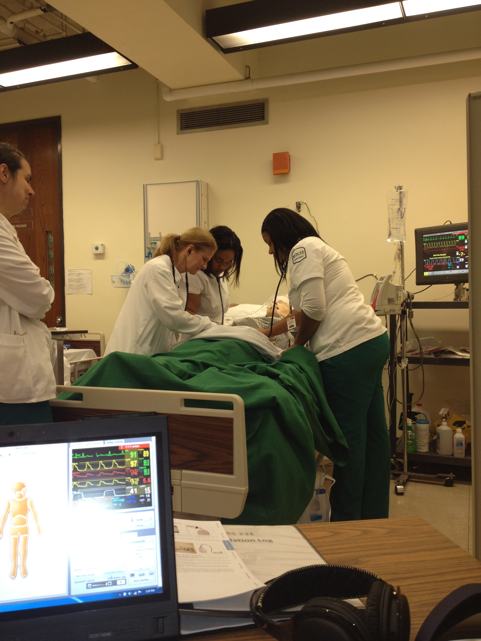

Slide 8
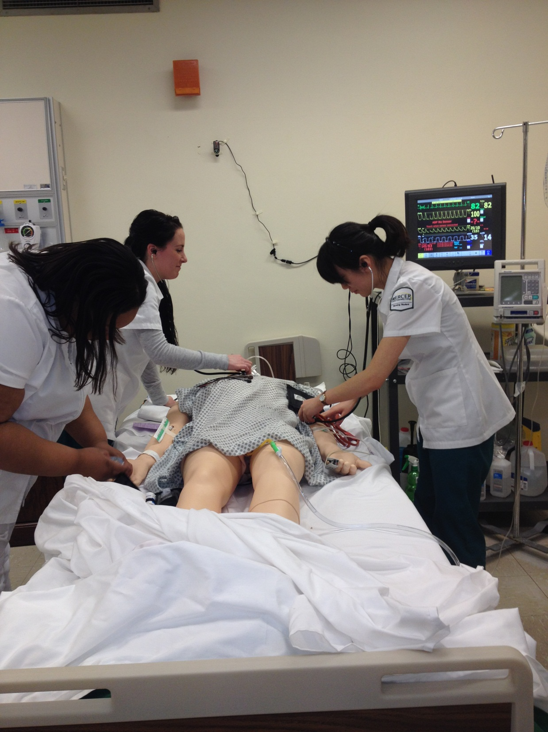

Slide 9
NRS 231 Observation Experiences
St. Barnabas Burn Unit:
A Session date Thursday 9/12 5pm
B Session date: Friday 10/18 pm 5pm
There are no make-up dates.
RWJ Hamilton Emergency Room Observation: Student will schedule a 8 hour observation with Professor Kelty during the first lecture class
Both observations are MANDATORY for all NRS 231 students (Land & Online)

Slide 10
Evolve case studies
Students are required to compete weekly case study as assigned in course outline.
Grade for case study will flow from the first attempt grade received.
Average of 5 case studies will count as 5% of course grade
Use course ID in which you originally enrolled in evolve
Keep up with weekly case study assignments per course outline

Slide 11
Test Blueprint
NCLEX Client Needs Categories
Safe & Effective Care Environment
Health Promotion & Maintenance
Psychosocial Integrity
Physiological Integrity
Nursing Process
Cognitive Levels: Knowledge, Comprehension, Application, Analysis
NCSBN NCLEX-RN Detailed Test Plan – https://www.ncsbn.org/2013_NCLEX_RN_Detailed_Test_Plan_Candidate.pdf

Slide 12
HESI Pediatric Exam
All NRS 231 students will take the Peds HESI web exam as follows:
Session A: Date and Location TBA
Session B: Date and Location TBA
HESI Pediatric Practice Test must be completed before you sit for Pediatric HESI exam.

Slide 13
Dosage Calculation
All students will need to pass (90%) the Dosage Calculation/Medication Math exam which will be administered during the first simulation clinical session for NRS 231
Guidelines on how to prepare for the exam can be found in the NRS 231 College Lab/Simulation Manual

Slide 14
Final Exam NRS 231
A session: Date and location TBA
B session: Date and location TBA
There is no new content presented in week 5. The pediatric HESI exam will be given during week 5

Slide 15
Lecture Slides
Lecture slides will be available via the ANGEL NRS 231 course shell (accessed via MercerOnline)
You will have access to audio-enhanced slides as an additional resource.
If you print the slides as handouts, it is recommended that you print them as 3 slides per page to save paper.

Slide 16
Things to Know
Health Forms (if you have outstanding health records, please turn them into Stephanie Horner ASAP)
Special Accommodations Forms (Please turn into Professor Kelty ASAP)
Attendance will be taken at each class session, please be on time for class
Please bring iclickers to lecture and PDA’s to simulation clinical

Slide 17
Start Prepping for NCLEX Now
NCLEX style questions in Silverstri book
Form study groups
Utilize 2013 NCLEX-RN Detailed Test Plan
HESI Case Studies and Practice Tests
Take a NCLEX Prep Course (Kaplan vs Hurst)
Have a plan after you graduate- success on NCLEX should be your main focus.
Do Questions, Questions, Questions!

Slide 18

Questions

Slide 19
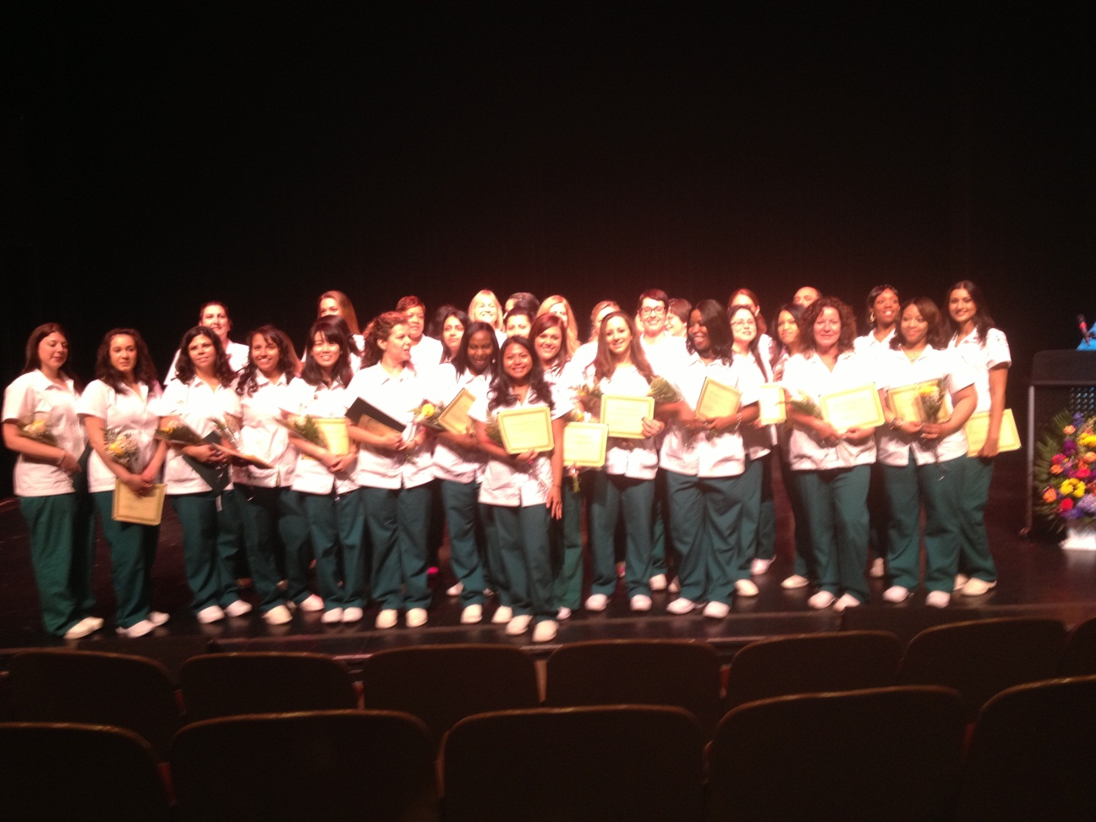
Have a great semester!

