Slide 1
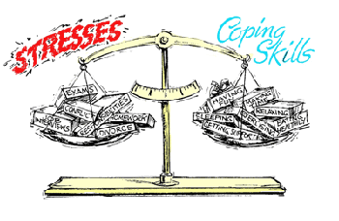
Concepts of Mental Health Nursing
Week 1
Stress and Coping

Slide 2
Concept Definitions
Stress: the body’s reaction to any stimulus in the environment that demands change or disrupts homeostasis.
Coping: An individual’s response to one or more stressors and his or her attempt to restore homeostasis (also referred to as stress response)
Stressor: Stimulus provoking the demand for change
Homeostasis: a state of dynamic balance of the human body’s internal environment, which is always adjusting in response to internal and external changes.

Slide 3
Stress & Coping Exemplars
Anxiety Disorders
Obsessive-Compulsive Disorder (OCD)
Phobias
Post-Traumatic Stress Disorder

Slide 4
Stress Model Review
Stimulus-Based Models
Response-Based Models
General Adaptation Syndrome
Local Adaptation Syndrome
Alarm Reaction
Resistance
Exhaustion

Slide 5
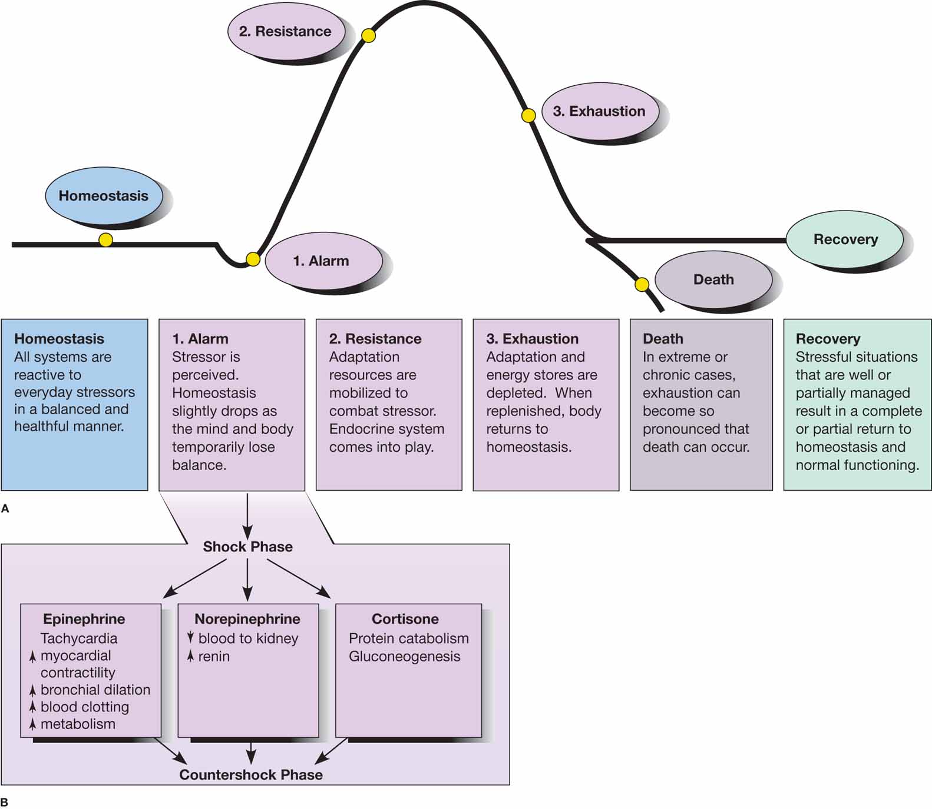
Figure 28-1 The three stages of adaptation to stress: the alarm reaction, the stage of resistance, and the stage of exhaustion. Source: Part A is from Wellness: Concepts and application, 6th ed. (p. 298) by D.J. Anspaugh, M. Hamrick, and F.D. Rosato, 2005, New York; McGraw-Hill. Reprinted with permission.

Slide 6
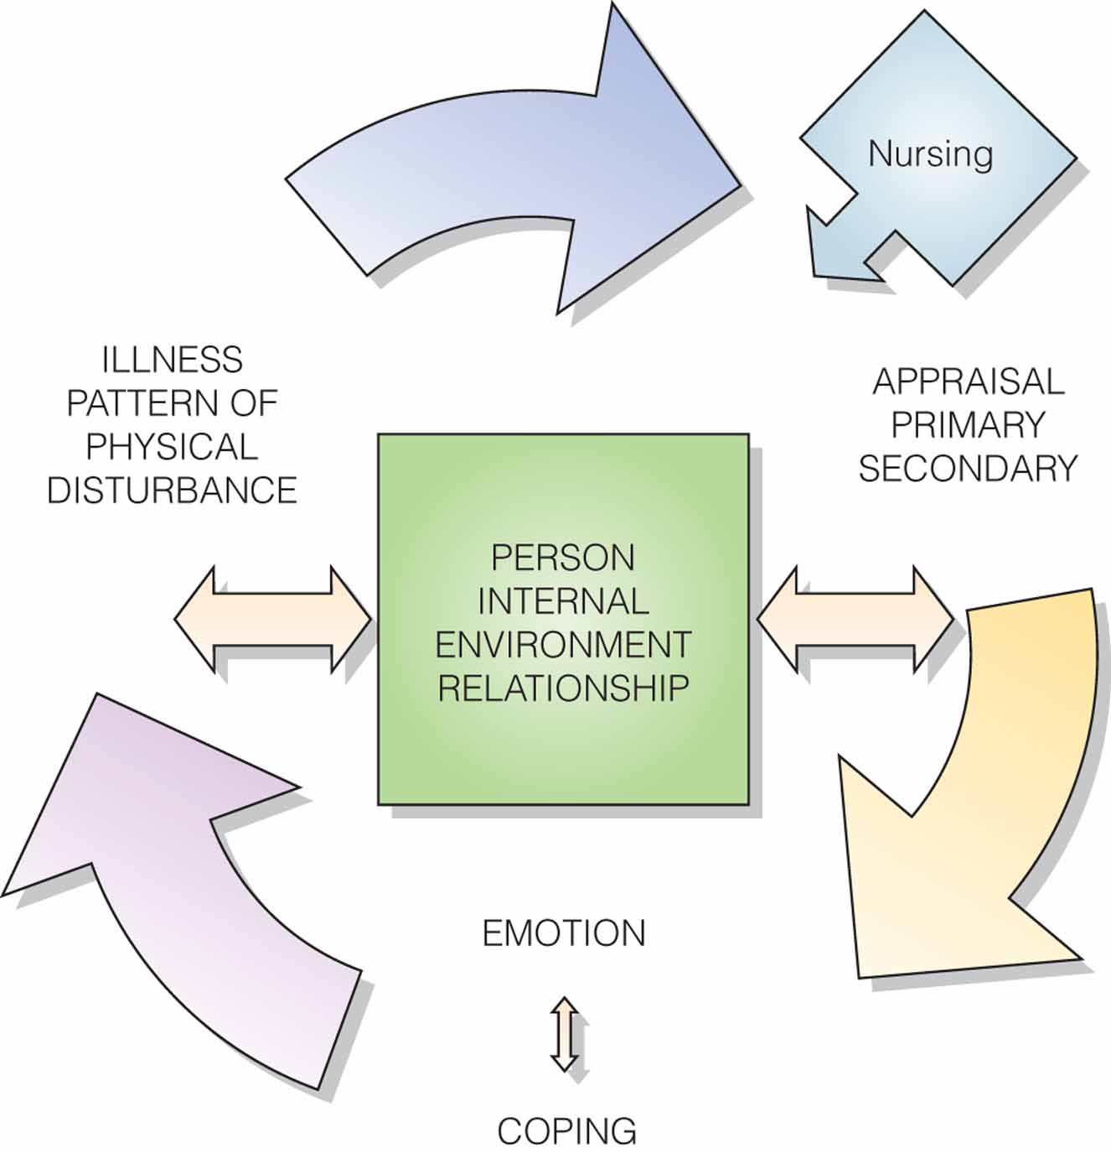
Figure 28-2 The nursing transactional model.

Slide 7
Stressors
Acute and time limited
Sequential events following an initial stressor
Chronic intermittent
Chronic permanent
Developmental
Environmental
Daily Hassel
Internal Stressors

Slide 8
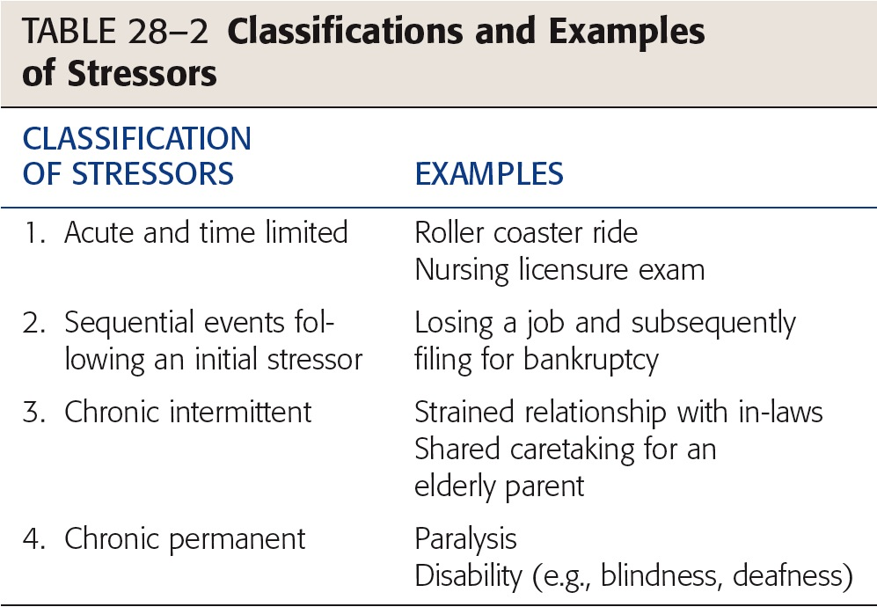

Slide 9
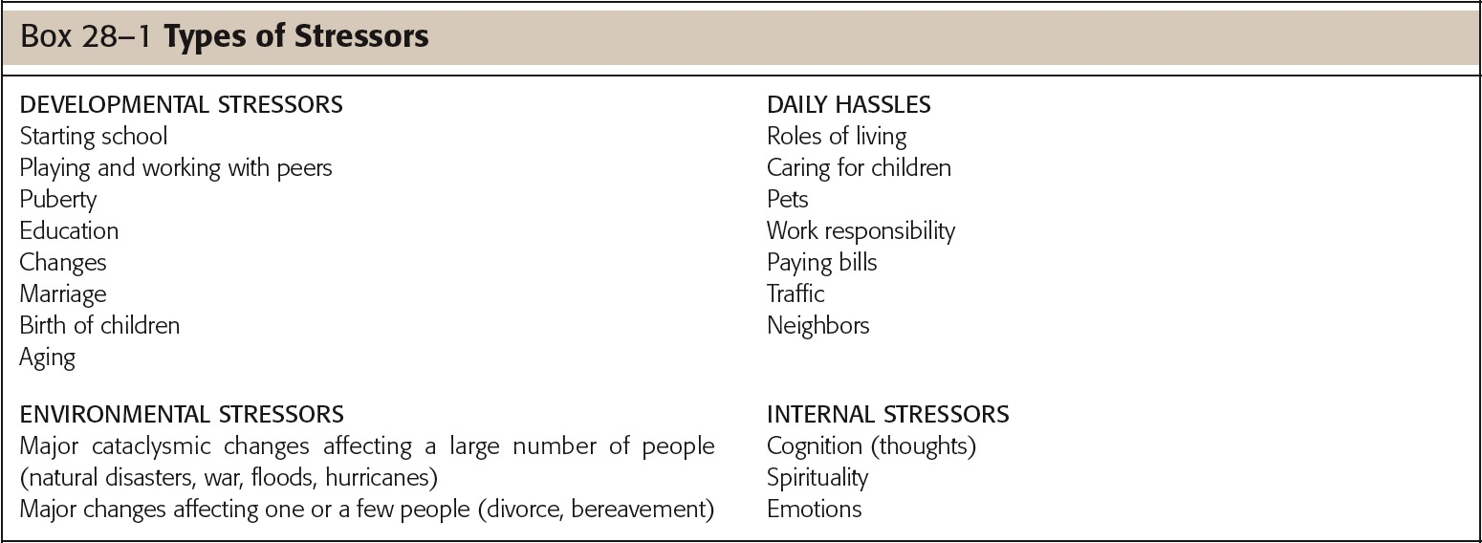

Slide 10
Coping
Problem-focused coping
Emotion-focused coping

Slide 11
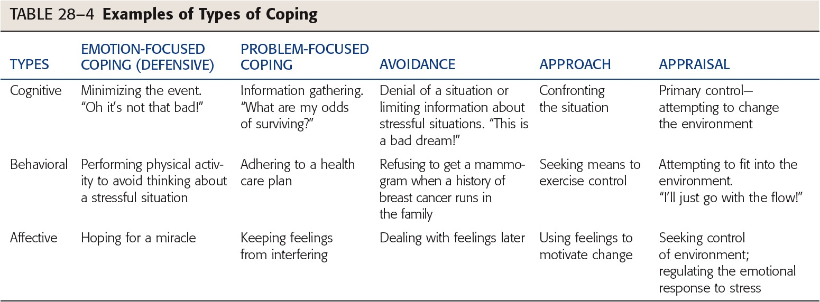

Slide 12
Indicators of Stress
Physiological Indicators
Psychoemotional Indicators
Anxiety
Fear
Anger
Depression
Cognitive Indicators
Problem solving
Structuring
Self-control
Suppression
Fantasy

Slide 13
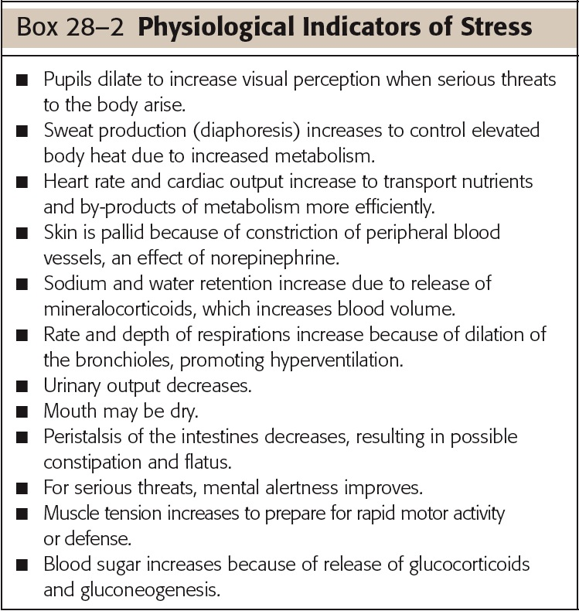

Slide 14
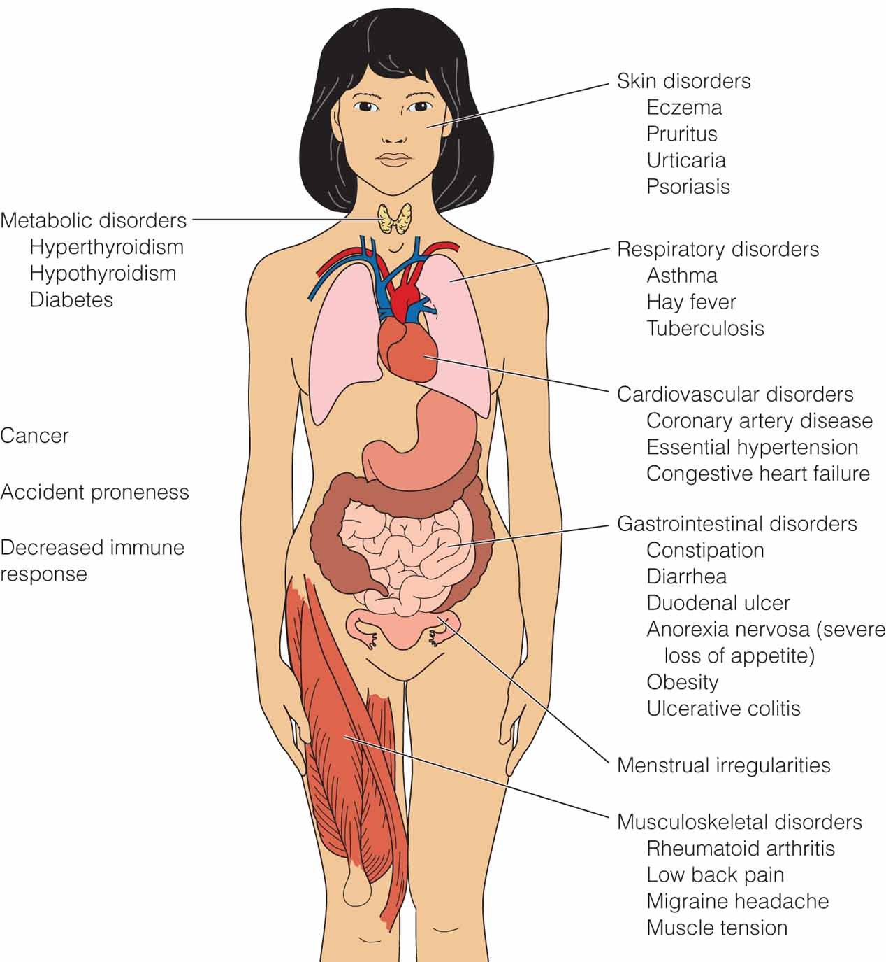
MULTISYSTEM EFFECTS OF Stress

Slide 15
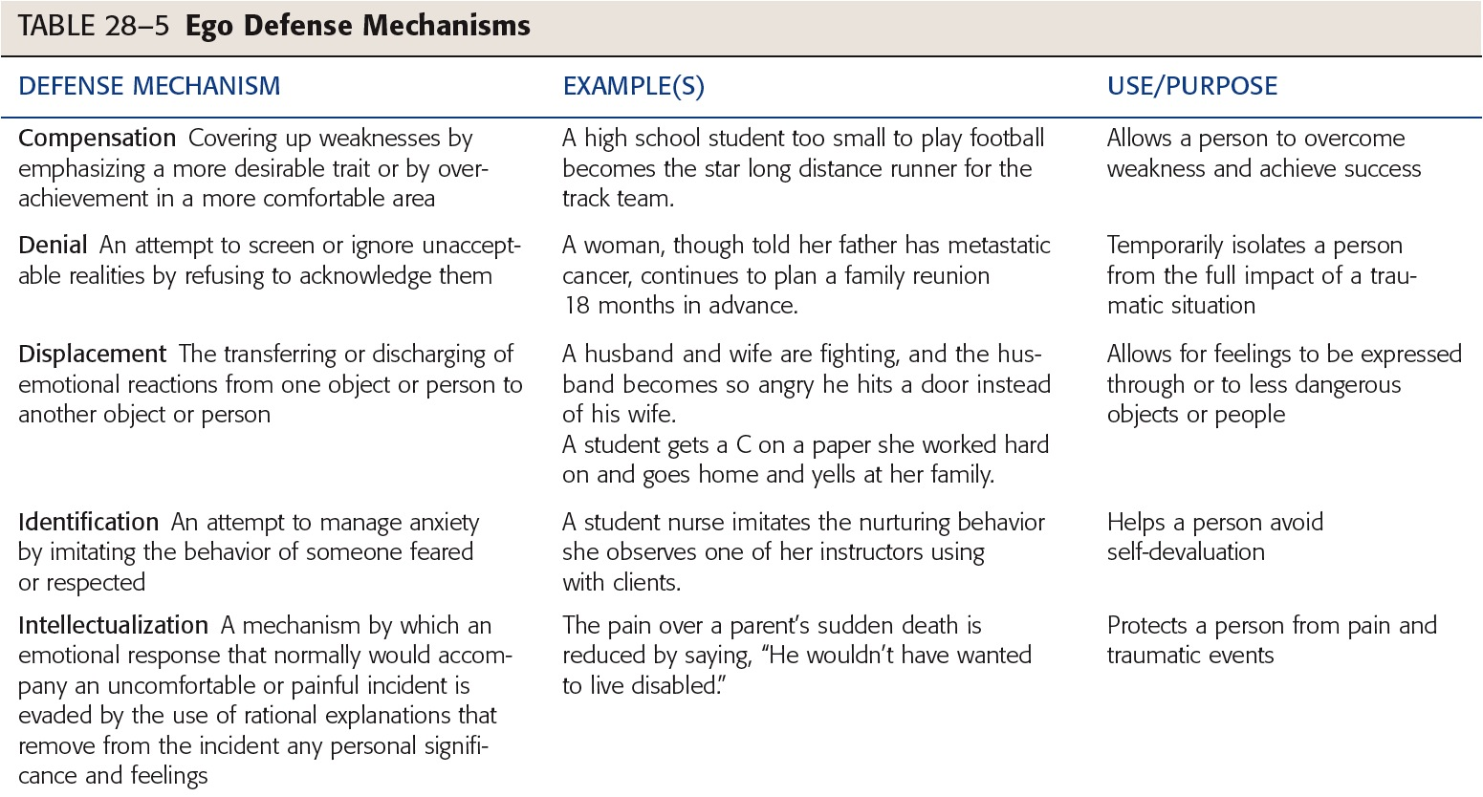
Ego Defense Mechanisms

Slide 16
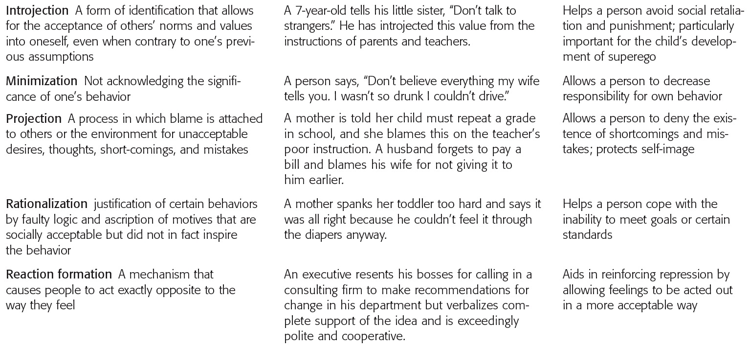
TABLE 28-5 (continued) Ego Defense Mechanisms

Slide 17
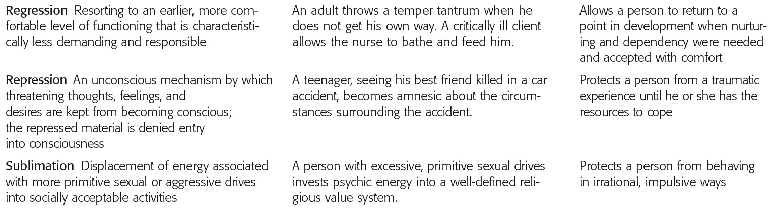
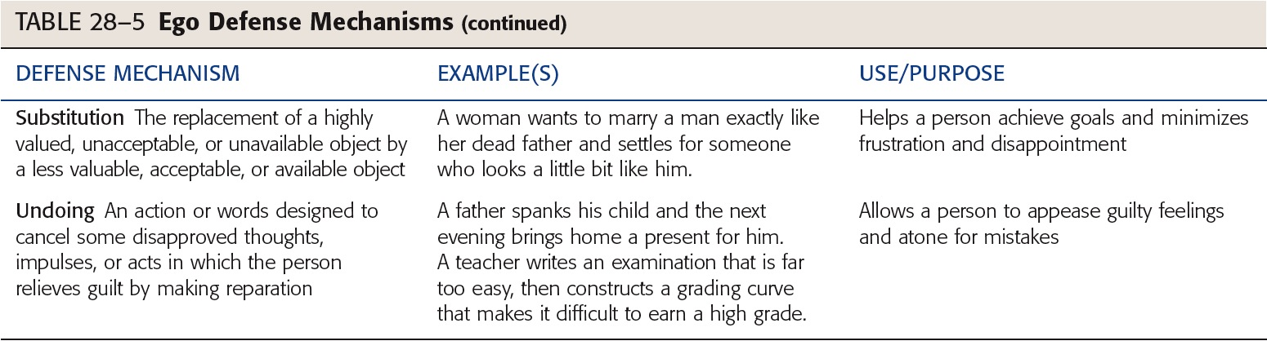
TABLE 28-5 (continued) Ego Defense Mechanisms

Slide 18
Alterations from Normal Coping Responses Assessment:
Nursing History and Assessment Interview
Physical Exam and Observation

Slide 19
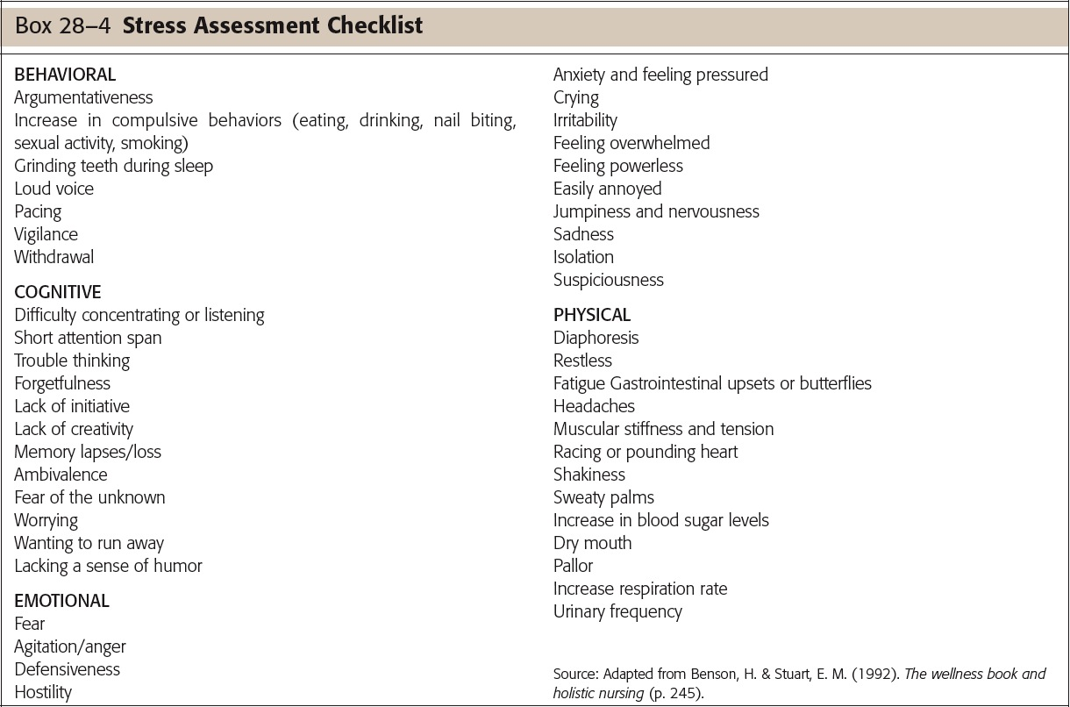

Slide 20
Exemplar: Anxiety Disorders
Anxiety is a stress response
Feelings of mental uneasiness, apprehension
Feeling of helplessness
Feelings accompanied by physical reactions
Elevated pulse
Elevated respirations
Elevated blood pressure
Can be experienced internally or externally
Notes:
20

Slide 21

Exemplar: Anxiety
Overview
Pathophysiology and Etiology
Anxiety Theories
Risk Factors (Children, Older Adults)
Clinical Manifestations
Generalized Anxiety Disorder
Separation Anxiety Disorder
Panic Disorder
Acute Stress Disorder

Slide 22
Pathophysiology and Etiology
Affects individuals of all ages
Can be predominant disturbance
Can be as defense mechanism
Free-floating anxiety
Anxiety disorders
Generalized anxiety disorder
Separation anxiety
Panic disorder
Notes:
22

Slide 23
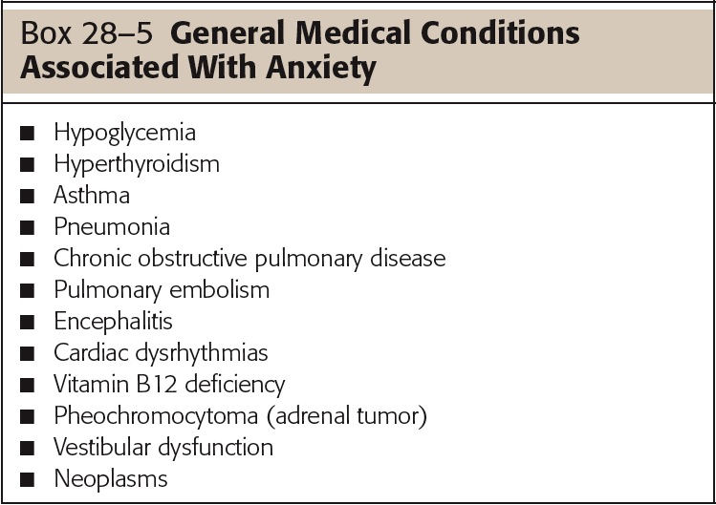

Slide 24
Anxiety Theories
Vulnerability
Neurobiological theories
Dysregulation of neurotransmitters
Serotonin
Norepinephrine
Gamma-aminobutyric acid (GABA)
Role of brain
Notes:
24

Slide 25
Anxiety Theories, continued
Neurochemical theories
Communication with brain
GABA
Norepinephrine
Neurotransmittors
Ligands
Psychodynamic theories
Anxiety when ego attempts to deal with conflict
Notes:
25

Slide 26
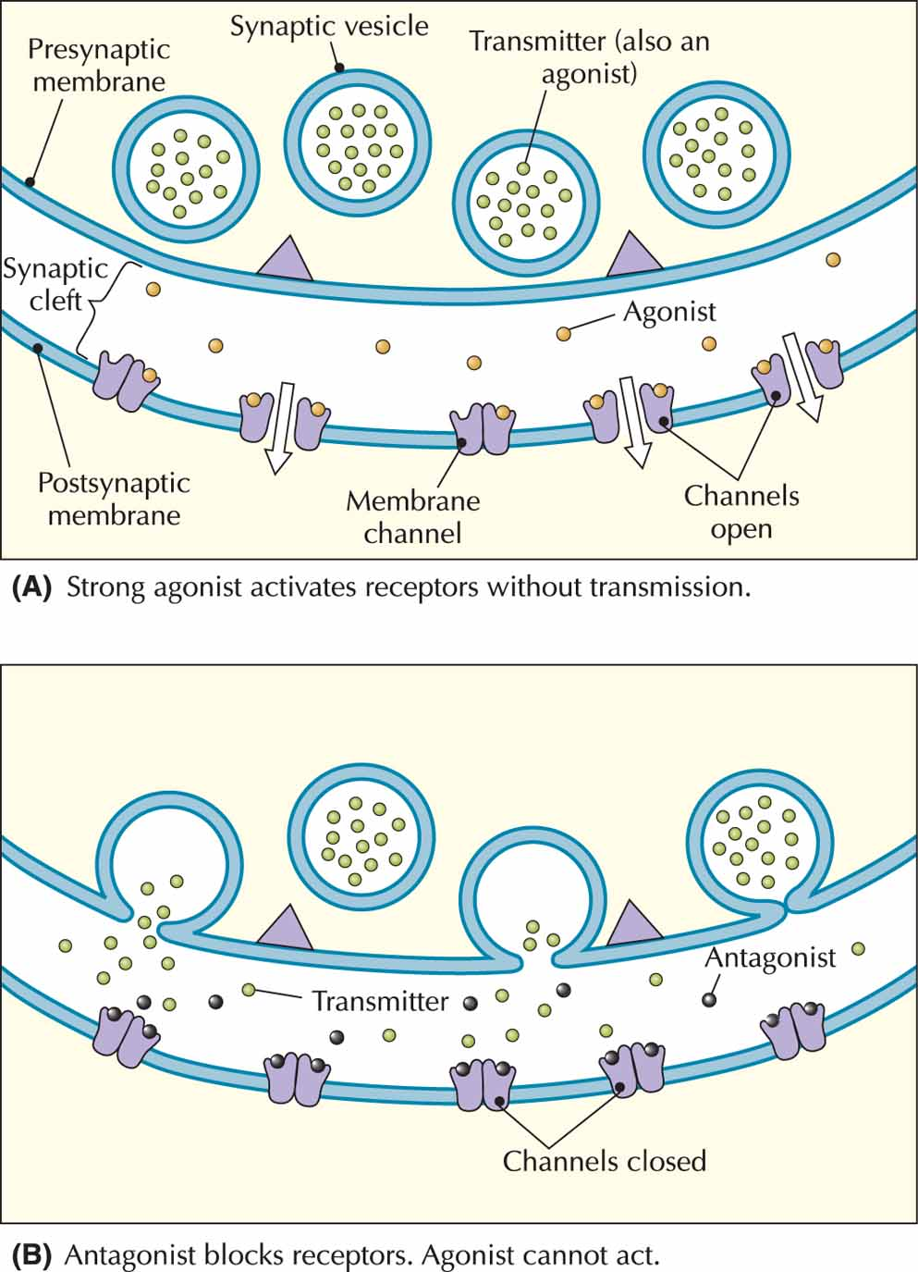
Figure 28-6 Ligands: Agonists and antagonists. Agonists and antagonists bind to the same binding site as transmitters. An agonist has potency, so it activates the cell biologically A, while antagonists bind and have no potency B, An antagonist produces its effect by blocking the binding site, preventing a transmitter from binding, and producing its biological effect. Source: Smock, T. K. (1999). Psysiological psychology: A Neuroscience approach. Upper Saddle River, NJ: Prentice Hall. Used with permission.

Slide 27
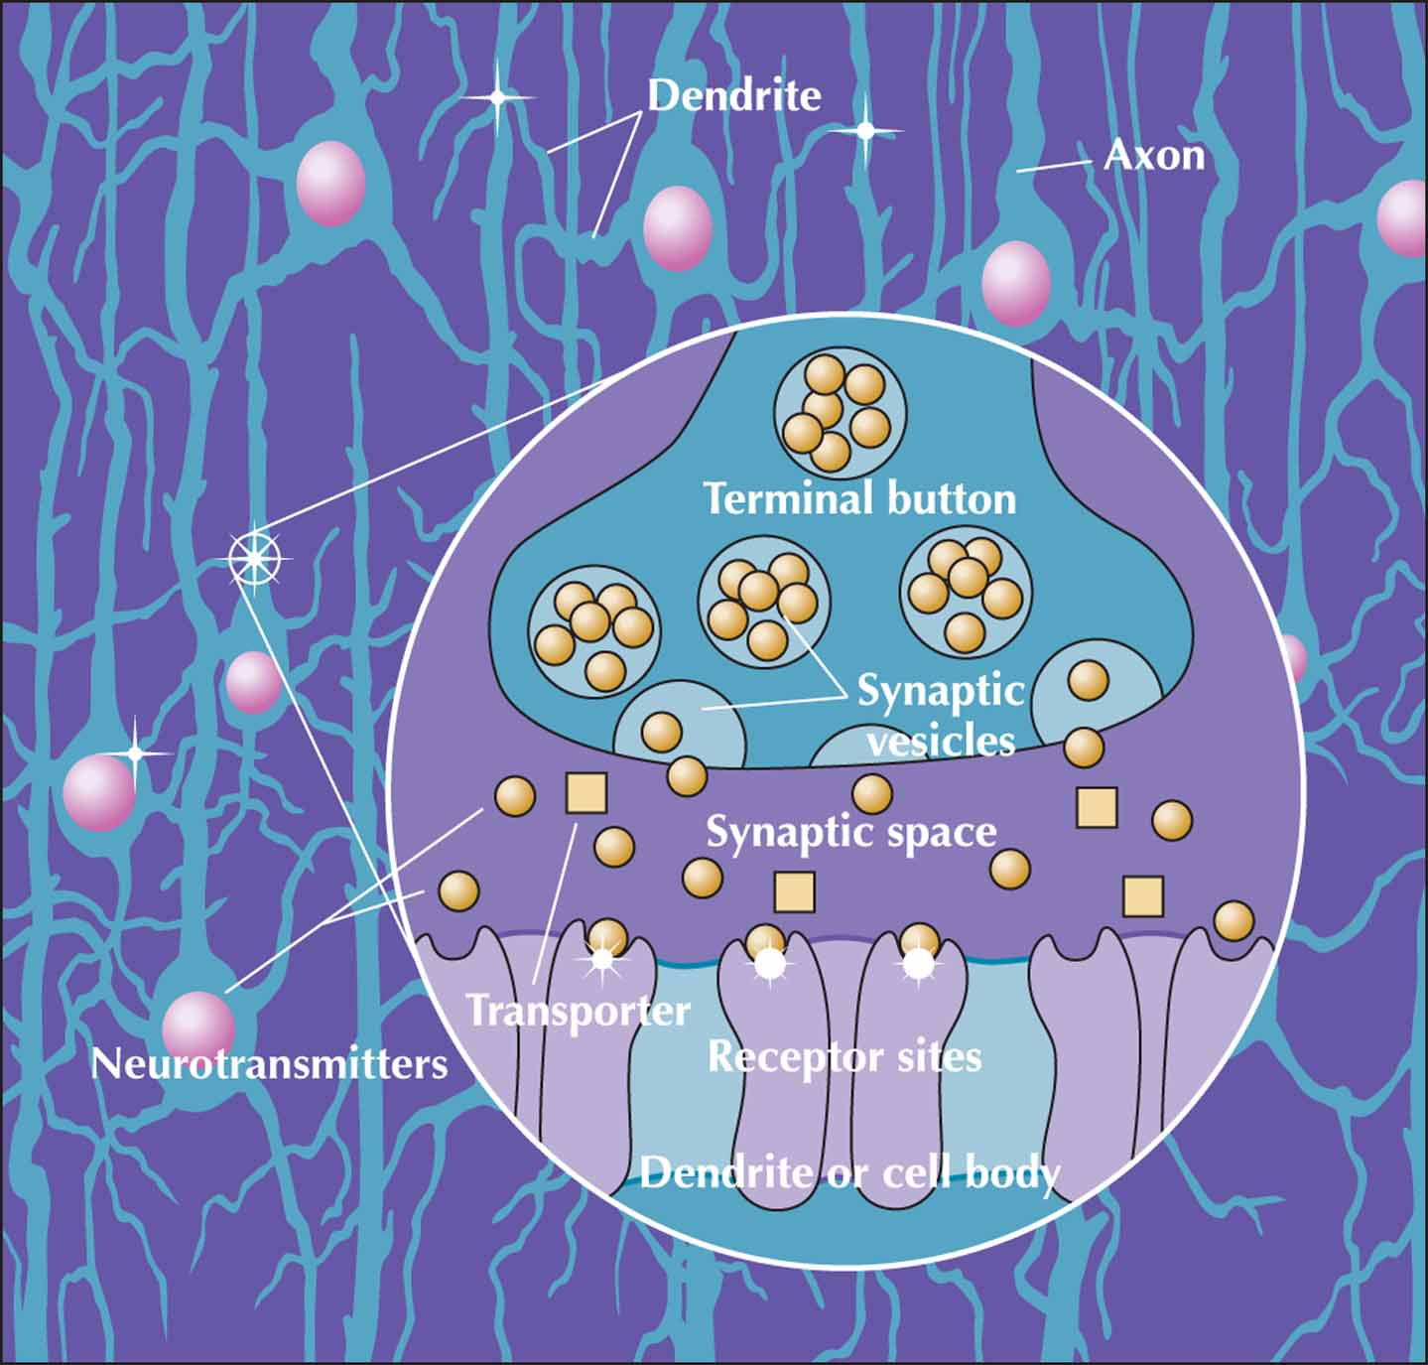
Figure 28-5 Neurotransmission: How neurons communicate. Source: Morris, C. G. & Maisto, A. A. (2001). Understanding psychology (3rd ed.). Upper Saddle River, NJ: Prentice Hall. Used with permission.

Slide 28
Anxiety Theories, continued
Cognitive-behavioral theories
Anxiety related to faulty thinking, dysfunctional response
Developmental theories
Attachment theory
Anxiety begins with separation from caregiver
Transactional models
All internal, external environments are integral, dynamic, interactive
Notes:
28

Slide 29
Etiology
Generalized anxiety disorder (GAD) a priority
10–15% of population affected
Children, older adults more vulnerable to physical reactions to stress
Notes:
29

Slide 30

Risk Factors
Childhood adversity
Family incidence
Social factors
Serious or chronic illness
Multiple stressors
Children
Older adults
Culture
Notes:
30

Slide 31
Clinical Manifestations
Mild
Increase in senses, perception, arousal
Increase in alertness, motivation
Restless, irritable, sleeplessness
Moderate
Narrowing of perceptual field, attention span
Increased restlessness, respirations, sweating
Feeling of discomfort, irritability with others
Notes:
31

Slide 32

Clinical Manifestations, continued
Severe
Perceptual field greatly reduced
Difficulty following directions
Feelings of dread, horror
Need to relieve anxiety
Headache, dizziness
Nausea, trembling, insomnia
Palpitations, tachycardia, hyperventilation
Notes:
32

Slide 33

Clinical Manifestations, continued
Panic
Inability to focus
Perception distorted
Terror, feelings of doom
Bizarre behavior
Dilated pupils, diaphoresis
Trembling, sleeplessness, palpitations, pallor
Immobility or hyperactivity
Incoherence or muscular incoordination
Notes:
33

Slide 34
Clinical Manifestations, continued
GAD
Pervasive apprehension and worry
Diagnostic criteria
Children and GAD
Restlessness
Excessive fatigue
Poor concentration
Irritability
Notes:
34

Slide 35
Clinical Manifestations, continued
Separation anxiety disorder
Most common type manifested by children
Extreme state of uneasiness with unfamiliar
Refusal to visit friends’ houses, attend school
For at least 2 weeks
Diagnosis made by mental health specialist
Notes:
35

Slide 36
Clinical Manifestations
Panic disorder
Recurrent attacks of severe anxiety
Lasting a few moments to an hour
Typically not associated with stimulus
Occur suddenly and spontaneously
Nocturnal panic disorder
Children and panic disorder
History of separation anxiety disorder
History of parental panic attacks
Rating scale for levels of severity
Notes:
36

Slide 37
Clinical Manifestations, continued
Acute stress disorder
After experiencing, witnessing extreme stressor
Feeling of numbness, emotionally unresponsive
Begins with a month of traumatic stress
Lasts at least 2 days
Goes away within 4 weeks
If lasts longer than 4 weeks → PTSD
Notes:
37

Slide 38
Collaboration
Treatment likely to occur in home, community
Includes individual and his/her family
Diagnostic tests
Based on observation and history
Developmental considerations
Anxiety in older adults
Notes:
38

Slide 39

Pharmacologic Therapies
Antianxiety medication used sparingly
Benzodiazepines effective
Periods of 4–8 weeks
SSRIs medications of choice
Some antipsychotics may trigger anxiety
Notes:
39

Slide 40
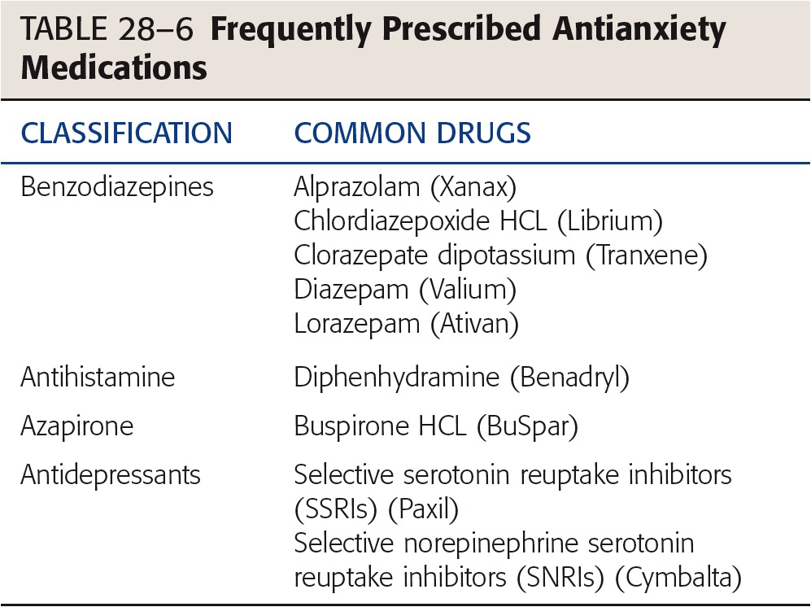

Slide 41
Cognitive and Behavioral Therapy
Teach client → internal locus of control
Develop goal-oriented contracts
Help clients test reality
Children and group therapy
Coping tool kit
Notes:
41

Slide 42
Complementary and Alternative Therapies
Herbs
Massage and touch therapy
Yoga and meditation
Acupuncture
Notes:
42

Slide 43
Nursing Process: Assessment
Health history
Physical
Notes:
43

Slide 44
Nursing Diagnoses
Anxiety
Defensive Coping
Disabled Family Coping
Fear
Ineffective Coping
Ineffective Denial
Notes:
44

Slide 45
Plan
Client will
Report a decrease in level and frequency of anxiety
Articulate successful coping mechanisms
Report increasing use of successful coping mechanisms
Participate in psychotherapy
Notes:
45

Slide 46
Implementation
Mild anxiety
Focus on appraisal
Evaluate thoughts that may increase anxiety
Moderate anxiety
Cognitive reframing
Severe anxiety/panic
Immediate intervention
Isolate client to avoid distressing others
Notes:
46

Slide 47
Implementation
Severe anxiety/panic, continued
Provide safe, quiet environment
Do not leave unattended
Encourage health promotion strategies
Exercise
Nutrition
Sleep
Time management
Notes:
47

Slide 48
Evaluation
Client anxiety diminished
Client demonstrates new or improved coping mechanisms
Client self-moderates anxiety
Notes:
48

Slide 49

Exemplar: Obsessive Compulsive Disorder (OCD)
OCD
Disabling anxiety disorder
Obsessive thoughts
Compulsive repetitive behaviors
Dominate one’s life
Obsession
Compulsion
Must lose > 1 hour/day for diagnosis
Notes:
49

Slide 50
Pathophysiology and Etiology
Genetic linkage strongly supported
Dysregulation of serotonin
Streptococcal infection may be a cause
2.2 million Americans have OCD
Risk factors
Family history
Major life stressor
Developmental considerations
Notes:
50

Slide 51

Clinical Manifestations
OCD not obsessive-compulsive personality disorder
Most frequently reported obsessions
Repeated thoughts about contamination
Repeated doubts with fear
Having hurt someone
Leaving door unlocked
Need to have things in certain order
Notes:
51

Slide 52


Clinical Manifestations, continued
Most frequently reported compulsions
Hand washing
Order, checking, locking
Mental activity such as praying, counting
Requesting or demanding assurances
Ritualistic behavior
Hoarding compulsions
Notes:
52

Slide 53
Clinical Manifestations, continued
Importance of early intervention
⅓ of OCD clients are treatment resistant
Social isolation and OCD
Hoarders particularly affected
Notes:
53

Slide 54
Collaboration
Coordinate care
Diagnostic tests
No definitive laboratory findings
Therapeutic management
Pharmacological most common
CBT effective
Complementary and alternative therapies
Yoga
Notes:
54

Slide 55
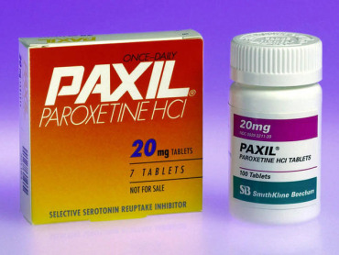
Collaboration
Pharmacologic therapies
First line: SSRIs
Clomipramine (Anafranil also effective)
Continued for 1–2 years
Gradually taper while observing
Notes:
55

Slide 56
Nursing Process: Assessment
Thorough physical assessment
Assessment interview
Notes:
56

Slide 57
Nursing Diagnoses
Anxiety
Fear
Ineffective Coping
Stress Overload
Disturbed Sleep Pattern
Insomnia
Fatigue
Deficient Knowledge
Risk for Caregiver Role Strain
Notes:
57

Slide 58
Plan
Assist client in identifying triggers
Promote quiet, restful environment
Encourage client to identify strengths
Reassure client
Continued behaviors not indication of failure
Notes:
58

Slide 59
Implementation
Supportive, nonjudgmental demeanor
Adaptive coping
Interrupting ritual can cause more anxiety
Work with client to work ritual into hospital routine
Notes:
59

Slide 60
Evaluation
Client reports reduction in performance of ritualistic compulsive behaviors
Client demonstrates adequate coping skills to control anxiety
Notes:
60

Slide 61
Health Care
Advocacy
National Alliance for the Mentally Ill (NAMI) reports that ⅓ of homeless suffers from mental illness
Ethical nursing practice → expertise in accessing data, resources
Notes:
61

Slide 62
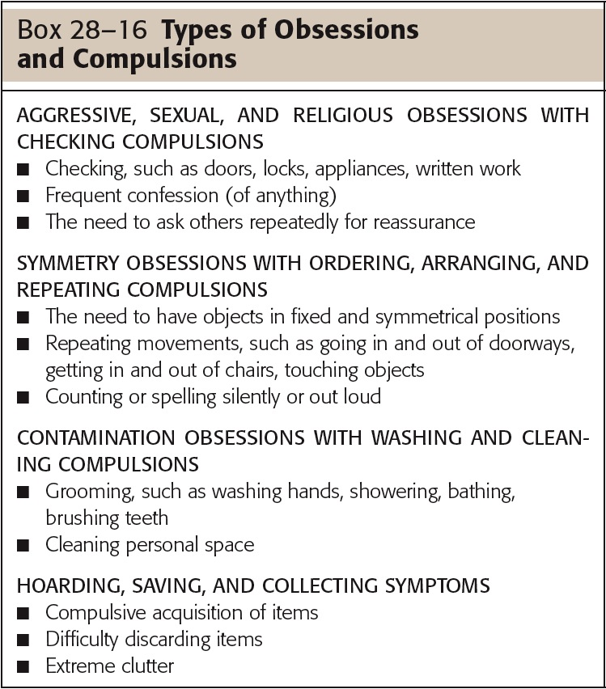

Slide 63
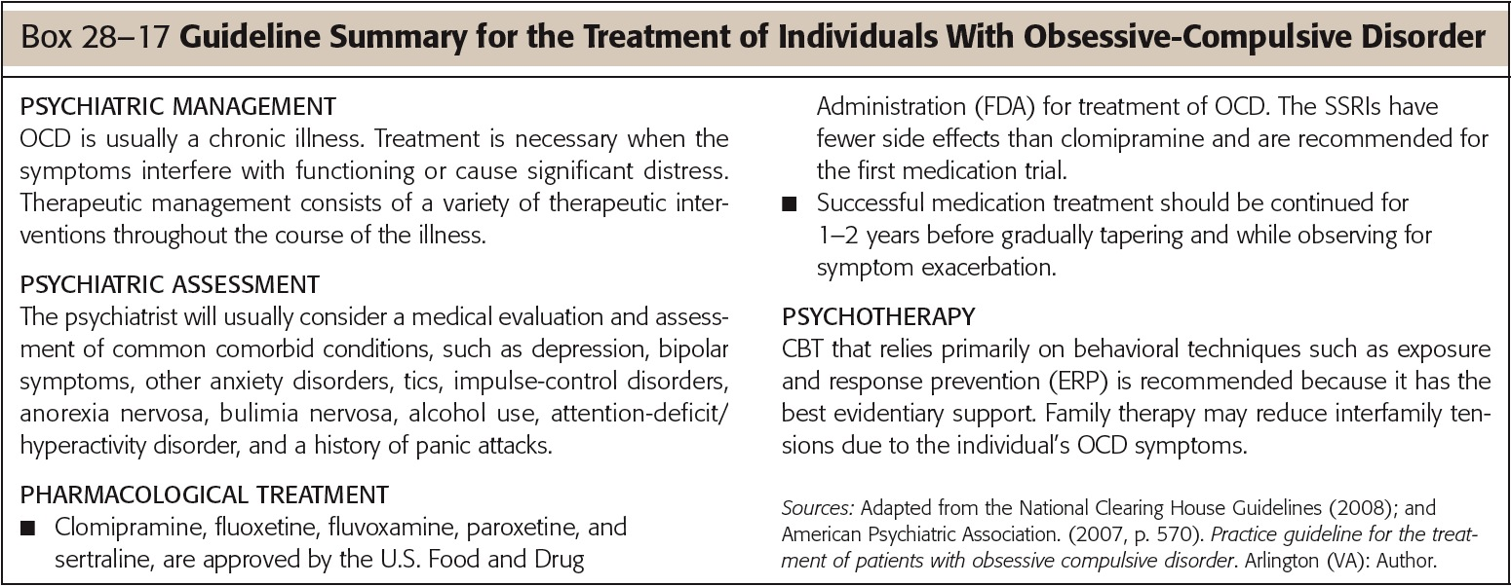

Slide 64
Exemplar: Phobias
Overview
Pathophysiology
Etiology
Risk Factors
Clinical Manifestations
Agoraphobia
Social Phobia
Specific Phobias
Collaboration
Pharmacologic Therapy
Cognitive-Behavioral Therapy
Journal Writing

Slide 65
Exemplar: Phobias
Intense, persistent, irrational fear of simple thing or social situation
Experience severe panic with contact
Displacement
Pathophysiology and etiology
Dysregulation of
Norepinephrine
Serotonin (5-HT)
GABA
Notes:
65

Slide 66
Phobias
Etiology
Twice as common in women
Onset usually in childhood, adolescence
Risk factors
Age between 11–15
Gender
Family
External locus of control
Notes:
66

Slide 67
Predisposing Factors for Phobias
Traumatic events
Unexpected panic attacks in feared situation
Observing other in feared situation
Seeing others demonstrate fear in situation
Informational transmission
Notes:
67

Slide 68
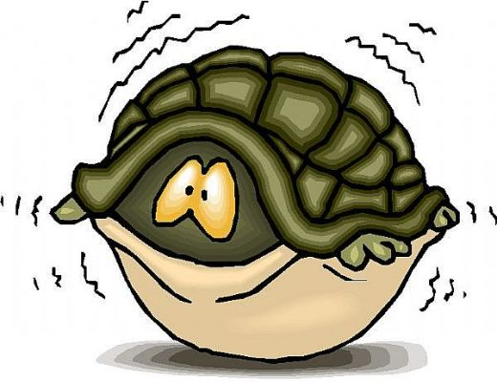
Clinical Manifestations
Three general categories
Agoraphobia
Social phobias
Specific phobias
Notes:
68

Slide 69

Agoraphobia
Anxiety about being in places/situations where escape may be difficult, embarrassing
Typically involve situations that involve being
Alone
Away from home
In a crowd
Commonly associated with panic disorder
Notes:
69

Slide 70
Social Phobia
Also called social anxiety disorder
Marked, persistent fear of social, performance situations
Diagnosed only if anxiety/fear significantly interferes with daily life
Physical symptoms may occur
Notes:
70

Slide 71
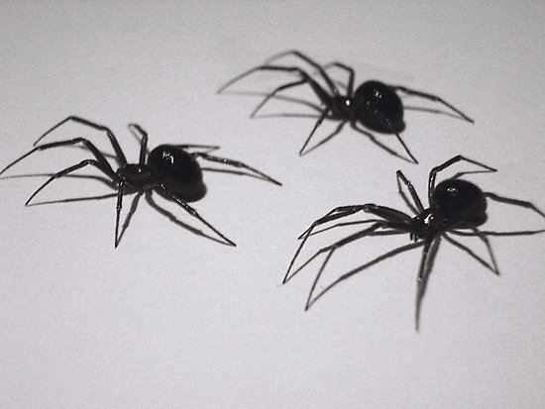

Specific Phobias
Excessive fear of a specific object or situation
Acrophobia
Algophobia
Androphobia
Arachnophobia
Claustrophobia
Developmental considerations
Notes:
71

Slide 72
Collaboration
Multidisciplinary
Pharmacologic therapies
Benzodiazepines
Short-term use only
SSRIs
Some antipsychotics
More effective with CBT
Notes:
72

Slide 73
Collaboration, continued
Cognitive Behavioral Therapy
Systematic desensitization
Reciprocal inhibition
Cognitive restructuring
Journal writing
Notes:
73

Slide 74
Nursing Process: Assessment
Health history
Attempt client has made to moderate anxiety
Explore possibility of comorbidity
Depression
Substance abuse
Assessment interview
Physical examination
Include assess for substance abuse
Notes:
74

Slide 75
Nursing Diagnoses
Anxiety
Fear
Ineffective Health Maintenance
Deficient Knowledge
Ineffective Coping
Notes:
75

Slide 76
Plan
Client will
Report decrease in frequency and severity of phobic episodes
Verbalize healthy ways to respond to fear
Demonstrate relaxation techniques
Participate in the therapeutic regimen
Notes:
76

Slide 77
Implementation
Panic phobias, severe anxiety
Must be treated immediately
Ensure safety
Validate concerns and fears
One-to-one supervision
Provides assurance to client there is no danger
Antianxiety medications as prescribed
Notes:
77

Slide 78
Implementation, continued
Assist client to rethink/reframe
Assist client to reappraise level of threat
Teach client relaxation techniques
Assist client to gain insight into reactions
Notes:
78

Slide 79
Evaluation
Based on
Client’s desire to overcome phobia
Client’s willingness to follow treatment regimen
Notes:
79

Slide 80
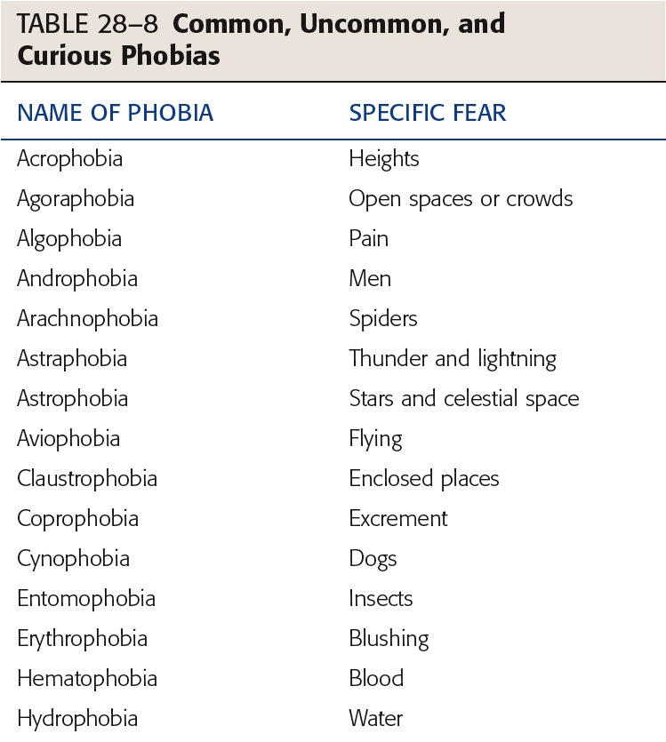

Slide 81
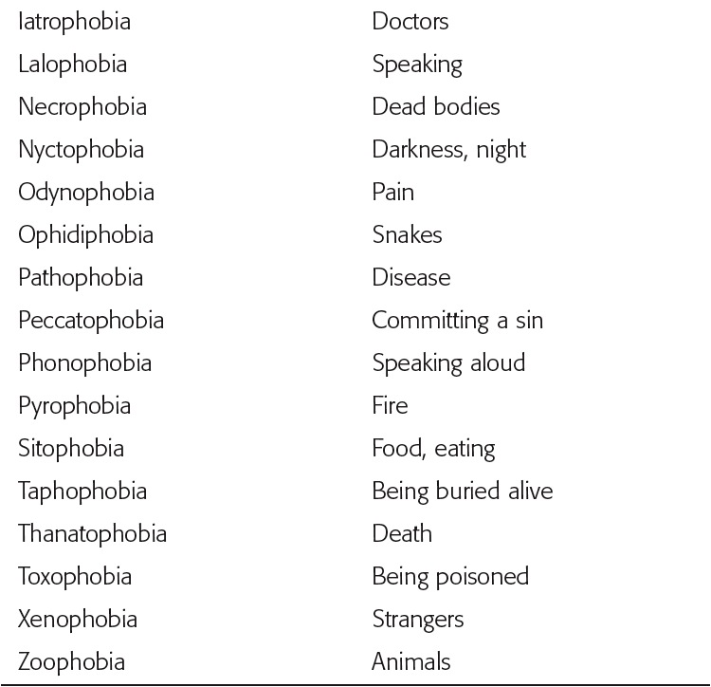
TABLE 28-8 (continued) Common, Uncommon, and Curious Phobias

Slide 82
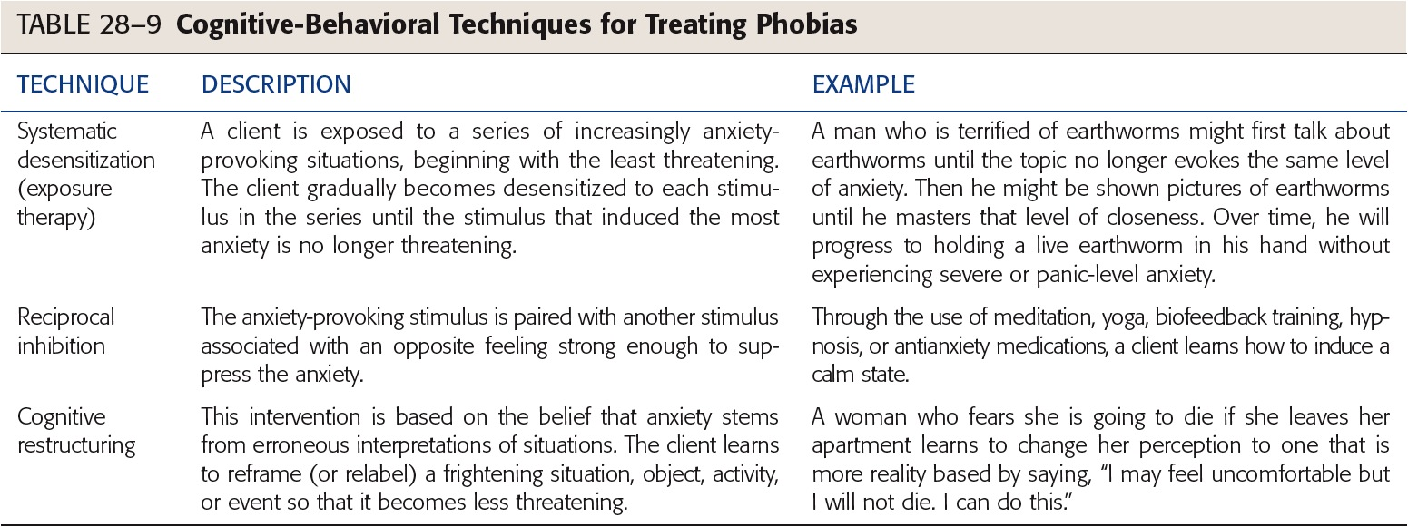

Slide 83
Exemplar: Post-Traumatic Stress Disorder
PTSD is anxiety disorder
Evolves after exposure to traumatic event
One’s physical health endangered
Pathophysiology and etiology
More likely to occur, longer lasting when stressor is intentional human action
Flashbacks
Often triggered by daily events
Diagnosed PTSD if symptoms longer than 1 month
Notes:
83

Slide 84

Figure 28-12 Many people who survived the World Trade Center Attack on 9-11-01 are now experiencing PTSD. Source: AP Wide World Photos.

Slide 85
PTSD
Diagnostic criteria
Cultural considerations
Etiology
Can occur at any time or age
Approximately half experience resolution
Notes:
85

Slide 86
Risk Factors for PTSD
Severity of event itself
Little or no social or psychological support
Additional stressors immediately following
Presence of preexisting mental illness
Notes:
86

Slide 87
Clinical Manifestations
May lose touch with reality
During flashback
Depersonalization
Depression may occur
Hyperarousal when reexperiencing trauma
Notes:
87

Slide 88
Categories
Acute
Symptoms last less than 3 months
Chronic
Symptoms last 3 months or more
Delayed onset
At least 6 months elapse between trauma and symptoms
Notes:
88

Slide 89
Clinical Manifestations in Children
Children 8+ exhibit symptoms similar to adults
Diagnosis difficult under age 8
Two strongest risk factors for children
Incidence of multiple traumas
Direct exposure to traumatic event or events
Mother’s response
Likely to modify child’s response
Notes:
89

Slide 90
Clinical Manifestations
Persistent frightening thoughts, memories
Emotional numbing
Sleep disorders
Hypervigilance, exaggerated startle response
Trouble with affection
Irritability, aggressiveness, violence
Avoidance of trauma-related situations
Drug and alcohol abuse
Depression
Suicidal thoughts or violence
Notes:
90

Slide 91
Collaboration
Holistic approach
Pharmacologic therapies
Used as adjunct to psychological treatment
Desire for immediate total relief
May foster chemical abuse, dependency
Benzodiazepines, neuroleptics
Tricyclic antidepressants, SSRIs, lithium
Beta blockers, alpha antagonists
Notes:
91

Slide 92
Collaboration
Eye movement desensitization and reprocessing (EMDR)
Psychotherapy
Elements of several therapy modalities
Dual stimulation
Acupuncture
Regularly for 3 months or more
Adjunctive therapy
Notes:
92

Slide 93
Nursing Process: Assessment
Client in hyperousal state may exhibit
Unpredictable, aggressive, bizarre behavior
Impact on family
Risk factors
Physical
Psychological
Social
Assessment interview
Notes:
93

Slide 94
Nursing Diagnoses
Post-Trauma Syndrome
Anxiety
Fear
Ineffective Coping
Compromised Family Coping
Disturbed Sleep Patterns
Risk for Self-Directed Violence
Risk for Other-Directed Violence
Notes:
94

Slide 95
Plan
Reduce high levels of anxiety
Improve quality of life
Verbalize feeling less anxious
Develop effective coping behaviors
Utilize support system when anxious
Describe a state of spiritual well-being
Notes:
95

Slide 96
Implementation
Mild symptoms present for 4 weeks or less
Ensure/confirm client’s safety, shelter
Note information to follow up in a month
Symptoms present within first 3 months
Refer client for psychological therapy
CBT or EMDR
Therapy should focus directly on trauma
Notes:
96

Slide 97
Implementation, continued
Symptoms present for 3–4 months
Refer for CBT, Body Centered Therapy
Help client understand best results will be
Weekly therapy
With same experienced therapist
Pharmacologic therapy if client
Nonresponsive to trauma-focused therapy
Refuses therapy
Likely to re-experience trauma
Notes:
97

Slide 98
Evaluation
Client utilizes self-calming techniques
Client experiences fewer cognitive distortions and decreased ruminations or obsessions
Client will decrease time spent ruminating over worries
Notes:
98

Slide 99
Health Care
Nurse ethically responsible to be knowledgeable about community resources
Notes:
99

