Slide 1
Developing Effective Study Habits
Donna M. Penn RN, MSN, CNE

Slide 2
Create an appropriate study environment
Limit noise
Plenty of light
Tidy surface
Comfortable furniture
No distractions
Studying is a skill you must master

Slide 3
Discover your learning style preference
Visual
Auditory
Verbal
Physical (Hands on)
Logical
Social
Solitary

Slide 4
Find out your preferred learning style
http://www.personal.psu.edu/bxb11/LSI/LSI.htm
http://www.edutopia.org/multiple-intelligences-learning-styles-quiz
http://www.odessa.edu/dept/govt/dille/brian/courses/1100orientation/learningstyleinventory_survey.pdf

Slide 5
How to improve as a visual learner
Visualize what you are studying
Use color in your notes
Draw pictures and diagrams
Use mind maps in your notes
Learn from videos
Use pictures to reinforce learning

Slide 6
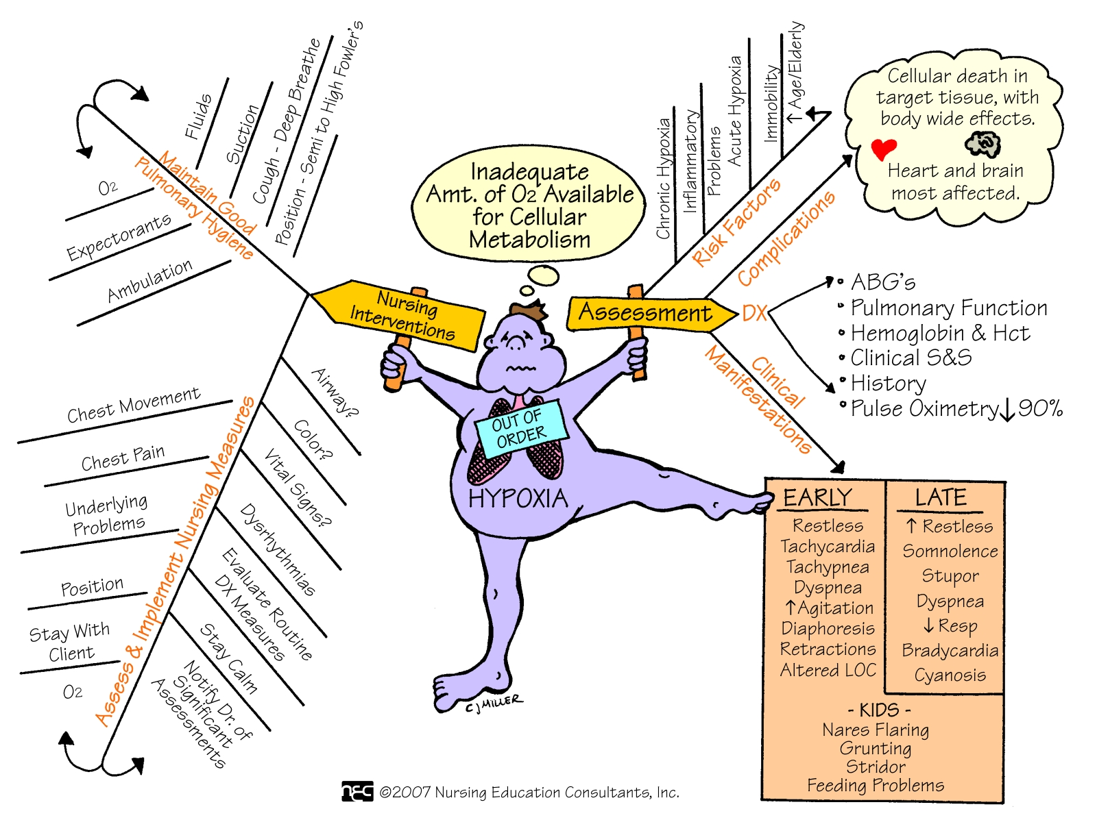

Slide 7
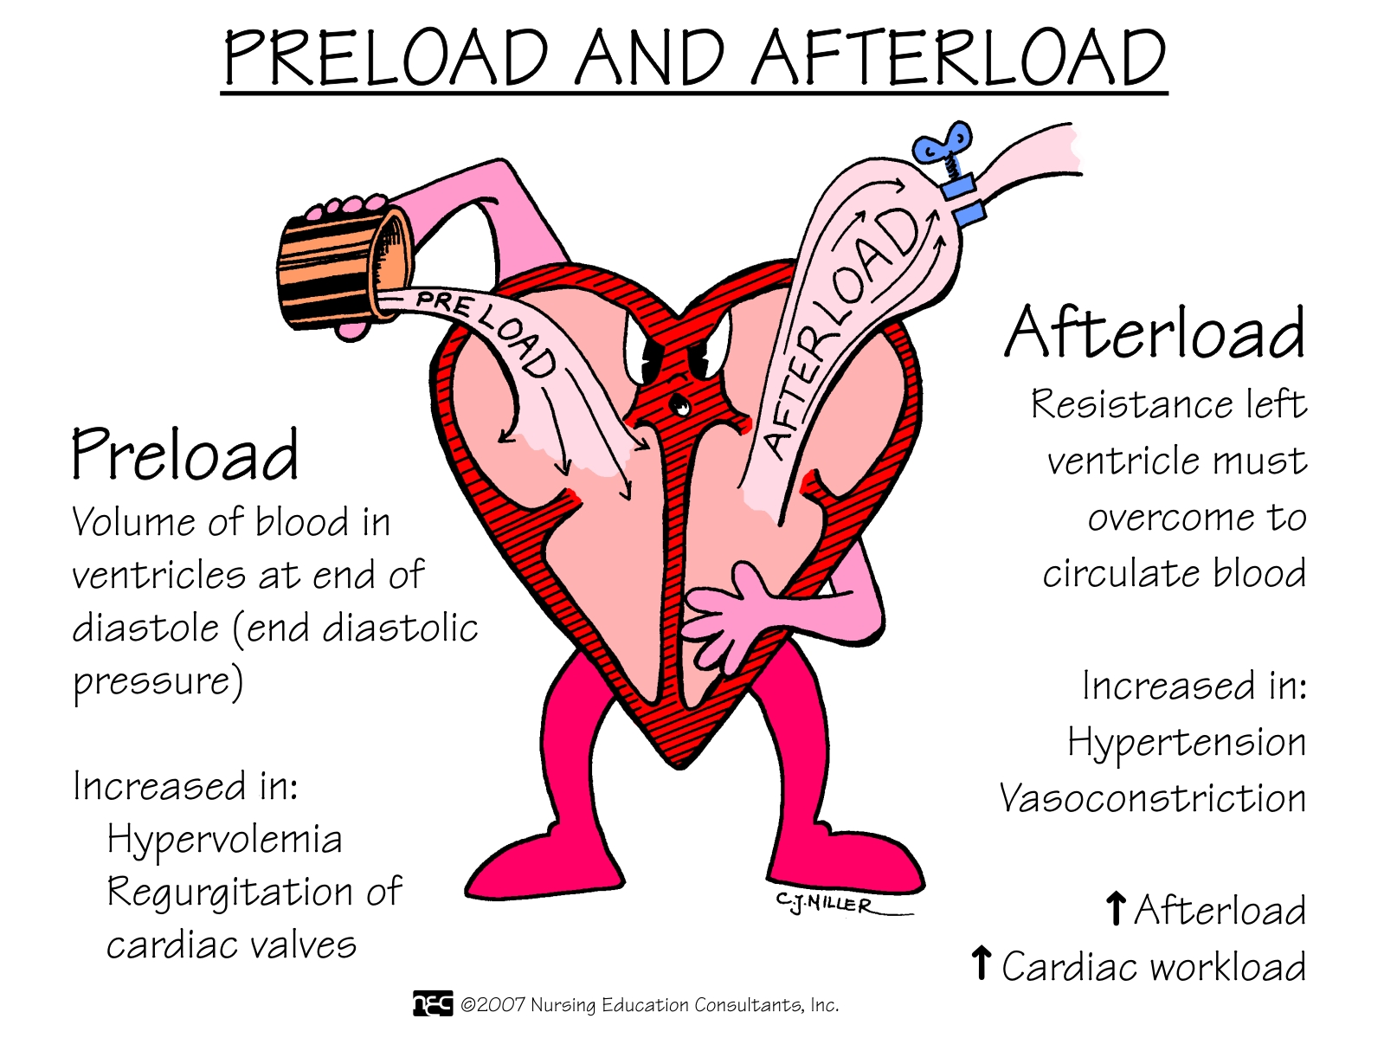

Slide 8
How to improve as an auditory learner
Listen to tapes of recorded content
Audio record your own textbook reading
Read out loud
Talk over content topics with other students
Participate in class discussions

Slide 9
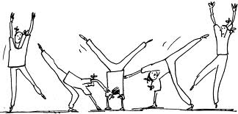
How to improve as a hands on learner
Stand up and move around while you are studying
Take frequent breaks from studying
Make use of your hands and write things down as you study
Use the computer to reinforce learning
Be physically active
Memorize or drill while walking or exercising

Slide 10
Get everything you need before you sit down and study
Textbooks
Notebooks
Pencils/Pens
Computer

Slide 11
Develop a study schedule
Set aside specific study time
How much time should I study?
Daily reviews
Weekly reviews
Pre-exam reviews
Study when you are at your peak
Bonus study time
State your intention/Think about your goals
http://www.howtostudy.com/create-a-study-plan/

Slide 12
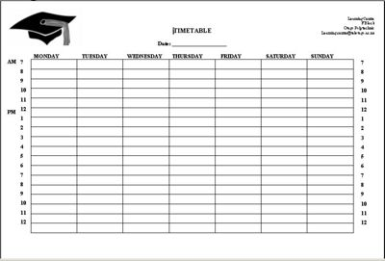

Slide 13
Develop a calm, positive attitude
Be calm & patient with yourself
Focus on positives
Avoid negativity
No one learns everything overnight

Slide 14
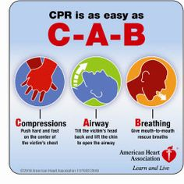
Take good notes
Prepare before lecture
Organize information
Listen carefully
Use pictures and diagrams
Underline key points
Use the 3 A’s (acronyms, acrostics, alphabet)
Re-write notes
http://lsc.cornell.edu/LSC_Resources/cornellsystem.pdf

Slide 16
Take frequent breaks
Give your mind a rest
Go for a walk
Ride your bike

Slide 17
Develop Critical Reading Skills
Nursing textbooks are complex reading
Poor reading skills make understanding difficult
Students needs to learn to read for key information

Slide 18
Form a study group
Working together facilitates problem-solving
Camaraderie replaces competition
Group membership fosters cooperation
Less chance of missing important material
Decreases depression
Increases productivity

Slide 19
Study Group Ground Rules
Understand and accept group purpose
Contribute ideas, information, opinions and feeling
Invite and encourage same from all members
Listen intently
Show group members support and respect

Slide 20
More Ground Rules
Help keep discussion relevant
Periodically help summarize major points
Share examples of personal experiences
Accept constructive criticism as positive - not personal
Avoid smoking, eating, etc.... during the group

Slide 21
How to arrange meetings
Exchange information on each participant:
Name, phone, email
Schedule of classes
Preferences for meeting times
Choose someone who will be responsible for finding a meeting place and contacting the others.

Slide 22
At your first meeting
Determine the rules you will follow so that each person will share in making the group strong.
Include specifics such as coming to the meetings on time, being prepared, and socializing.
Discuss the leadership of your group:
Will one person assume the leadership?
Will your group alternate leaders?

Slide 23
Session Structure
Decide how long sessions will be.
First ½ hr: Review previous week concepts, allow members to voice issues of confusion or concern, problems with material.
Rest of time work on problems, take turns presenting problems
Work on practice questions
Last 10 minutes” quick summary/review
Identify “assignments” for next session

Slide 24
Important points to remember
The study group must find a common place to meet and meet on a regular basis.
The group must work as a team, and all members of the team must participate equally.
For a study group to be most effective it must work together. Each group member must do his or her share
Students who habitually come to the group unprepared or under-prepared should be dropped from the group.

Slide 25
Characteristics of a Successful Study Group
Each member contributes to session
Group members “actively listen” without interrupting.
Group members are prompt and come prepared
Group stays focused and on task
Group members show respect for each other.
Group members feel free to ask questions
Provides emotional support

Slide 26
Characteristics Of A Successful Study Group
Question each other on the material
Take turns “teaching” each other the material
Try and predict test questions
Compare notes
Focus on everyone learning as much as he/she can
Stay positive: WE CAN DO THIS TOGETHER

Slide 27
Take care of yourself
Get enough sleep
Eat right
Stress reduction
Manage time effectively
You cannot be all things to all people and go to nursing school

Slide 28
Time Management=Self Management
How you use your time will reflect directly on how successfully you manage the efforts that will ultimately help you achieve your goal!
Need to learn strategies to increase productivity
Learning how to function in a 24/7 society

Slide 29
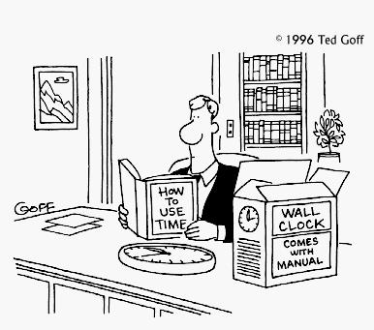
Getting Started…..
Assess inconsistencies between values and behaviors
Keep a personal time/activity journal
Self-assessment of barriers to productivity

Slide 30
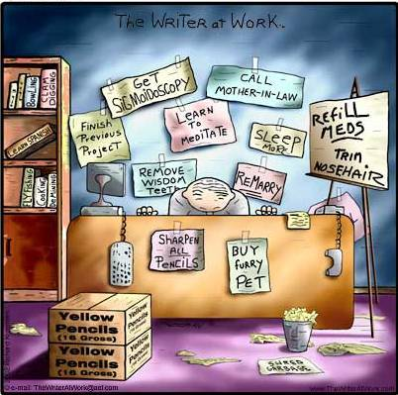
Maximize Your Productivity
Identify Goals
Set Priorities
Get Organized
Develop Self-Discipline

Slide 31
Self-Discipline
Learning how to say “NO”
Avoiding time traps
Motivating Yourself

Slide 32
Achieving a Personal Balance
Do you consider yourself a perfectionist?
Perfectionism can by physically and emotionally debilitating.
No one ever really achieves perfection
Increases stress, becomes self-destructive
It would be better to strive for excellence

Slide 33
Learning to Delegate
Can the person complete the task?
Identify the outcomes of the task.
Identify the resources that are necessary to complete the task.
Relinquish accountability for the task
Good communication necessary

Slide 34
Overcome Procrastination
Way we rationalize our behavior
Just an excuse!!!!
Break the cycle of procrastination
Put your schoolwork in a positive frame of reference
Will help to motivate you more!!

Slide 35
Managing Your Time During A Test
Practice taking a timed exam
Pace yourself, pacing strategies
Take all the time you are given, re-read exam if done
Do not constantly change answers
Avoid distractions
Increase your concentration skills
Manage test anxiety

Slide 36
Managing Study Time
Set goals
Use the course outline
Work to boost memory
Learn what works best for you
Study difficult concepts first
Work in short blocks, take breaks
Study groups
Don’t skip class
Create study strategies
Prioritize
Don’t wait till the last minute
Find your peak study hours

Slide 37
Time can be on your side
Avoid over-commitment
Use a planner/calendar
Account for the unknown
Keep track of your time
Stick to the plan
Weekly schedules/daily study times
Realistic to-do lists
Know important dates

Slide 38
Know your resources
Course outline
Course faculty
Textbooks
Online resources
Learning center
Tutoring services
Internet
Library

Slide 40
Have a Great Semester

