Slide 1
What is Your career area in Entrepreneurship?

Slide 2
What is Entrepreneurship and AC?
Advanced Career aims to prepare students for multiple postsecondary options, including careers right out of high school and multiple postsecondary training options.
Do our students know this?

Slide 3
For what occupations will your
Advanced Career curriculum prepare students?
As a table team, brainstorm as many as you can. Record in your notebook.
Don’t forget occupations requiring no, little, some and/or much postsecondary training.

Slide 4
Job Market Outlook
What is the job market outlook for
our current Advanced Career students?
What are the knowledge and skills they need?
Where can we find out?
Sources:
http://www.mynextmove.org
http://www.bls.gov/oco
http://lwd.dol.state.nj.us/labor/lpa/lbrdmand/LaborDemand_index.html

Slide 5
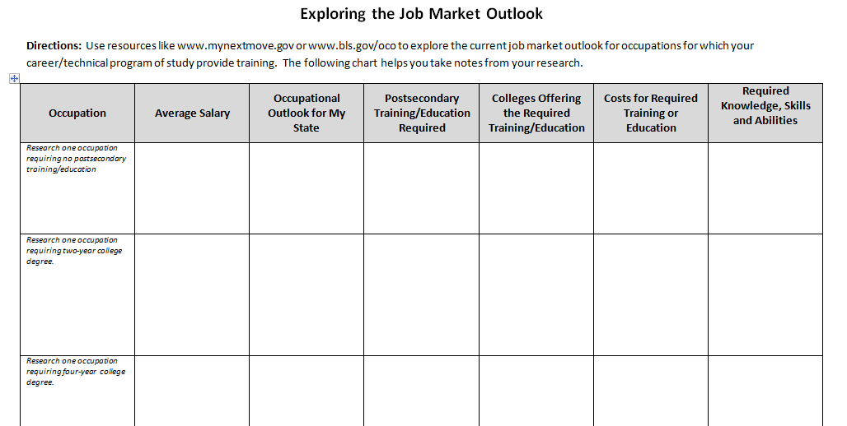
Researching the Job Market
Use Exploring Job Market Outlook to record information about occupations you brainstormed earlier.
Research at least three occupations—one each requiring no postsecondary training, one to two-year postsecondary training and four-year postsecondary training. Be prepared to share what you have learned.

Slide 6
Reflection
What occupation seems to suit your goals and interests? Why?
What training, if any, does this occupation require after high school?
How much will it cost the your and/or the your parents to provide required training after high school?
Is the salary reasonable, and does it make sense to spend the money for further training you may need?

Slide 7
Entrepreneurship Occupations
Forbes
10 Best Careers For Potential Entrepreneurs
Sales managers
Medical and health service managers
Marketing managers
Computer systems managers
Construction managers
Registered nurses
Financial advisors
Public relations specialists
Sales representatives
http://www.forbes.com/sites/meghancasserly/2012/09/25/the-10-best-careers-for-wannabe-entrepreneurs/

Slide 8
Entrepreneurship Industries
Forbes
11 Hottest Industries For Start-Ups
Corporate Wellness Services
Human Resources & Benefits Administration
Scientific & Economic Consulting
Relaxation Beverages
Street Vendors
Ethnic Supermarkets
Wineries
Social Network Game Development
Internet Publishing & Broadcasting
Online Survey Software
E-Commerce & Online Auctions
http://www.forbes.com/sites/meghancasserly/2012/02/06/11-hottest-industries-for-start-ups-foodtrucks-wineries-booze/

